Slide 2
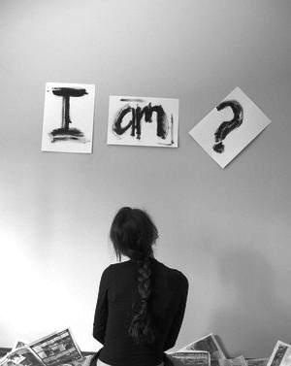
Accurately Seeing Ourselves

Slide 3
5 …rejoicing to see your good discipline and the stability of your faith in Christ.
6 Therefore as you have received Christ Jesus the Lord, so walk in Him,
7 having been firmly rooted and now being built up in Him and established in your faith, just as you were instructed, and overflowing with gratitude.
That No One May Delude You With Persuasive Argument (4)
(1:23)

Slide 4
“And I give eternal life to them…
and no one shall snatch them out of My hand.”
not the voices of various media,
peers
who do not speak consistently with truth
“My sheep hear My voice, and I know them, and they follow Me.”
John 10:27
, 28

Slide 5

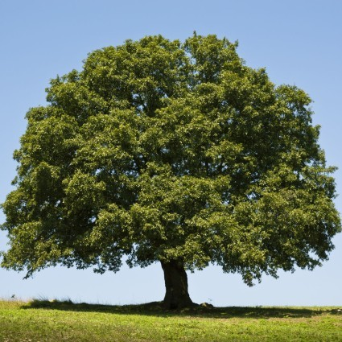
Oaks of Righteousness
…the planting of the Lord
…that He may be glorified
Isaiah 61:3

Slide 6
Oaks of Righteousness
Realization of Our Glorious Calling

Slide 7
Isaiah 59:16-60:21
No Man/Divine Warrior (59:16-18)
Turn From Transgression (59:20)
Light to the World (60:1-3)
Multitude of Camels (60:6)
Gates Open Continually (60:11)
City of the Lord (60:14)
Everlasting Pride & Joy (60:15)
Precious Metals; Peace & R. (60:17)
Walls of Salvation; Gates of Praise (60:18)
Lord – Everlasting Light (60:19)

Slide 8
Isaiah 59:16-60:21
Oil of Gladness; Mantle of Praise
Called Priests of the Lord (61:6)
Ministers to Our God (61:6)
Double Portion; Everlasting Joy (61:7)
Robes of Righteousness (61:10)
Called By a New Name (62:2)
Hephzibah & Beulah (62:4)
Jerusalem a Praise (62:7)
The Holy People / Redeemed (62:12)
Sought Out, a City Not Forsaken

Slide 9
Oaks of Righteousness
1 John 3:14,15
Realization of Our Glorious Calling

Slide 10
Oaks of Righteousness
The
Development
of Spiritual Maturity

Slide 11
1 Timothy 6:12,19
No Amount
of Negative Circumstances Can Uproot!
Efforts In Righteousness
Hope
Confidence
Deep & Abiding
Roots
Psalm 1:1-3

Slide 12
Oaks of Righteousness!

Slide 13
Oaks of Righteousness
Unrelenting Pursuit & Maintenance of a Spiritual Center & the Daily Practice of Worship

Slide 14
Oaks of Righteousness
VIEW OF SELF:
Mighty & Majestic
not sickly sapling or tiny tender twig

Slide 15

Ephesians 4:17-24
Galatians 3:27
digging deeper spiritual roots!

