Slide 1
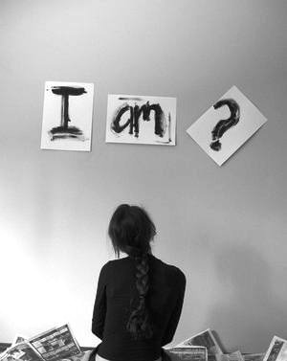
Accurately Seeing Ourselves

Slide 2
Psalm 51
1 Corinthians 11:27

Slide 3
NOT
“I reject God …
He offers nothing
I need”
“I can map out, chart or invent
my own way or course to fulfillment & ultimate happiness”
“I am, and there is no other besides me”
2:36
Matthew 27:22-25
Acts
3:17-19
Living in denial of the problems of sin?

Slide 4
Sinners Unfit for the Presence of a Holy God
Coming
Day of Reckoning
UnseenRealities

Slide 5
The Building of a Healthy Self-Image

Slide 6
Self-Image Correctly Remade
1 Peter 1:13-25
1 Peter 3:21
Citizen of Heaven
Wellness Defined By
Relationship with God
Vessel of Honor
Cleansed
Conscience
Ongoing Recipient
of His Favor
Valued by Creator
-- Redeemed –
Others Elevating
-- affects view of trials

Slide 7
abundance!
faithful
child of
the King
of Kings
Psalm 66:12
wealthy
place!
You brought us out to rich fulfillment!

