Slide 1
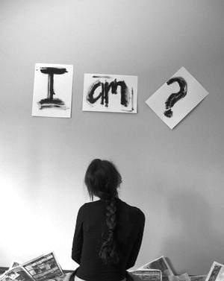
Accurately Seeing Ourselves

Slide 2


of GOD

Slide 3
Lesson for everyone who has ever felt passed over, unappreciated, unacknowledged or undervalued
Matthias
Joseph Barsabbas (Justus)
Barabbas
not...
Acts 1:21-26
Joseph (Barnabas)
Feelings of Inadequacy or Disappointment?
Passed Over / Did Not Make the Grade
Why Matthias and Not Me?

Slide 4
Chosen Of God
added responsibility / difficulty?
Not Chosen Yet Still Chosen
1 Corinthians 1:27,28
Ephesians 1:4
Colossians 3:12
2 Thessalonians 2:13
2 Timothy 2:10
Titus 1:1
1 Peter 1:1; 2:9
Revelation 17:14
All Are Not Apostles, Are They?
Joseph Barsabbas (Justus)
Rejoice With Those Who Rejoice
Excel Still More
It's okay!
Seek Maximum Yield!
The Lord will not overlook!

Slide 5
Handling Disappointment in the kingdom & in life generally; Responding to the selection of others over yourself…
Do not wallow in self-pity nor be consumed with your hurt.
Be determined to imitate Christ in your thinking & character to the best of your ability. Do not leave off in the pursuit of His perfection.
Cultivate your talent, tap into all of your ability for service in the kingdom. Who knows what the Lord may yet be able to do in and through you?
Kill jealousy & rivalry in your heart! Rejoice with, acknowledge, appreciate and encourage those who excel among us, 1 Thessalonians 5:13.
Stay focused in your aim & in your constant effort to fulfill the greatest command: Mark 12:30,31!

Slide 6
Chosen Of God
Enough!
The Ultimate!
"Well Done..."
Finding Significance “In Him!”

Slide 7
Accurately Seeing My Lofty Place in the LORD!

