Slide 1

634 -562 B.C.
NEBUCHADNEZZAR
Roughly 60 Old Testament references
8 of the 39 Old Testament books
Greatest King Ever? Accomplishments?
His unique relationship with the history of God’s covenant people!

Slide 2

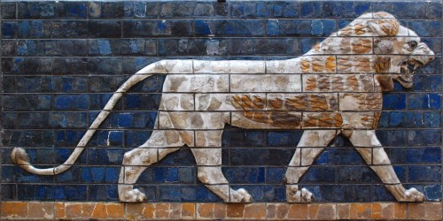
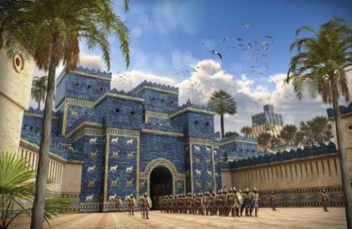
Look At What …I Did!
“While the word was in the king’s mouth, a voice came from heaven saying, “King N…sovereignty has been removed from you!”
-- Daniel 4:31
“Is this not Babylon the great, which I myself have built…by the might of my power and for the glory of my majesty?” -- Daniel 4:30

Slide 3
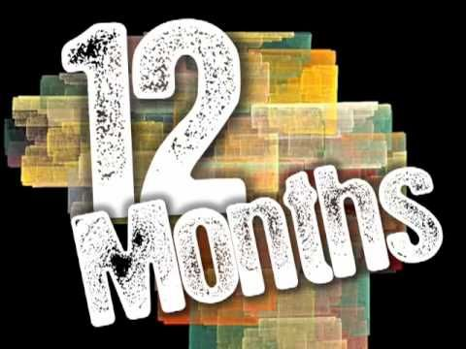
4:1-28
What He Forgot!
4:29

Slide 4
Look At What …I Did!
What Nebuchadnezzar & most others struggle to appreciate…
Who Is Really In Control!
-- Daniel 4:31-37

Slide 5
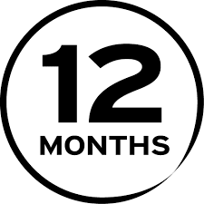
2 Lessons
God’s Activities & Purposes Are Accomplished In His Time
How Quickly We Are Prone To Forget!
time can erode knowledge & faith

Slide 6
4 Keys To Successful Changes Over Time
Anchoring
Assessing
Appealing
Attuning

Slide 7
When The Crowds Stop Cheering
Matthew 7: 24-27
How to Regard Life’s Fleeting Moments

Slide 8
When The Crowd Stops Cheering
Enjoy The Moments of Your Life
Ecclesiastes 9:7-13
Psalm 62:5-8
Philippians 4:8-13
The Crowd That’s Still Cheering
Hebrews 12:1
The Crowd That Cheers Eternally
Revelation 7:9-17

Slide 9
James 1:2-4,9-12
Which awards really matter?
Which crowds really matter?
Why are you here?
Why am I up here?
Will you ultimately be numbered among the blessed & exalted throng at God’s throne?

