Slide 1
Colossians 1:19-24
“For it pleased the Father that in Him all the fullness should dwell, and by Him to reconcile all things to Himself, by Him, whether things on earth or things in heaven, having made peace through the blood of His cross. And you, who once were alienated and enemies in your mind by wicked works, yet now He has reconciled in the body of His flesh through death, to present you holy, and blameless, and above reproach in His sight…”

Slide 2
Colossians 1:19-24
“…if indeed you continue in the faith, grounded and steadfast, and are not moved away from the hope of the gospel which you heard, which was preached to every creature under heaven, of which I, Paul, became a minister. I now rejoice in my sufferings for you, and fill up in my flesh what is lacking in the afflictions of Christ, for the sake of His body, which is the church.”

Slide 3
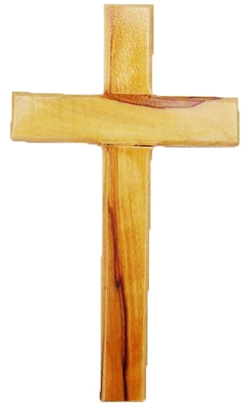
Pressures Jesus Faced (Colossians 1:19-24)
Luke 4:14-28
John 6:60-71
Matthew 20:20-28
Luke 4:1-13
Mark 9:2-13
Mark 14:1-11
Luke 4:31-37
Mark 11:27-33
Luke 7:36-50
Mark 3:20-27
Matthew 21:12-17
I. Pressures from Others.
A. Rejected by His Home Town (Luke 4:14-28).
B. His Disciples Deserted Him (John 6:60-71).
C. Pressured to Exalt James and John (Matthew 20:20-28).

Slide 4
Pressures Jesus Faced (Colossians 1:19-24)
Luke 4:14-28
John 6:60-71
Matthew 20:20-28
Luke 4:1-13
Mark 9:2-13
Mark 14:1-11
Luke 4:31-37
Mark 11:27-33
Luke 7:36-50
Mark 3:20-27
Matthew 21:12-17
II. Pressures from Temptation.
A. Direct Temptation (Luke 4:1-13).
B. Premature Glory (Mark 9:2-13).
C. Witnessing Hypocrisy (Mark 14:1-11).
D. Evil Spirits Taunt Him (Luke 4:31-37).

Slide 5
Pressures Jesus Faced (Colossians 1:19-24)
Luke 4:14-28
John 6:60-71
Matthew 20:20-28
Luke 4:1-13
Mark 9:2-13
Mark 14:1-11
Luke 4:31-37
Mark 11:27-33
Luke 7:36-50
Mark 3:20-27
Matthew 21:12-17
III. Pressures from Religion.
A. Challenges to His Authority (Mark 11:27-33).
B. Criticism of His Work (Luke 7:36-50).
C. Labeled Beelzebub (Mark 3:20-27).
D. Commercial Religion (Matthew 21:12-17).

Slide 6
Hebrews 12:1-2
“Therefore we also, since we are surrounded by so great a cloud of witnesses, let us lay aside every weight, and the sin which so easily ensnares us, and let us run with endurance the race that is set before us, looking unto Jesus, the author and finisher of our faith, who for the joy that was set before Him endured the cross, despising the shame, and has sat down at the right hand of the throne of God.”

