Slide 1
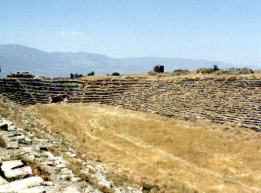
Hebrews 12:1-3
Ancient Race Track
“Therefore we also, since we are surrounded by so great a cloud of witnesses, let us lay aside every weight, and the sin which so easily ensnares us, and let us run with endurance the race that is set before us, looking unto Jesus, the author and finisher of our faith…”

Slide 2
Hebrews 12:1-3
Ancient Race Track
“…who for the joy that was set before Him endured the cross, despising the shame and has sat down at the right hand of the throne of God. For consider Him who endured such hostility from sinners against Himself, lest you become weary and discouraged in your souls” (NKJV).

Slide 3
“The Race That Is Set Before Us”
(Hebrews 12:1-3)
Ancient Race Track
I. We Need to Lay Some Things Aside.
A. “Every weight”
    Luke 21:34-36
B. “The sin which so easily ensnares us”
    Hebrews 10:26-31

Slide 4
“The Race That is Set Before Us”
(Hebrews 12:1-3)
Ancient Race Track
II. We Need to Have Endurance.
A. Jesus encourages endurance.
    Matthew 10:22
B. The Hebrew writer on endurance.
    Hebrews 6:11-15
C. Paul on Endurance.
    Romans 2:5-10

Slide 5
“The Race That is Set Before Us”
(Hebrews 12:1-3)
Ancient Race Track
III. We Need to Focus on Jesus.
A. “Looking Unto Jesus” (vs. 2)
    Colossians 3:1-2
    Hebrews 6:19-20
B. “Consider Him” (vs. 3).
    2 Peter 3:14-15

