Slide 1
Genesis 49:10
“The scepter shall not depart from Judah, nor a lawgiver from between his feet, until Shiloh comes; and to Him shall be the obedience of the people”

Slide 2

“Until Shiloh Comes”
The Scepter
  A sign of royal authority
  King Ahasuerus’ scepter (Esther 4:11; 5:2).
  Rulers of Syria and the Philistines (Amos 1:3-8).
  Saul, the Son of Kish—Of the tribe of Benjamin (1 Samuel 9:1-2; 10:1).
  His fall from authority (1 Samuel 13:13-14).
  David, the son of Jesse—Of the tribe of Judah (1 Samuel 16:1; 11-14).

Slide 3
“Until Shiloh Comes”
The Scepter
“The scepter shall not DEPART from Judah…”

Slide 4
“Until Shiloh Comes”
A Lawgiver
  Moses, the Levite (Exodus 2:1-3; 10).
  “Moses commanded a law” (Deut 33:4).
  “Judah is My Lawgiver” (Psalm 60:7; 108:8).
  “The Lord is our Lawgiver” (Isaiah 33:22).

Slide 5
“Until Shiloh Comes”
A Lawgiver
“The scepter shall not depart from Judah, nor a lawgiver from between his feet, UNTIL Shiloh comes…”

Slide 6
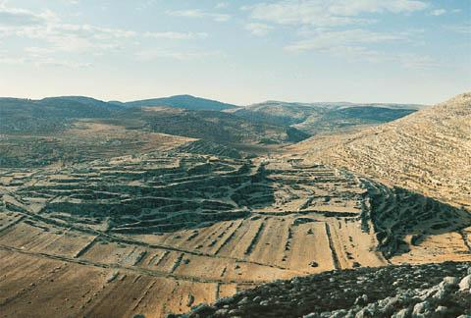
“Until Shiloh Comes”
Shiloh
  City in the territory of
  Ephraim where the
  tabernacle was set up.
  By Joshua
  (Joshua 18:1).
  In the time of Samuel (1 Samuel 1:24).
  There is no mention of the city of Shiloh in Genesis.
Location of Ancient Shiloh

Slide 7
“Until Shiloh Comes”
Shiloh
  Some would understand this to refer to...
  Judah, through the rise of David “coming to Shiloh.”
  The Problem is, Jacob describes authority not departing from Judah…
“UNTIL Shiloh comes”
  Through David and Solomon Jerusalem (not Shiloh) becomes the place of worship (2 Samuel 7:5-13).

Slide 8
“Until Shiloh Comes”
Shiloh
Royal authority doesn’t START for Judah until AFTER David comes to Shiloh.
What (or who) is the Shiloh of
Jacob’s blessing?

Slide 9
“Until Shiloh Comes”
Shiloh
Heb. shiyloh שִׁילֹה
= “he to whom it belongs”
“he whose it is, that which belongs to him”
Hebrew-English Lexicon of the Old Testament ,
Brown, Drivers & Briggs

Slide 10
“Until Shiloh Comes”
Shiloh
  This interpretation is supported by...
  “The almost unanimous testimony of ancient versions” including the Septuagint and the Hebrew Targums.
  Victor P. Hamilton, “Shiloh” Theological Wordbook of the Old Testament, Vol. 2, eds. R. Laird Harris, Gleason L. Archer, and Bruce K. Waltke. Chicago: Moody Press, 919.

Slide 11
“Until Shiloh Comes”
Jacob prophesied…
  A King from the line of Judah, before a king was even imagined in Israel.
  A Lawgiver from Judah, before written law was revealed, a title applied to the Divine “Lawgiver.”
  This authority will stand “until he comes to whom it belongs” (NIV).

Slide 12
“Until Shiloh Comes”
“To Him shall be the obedience
of the people.”
Ancient Translations rendered amyim “people”
“nations” (i.e. not just Israel)
“The obedience of the
nations” (NIV)

Slide 13
“Until Shiloh Comes”
Who would…
  Descend from Judah?
  Be a King…
  And a Lawgiver?
  Who is one to whom the right of royal authority “belongs”?
  To whom would be “the obedience of the nations”?

Slide 14
“Until Shiloh Comes”
Hundreds of years before His coming Jacob prophesied the coming of…
Jesus Christ
Of the tribe of Judah
King and Lawgiver
Shiloh, “He to whom (the right to rule the nations) belongs.”

