Slide 1
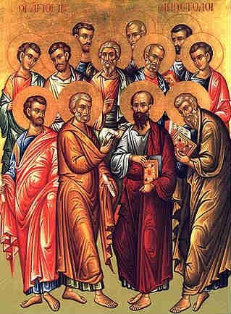
The Great
Commission
Matthew 28:16-20
“Then the eleven disciples went away into Galilee, to the mountain which Jesus had appointed for them. When they saw Him, they worshiped Him; but some doubted. And Jesus came and spoke to them, saying, "All authority has been given to Me in heaven and on earth…”

Slide 2
The Great
Commission
Matthew 28:16-20
“…Go therefore and make disciples of all the nations, baptizing them in the name of the Father and of the Son and of the Holy Spirit, teaching them to observe all things that I have commanded you; and lo, I am with you always, even to the end of the age. Amen.”

Slide 3
The Great
Commission
Mark 16:15-16
“ And He said to them, ‘Go into all the world and preach the gospel to every creature. 16 He who believes and is baptized will be saved; but he who does not believe will be condemned’”

Slide 4
Conversions in the Book of Acts
What Did They Do?
How Did People Convert to Christ?
If We Do What They Did Won’t We Be What They Were?

Slide 5

Conversions in the Book of Acts
Hear
Believe
Repent
Confess
Baptism
Pentecost
2:14-41
2:14
2:37-38
2:38-41
Samaria
8:4-13
8:4, 6
8:12
8:12-13
Eunuch
8:26-40
8:35
8:36-37
8:37
8:38
Saul (Paul)
9:1-20
9:18
22:16
9:4-6
9:20

Slide 6
Conversions in the Book of Acts
Hear
Believe
Repent
Confess
Baptism
Cornelius
10:34-48
10:44
10:43
11:18
10:46
10:47-48
Lydia
16:11-15
16:14
16:14
16:15
The Jailer
16:25-34
16:30
16:31
16:33
16:34
16:33
What About You?
Rom. 10:17
Heb. 11:6
Luke 13:3
Rom. 10:10
Gal. 3:27

Slide 7
Conversions in the Book of Acts
Have You Been Converted to Christ?

