Slide 1
2 Kings 20:1
“In those days Hezekiah was sick and near death. And Isaiah the prophet, the son of Amoz, went to him and said to him, ‘Thus says the LORD: “Set your house in order, for you shall die, and not live”’” (NKJV).

Slide 2
2 Kings 20:1
Imagine learning that you were about to die.
How would you react?

Slide 3
Isaiah Could Be Trusted
He prophesied in the time of his father, grandfather, and great-grandfather (Isa. 1:1).
Isaiah had revealed to him God’s deliverance from the Assyrian army that threatened Jerusalem (2 Kings 19:1-7).
God revealed through Isaiah God’s answer to his prayer at that time (2 Kings 19:15-34).
God destroyed the Assyrian army, as Isaiah had prophesied (2 Kings 20:35).

Slide 4
Isaiah Could Be Trusted
Now his prophesy was not of deliverance,
but death—
the death of Hezekiah.

Slide 5
2 Kings 20:2-3
“Then he turned his face toward the wall, and prayed to the LORD, saying, ‘Remember now, O LORD, I pray, how I have walked before You in truth and with a loyal heart, and have done what was good in Your sight.’ And Hezekiah wept bitterly.”

Slide 6
2 Kings 20:2-3
Hezekiah wept “bitterly” (or literally “a great weeping,” YLT).
Death can lead us to sadness…
…But God is not blind to this.

Slide 7
2 Kings 20:2-3
Jesus wept at the death of Lazarus (John 11:35).
Because by sharing in our flesh and blood, He destroyed the devil’s “power of death” (Heb. 2:14)…
…Releasing those in bondage to “the fear of death” (Heb. 2:15).

Slide 8
2 Kings 20:2-3
His reaction is impressive.
His first reaction was prayer.
“Pray without ceasing” (1 Thess. 5:17).
“In everything by prayer and supplication” (Phil. 4:6-7).

Slide 9
2 Kings 20:2-3
Sometimes the answer is no (2 Cor. 12:7-9).
Prayer demonstrates a humble recognition of God’s dominion in our lives.
God cares for us (1 Pet. 5:6-7).

Slide 10
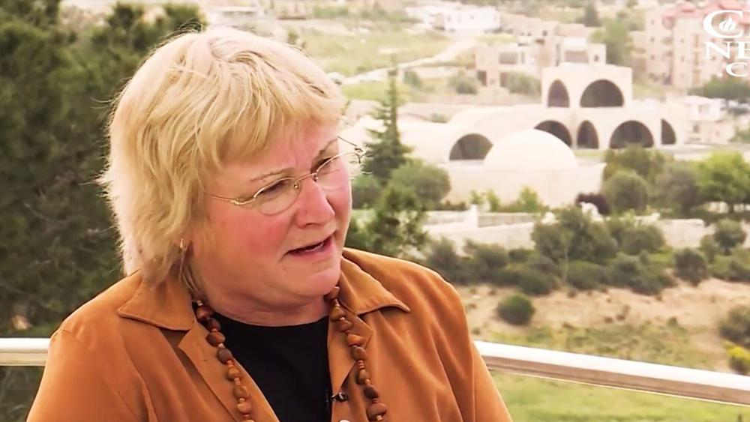
These Were Real Men—Not Myths
2009 Ophel Excavations led by Eilat Mazar found two important artifacts.

Slide 11
These Were Real Men—Not Myths
Two clay bullae from the 8th century BC were found just south of the Temple Mount.

Slide 12
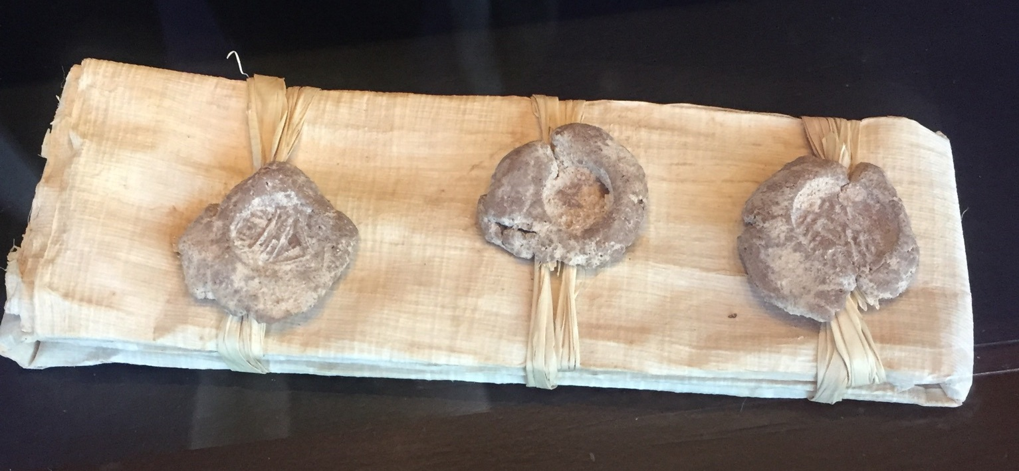
These Were Real Men—Not Myths
Bullae are the clay impressions made by a seal used to seal documents.

Slide 13
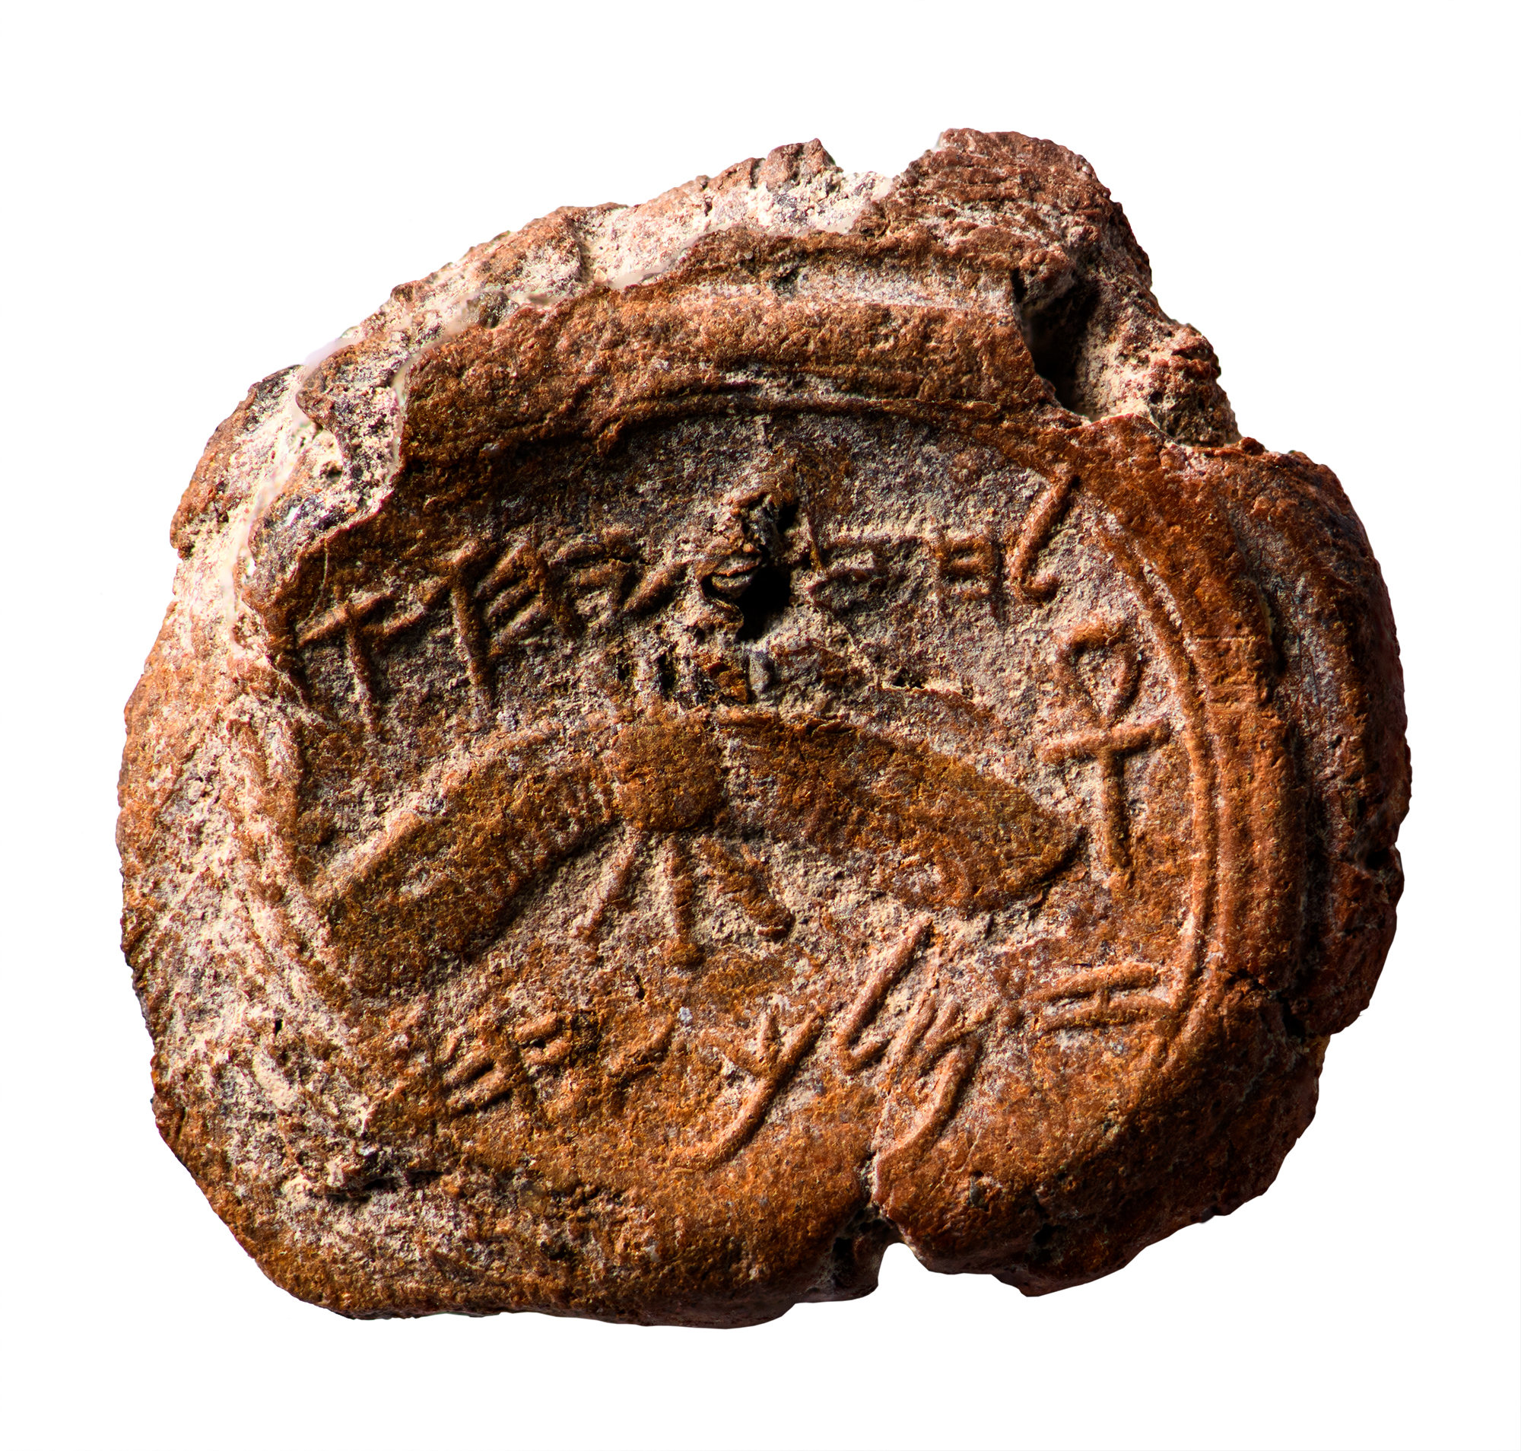
These Were Real Men—Not Myths
Decorated with a winged sun-disk, believed to represent God’s care over His people.
“Belonging to Hezekiah, [son of] Ahaz, king of Judah.”
0
1 cm

Slide 14
These Were Real Men—Not Myths
“For the LORD God is a sun and shield” (Psa. 84:11)
0
1 cm

Slide 15
These Were Real Men—Not Myths
“He shall cover you with His feathers, and under His wings you shall take refuge; His truth shall be your shield and buckler” (Psa. 91:4).
0
1 cm

Slide 16
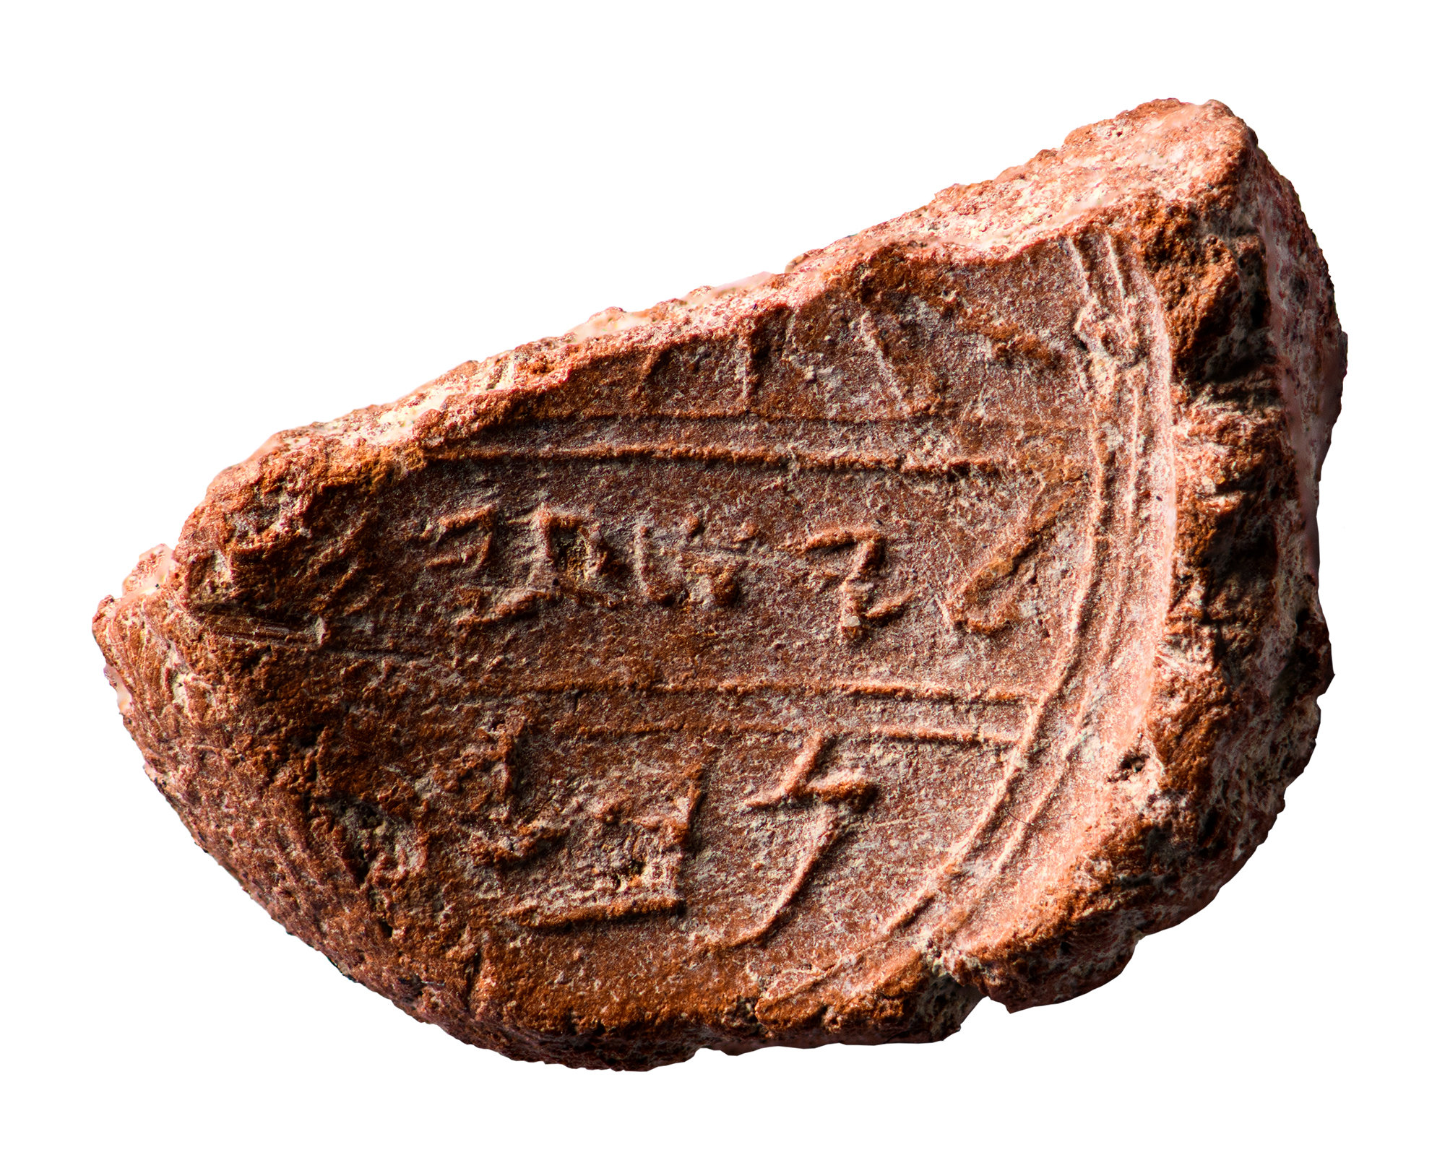
These Were Real Men—Not Myths
Damaged
About ten feet away another bulla was found.
Thumbprint
0
1 cm

Slide 17
These Were Real Men—Not Myths
Heb. leyesha‘yah[u]
“Belonging to Isaiah”
What has been preserved is remarkable!
Heb. nvy
0
1 cm

Slide 18
These Were Real Men—Not Myths
“Belonging to Isaiah, [the] prophet.”
If thumbprint covered Heb. aleph—nvy’ “prophet”
0
1 cm

Slide 19
These Were Real Men—Not Myths
Sixteen times the Bible uses these names together (2 Kings 19:5, 20; 20:1, 8, 12, 14, 16, 19; 2 Chron. 32:20, 32; Isa. 37:5, 21; 38:1; 39:3, 5, 8).

Slide 20
These Were Real Men—Not Myths
“…The close relationship between Isaiah and King Hezekiah, as described in the Bible, and the fact the bulla was found next to one bearing the name of Hezekiah seem to leave open the possibility that, despite the difficulties presented by the bulla’s damaged area, this may have been a seal impression of Isaiah the prophet, adviser to King Hezekiah”
Mazar, Eilat. “Is This the Prophet Isaiah’s Signature?” Biblical Archaeology Review 44.2 (May/June 2018): 64–73, 92.

Slide 21
2 Kings 20:4-6
“It happened, before Isaiah had gone out into the middle court, that the word of the LORD came to him, saying, ‘Return and tell Hezekiah the leader of My people, “Thus says the LORD, the God of David your father: ‘I have heard your prayer, I have seen your tears; surely I will heal you…”

Slide 22
2 Kings 20:4-6
“…On the third day you shall go up to the house of the LORD. And I will add to your days fifteen years. I will deliver you and this city from the hand of the king of Assyria; and I will defend this city for My own sake, and for the sake of My servant David.”

Slide 23
Hezekiah’s Life Extended
God may not extend our lives here on earth…
…But like Hezekiah, by His mercy He extends life in the age to come to those who serve Him faithfully.
Jesus came to bring life (John 10:10b).

Slide 24
Hezekiah’s Life Extended
John wrote to motivate faith unto eternal life (John 20:31).
The extension of Hezekiah’s life was merely a foretaste of the Power that would ultimately conquer death and offer to all souls the way to eternal life.

Slide 25
Hezekiah’s Life Extended
What a comfort to hear “I will deliver you” and “I will defend this city.”
We too face many dangers, obstacles, and threats.
In Christ we have the promise that God will deliver us from all our foes, whether persecution, temptation, enemies, or death.

Slide 26
Hezekiah’s Life Extended
Through all we are “more than conquerors” (Rom. 8:37).
Our victory is found in obedience to the gospel (Rom. 8:38-39).
Like this ancient prophet and king, we too serve a real God of real promises and real deliverance.

