Slide 1
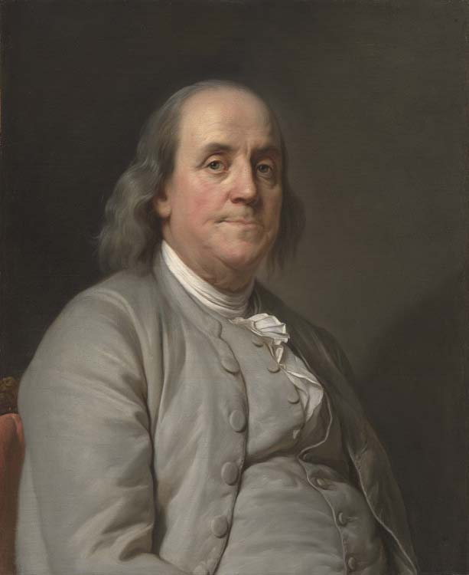
Matthew 25:1-12
“By failing to prepare, you are preparing to fail.”
- Benjamin Franklin

Slide 2
Prepare for Worship
Preparedness
Be ready to work and worship (1 Cor. 14:33, 40)
Have a mind focused on spiritual things (Col. 3:1-4)
Be right with God and others (Matt. 5:23-24; Prov. 28:9)

Slide 3
Prepare for Service
Preparedness
To help the physical needs of others (Eph. 4:28; Phil. 2:3-4)
To help the spiritual needs of others (Gal. 6:1; James 5:19-20)
This will take some work (2 Tim. 4:2-5).

Slide 4
Prepare for Eternity
Preparedness
All who are of sound mind & accountable age have sinned (Rom. 3:23; Isa. 59:1-2)
All will give an account (2 Cor. 5:9-11)
We must prepare by accepting God’s conditions of salvation (Rom. 10:17; Heb. 11:6; Acts 17:30; Rom. 10:10; Mark 16:16; Rev. 2:10)

