Slide 1
Noah Escapes The Flood
Genesis 6-9

Slide 2
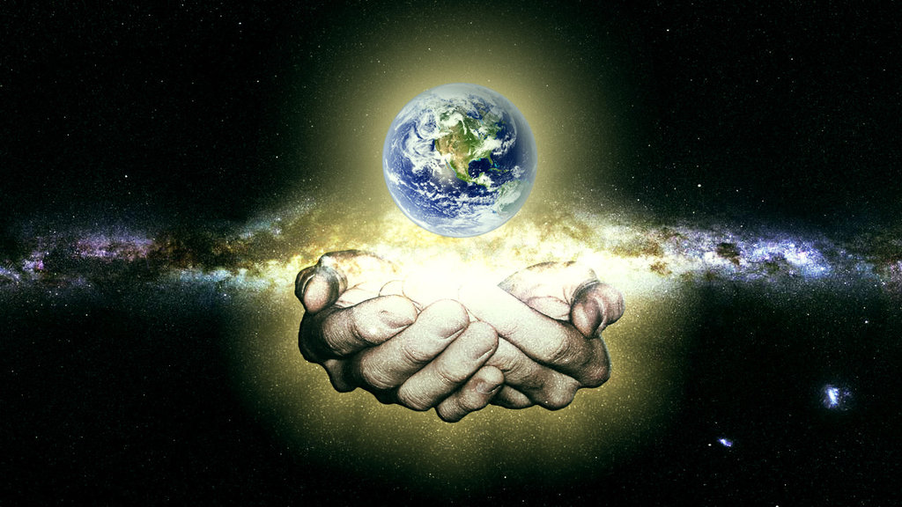

Slide 3
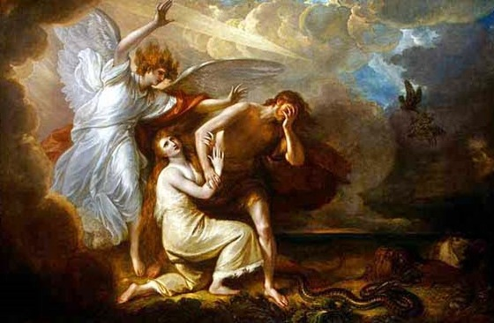

Slide 4

How did it get THIS bad?!
The Devil is good at getting Man to do bad.
  1 John 5:19; 1 Peter 5:8
The Devil wants Man to…
  Befriend the world (James 4:4).
  Love the world (1 John 2:15-17).
  Conform to the world (Romans 12:1-2).
The Devil used “the daughters of men” to do it.

Slide 5
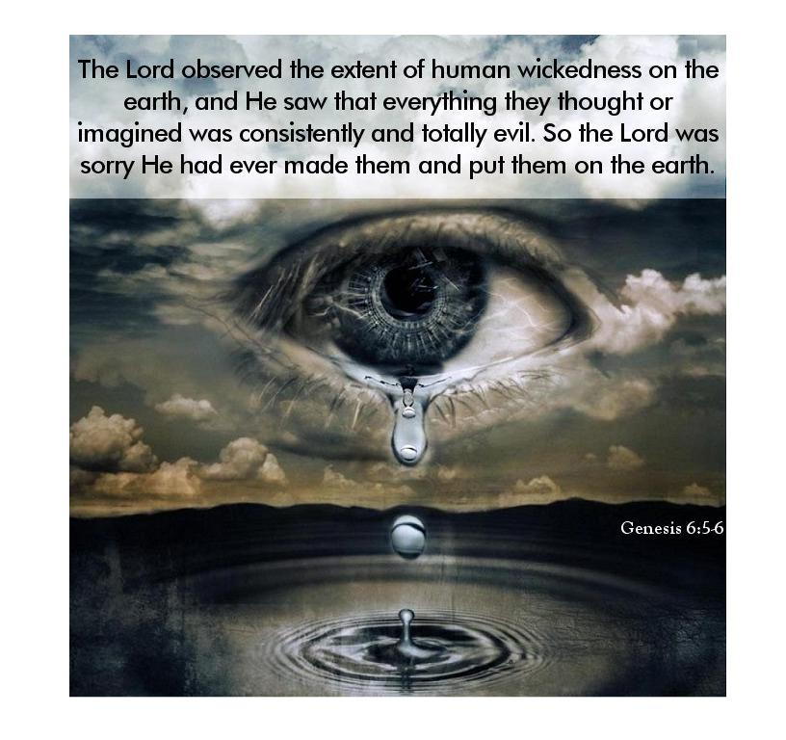
Why was God so grieved?
  Has someone ever ruined something you did that you thought was “pretty good”?
  God deserved to be honored/worshipped and wasn’t!
  Have you ever seen a loved one go wrong? (3 John 1:4).
  They couldn’t care less (ref. Matthew 24:38).
Why did God have to destroy the world?
  God is holy and just (1 John 1:5; Psalm 7:11).
  It was so bad, He had to “start over” (ref. Matt. 24:38).
  To teach Man about the seriousness of sin (Romans 15:4).

Slide 6
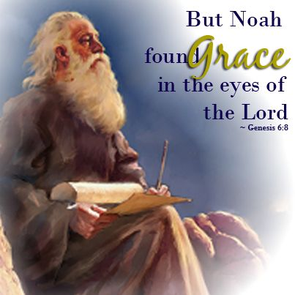
Why did Noah stand out from the world?
  He was a man of faith in a faithless world (Heb. 11:6-7).
  He was a just man in an unjust world.
  He was a blameless man in a guilty world.
  He walked with God in a godless world.
  He was a preacher of righteousness in a world that desperately needed his message (2 Peter 2:5).
From where did Noah come?
  While Cain’s descendants “went out from the presence of the Lord” (4:16ff), Seth’s descendants “called on the name of the Lord” (4:26-5:32).

Slide 7
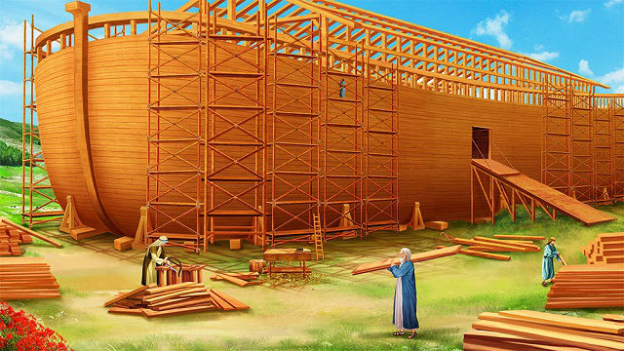
God told Noah how he could escape the Flood.
Ephesians 2:8-9; James 2:14-26; Hebrews 11:7
What did God tell Noah to do?
  What did Noah have to be thinking when God told him all of this?!
What did Noah do?
  He did everything God told him to do (6:22; 7:5).
  What issues might Noah have faced while he was building the Ark?

Slide 8
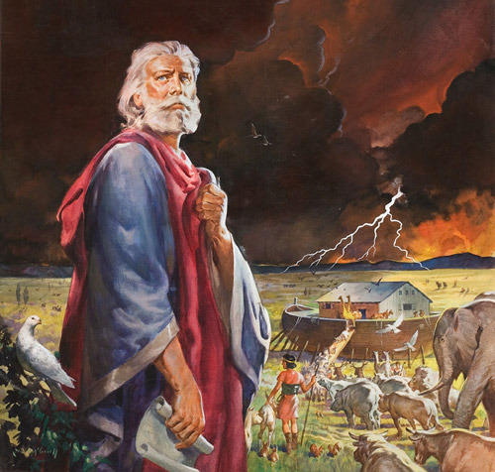
What did Noah’s neighbors have to be thinking while he built this Ark?!
While he was a preacher of righteousness, how many people did he convince?

Slide 9
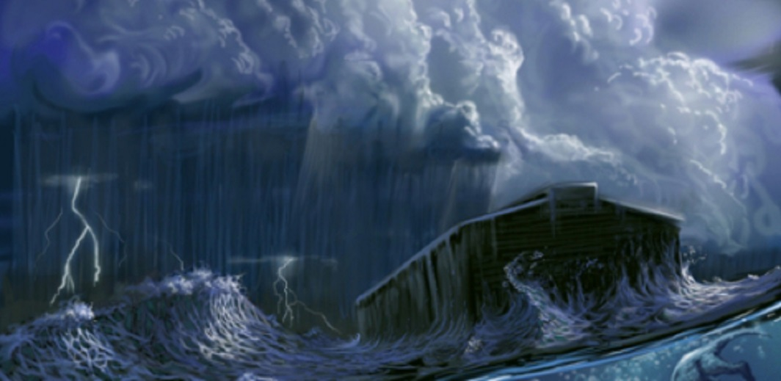
Would it have taken faith to enter the Ark?
What did God do when they entered the Ark?
What had to be going through people’s minds when it started to rain?
Did God speak with them while in the Ark?

Slide 10
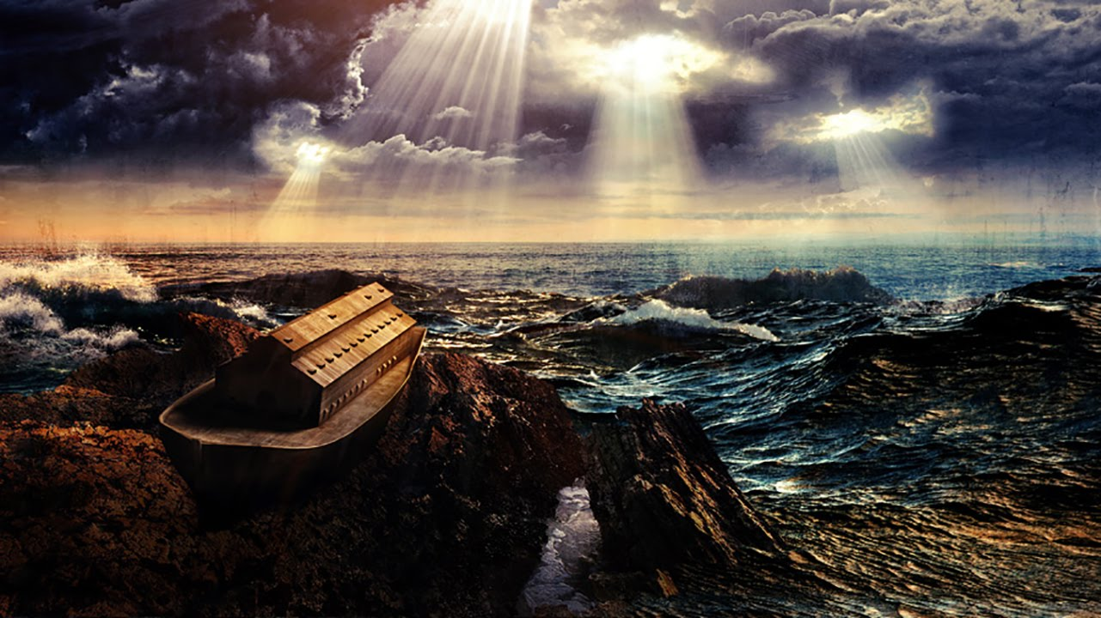

Slide 11
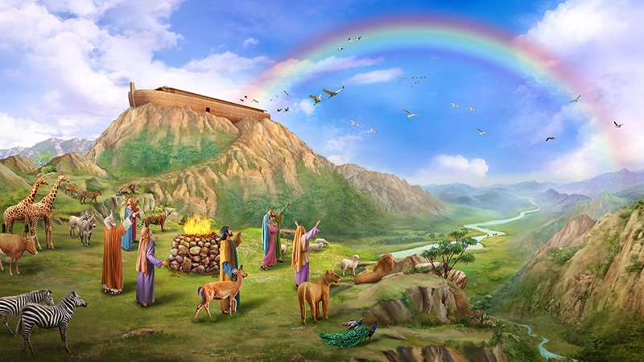
What did Noah do after he exited the Ark? Why?
  He offered sacrifices to God, thanking God for saving them.
What did God do after Noah did his thing?
  He made a covenant with them, gave them a sign of this covenant, and gave them a law.

Slide 12
Lessons and Applications
There is a coming Day of God’s Judgment & Wrath!
God has graced us with a way of escape: Jesus!
Those who live by faith in Him* will be saved!
Resist the Devil and draw nearer to the Lord.
Do your best to please, not grieve, God.
Keep preaching righteousness to everyone.
In short, stand out from the rest of the world by walking ever-closer with the Lord.
The “new heavens & earth” are worth it!

