Slide 1
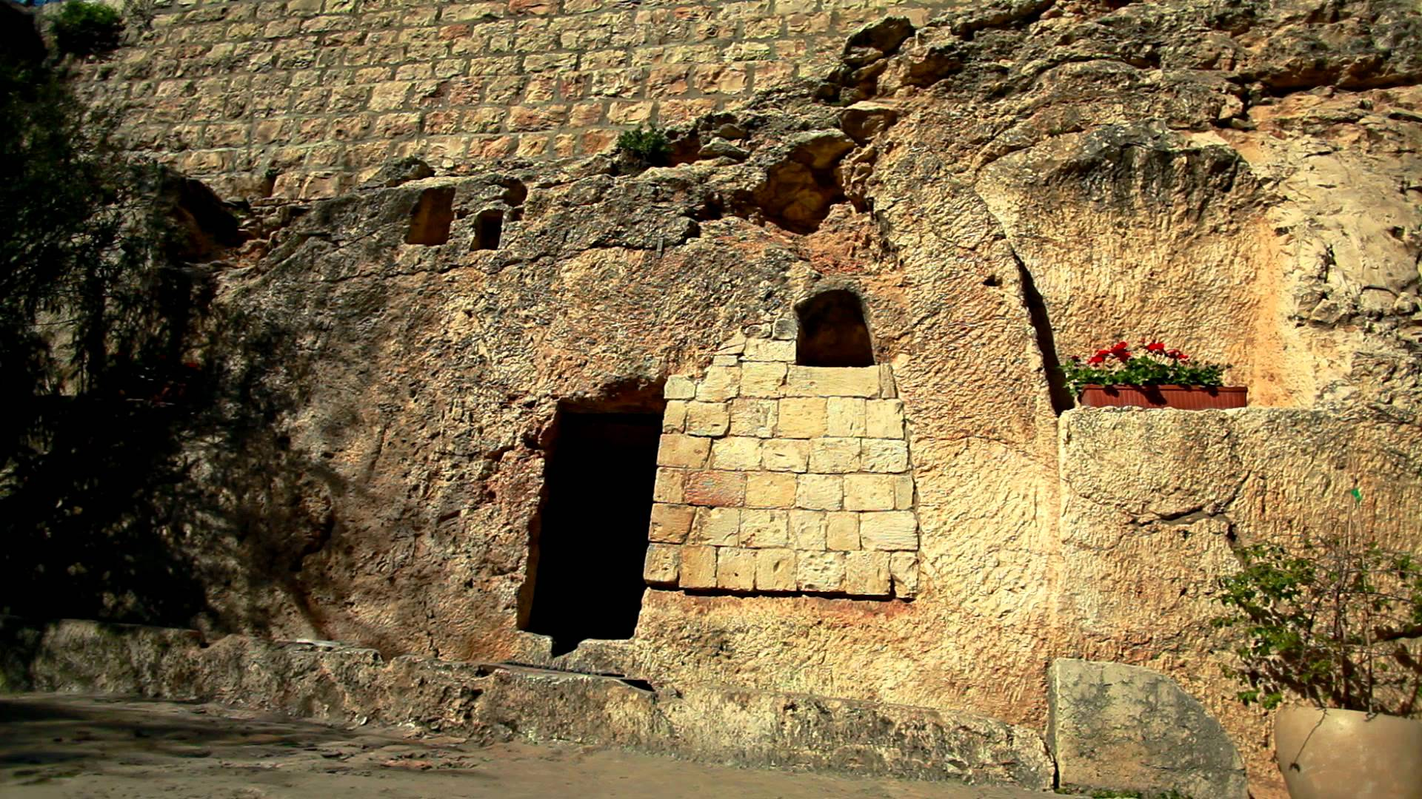

Slide 2
Jesus Escapes
the Tomb
John 20

Slide 3
Jesus Escapes
es·cape –
1. break free from confinement or control.

Slide 4
Jesus Escapes
But God raised Him from the dead, releasing Him from the agony of death, because it was impossible for Him to be held in its clutches. (Acts 2:24)

Slide 5
Timeline of the Resurrection
Jn. 20:26-29
Women Depart
Matt. 28:8
Mk. 16:8
Lk. 24:9-11
Jn. 20:18
Women Report
✓ Thomas
Matt. 28:1
Mk. 16:1-4
Lk. 24:1
Jn. 20:1
Lk. 24:36-43
Jn. 20:19-23
Women Arrive
Jesus Appears
Matt. 28:9-10
Mk. 16:8
⃠ Thomas
Matt. 28:5-7
Mk. 16:5-7
Lk. 24:4-7
Angel Appears
Angels Speak
Jesus & Mary
Mk. 16:9
Jn. 20:11-17
Matt. 28:3-4
Mk. 16:12-13
Lk. 24:13-35
Emmaus
Mary M. Departs
Jesus Raised
Pet. & Jn. Depart
Jn. 20:10
Jn. 21:12
Jn. 20:2
Galilee
Acts 10:40-41
Matt. 28:2
Jesus & Peter
Mary M. Returns
Jn. 20:3-9
w/ Pet. & Jn.
Lk. 24:12
1 Cor. 15:5
(Break of Dawn)
(Noon-Evening)
+8
?
Resurrection Sunday

Slide 6
Answering Skeptics
Disciple Conspiracy
(Mk. 9:10, 32; Lk. 18:32-34)
Enemy Conspiracy
(Matt. 27:65-66)

Slide 7
Meaning for Us
Physical Death is not the End
(1 Cor. 15:20,23)
A Declaration of Victory
(2 Pet. 1:16)

Slide 8
Meaning for Us
No Resurrection, No Hope
(1 Cor. 15:13-17)
Obedience: The ONLY Acceptable Response

