Slide 1
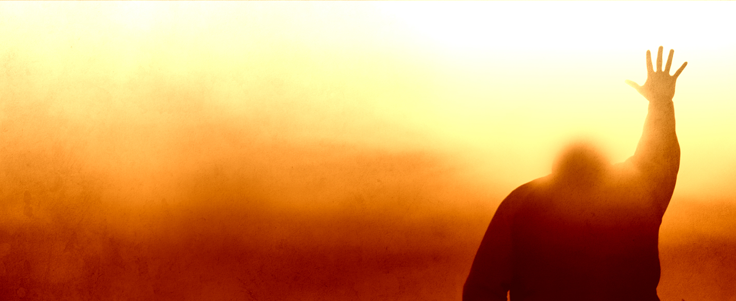
How will we escape if we neglect
SO GREAT A SALVATION?
- Hebrews 2:2
Notes:
Appreciate the invite
Enjoyed listening to the other guys this week
I welcome comments. This will not be a sermon but a class.
Our text comes from Hebrews 2:1-4, but we’ll read that in a minute.

Slide 2
Themes of Hebrews
1. Superiority of New Law
2. Persevering Towards Christ
Notes:
We don’t have time to go through a complete overview of the entire book, but it’s good to at least get a surface overview of what we’re dealing with here. I think you see that outlined very well in (Hebrews 10:32-39)
From everything that we can tell, the audience for this book is a group of Christian Jews who have struggled to push forward towards Christ. They keep wanting to turn back towards the Old Law.
I would argue that that’s a temptation for all of us. In times of hardship, we will often revert back to the area of our life that’s most comfortable.
Hebrews is about having the confidence to move forward through the danger and push on towards what you know is right. Taken in a modern-day context, that’s something we all struggle with.
There’s a heavy emphasis on practical faith throughout this book: what does it mean, why should you believe, how does that faith manifest itself in everyday life.

Slide 3
Christ is Higher than Angels?
(Hebrews 1)
Christ Was Lower Than Angels?
(Hebrews 2)
Notes:
Two degrees of importance here: First is that He is higher than the angels (Heb. 1:1-4)
You could theoretically just read “Has in these last days spoken to us by His Son” and fast forward to Chapter 2, because everything in between is more or less proof of that central thesis.
Angels acted as God’s messengers throughout the OT; possibly even the Law administered through angels (Gal. 3:19; Acts 7:53)
The second is that He was made lower than the angels (2:9)
The fact that He is made “lower than the angels” is important because it describes our kinsmanship that we have with Him (Heb. 2:14-18)
In a sense, because of His great humiliation, He was granted the highest exaltation, if that makes any sense.
All of this goes back to the central point that Jesus is King. He’s the authority, He’s the law, and you should push forward towards Him and not backwards toward the Law.
All of this puts our verse this morning into context, because the verses that we’re talking about are all about authority. Authority of Christ, authority of the Law, and how those two intersect to describe our salvation.

Slide 4
“For This Reason…”
“Proved Unalterable…”
“Received a Just Penalty…”
“The Law Brings Wrath”
- Romans 4:15
Notes:
Now, let’s read (Hebrews 2:1-4)
There’s a whole lot going on in these verses so we’ll try to digest it chunk by chunk.
“For this reason” - what reason?
He’s talking about the Law. We could go on about this for a long time, but there’s two fundamental points he brings out in this text about the Law and how it compares to the Law of Christ.
“Proved unalterable” - Jesus understood that - Matthew 5:18. The point was not that it was unchanging as much as it is that it was binding - that’s the main point here (Heb. 10:28-29).
“Received a Just Penalty” - You don’t set it aside. Period.
Transgression is an outwardly visible failure to comply with a law
Disobedience is an intentional neglect to hear (more inward). This is the one that Jesus chastised the Pharisees for so often. Both are in play here.
This is what Paul means in Romans 4:15 when he says “The Law brings wrath.”
This is maybe jumping forward a little bit, but when the Hebrew writer asks the question: “How do you escape condemnation [under the Old Law]?” what’s the answer? You can’t!
And of course, we look at the OT and we think, “God is super mean!” What the Old Law represents is His extreme hatred of sin. That’s balanced out by looking at the cross, because only when we understand the magnitude of sin do we understand the depth of God’s love by sending Jesus to die on the Cross. That’s a powerful concept, and I would say if we get nothing else out of this discussion, grab hold of that concept. (Rom. 7:24-25; 8:1-8; Heb. 9:11-14)

Slide 5

Notes:
This is why the cross is so powerful.

Slide 6
Because…
Jesus Has All Authority
Moses’ Law Was Binding
We Now Have Hope
What’s Our
Responsibility?
Notes:
Because of all these things, what’s our responsibility.

Slide 7
Do Not Drift Away
“This Hope We Have, as an Anchor for the Soul.”
- Hebrews 6:19
Notes:
Hearing denotes responsibility.
2 Peter 2:21 - better for you not to have heard than to have heard and depart from it.
Drifting is a passive thing; it doesn’t happen intentionally
We made mention of this fact at the beginning, but the audience here is people who are leaving the Judaistic system and are tempted to go back. They’re listening to Judeaizing teachers who are telling them to go back.
That’s a tough temptation for these people, because they’re being asked to leave everything they know and move into something different.
The Jewish system was more than just a religious system. It represented their culture, social life, economic, national identity, etc. Sometimes we think of it as a religious document when the Law encompassed much more than that.
Because of that, they want to implement circumcision and the Sabbath and the Passover. If you look at Paul’s epistles, that type of struggle is mentioned in almost every book.
If you do that though, you become guilty of making void in your own life everything that Jesus died to accomplish (Hebrews 6:7-8, 9-12)
Staying in Hebrews 6, the writer talks about this guarantee: two immutable things - God’s promise of salvation, and His oath of the promise - and then calls that hope our “anchor of the soul.” That’s a direct tie-in to the idea of not drifting away.
This is how we’re going to escape condemnation, folks.

Slide 8
Do Not Drift Away
Realize How Great Salvation Truly Is
Notes:
What makes it so great?
Because of what it took to secure it
Because of what it rescues us from.
At its core, salvation rescues us from death, not from social injustice or boredom or anything else.
Because of who testifies about it:
Jesus (2:3)
Apostles (2:3)
God Himself (2:4)
Sign - points to something else
Wonder - exemplifies it’s extraordinary status
Miracle - displays the power of God.

Slide 9
Do Not Drift Away
Learn From Past Generations
Notes:
(1 Cor. 10:1-13)
Why do you think the generation that saw the exodus and the plagues ended up leaving God in the wilderness? They’re people like us, so what changed?
They became familiar with it. It’s old news, we’re not as hungry for it as we used to be.
They became lazy. It simply was easier to do things one way as opposed to another.
They became busy. This is a big issue in our society. We make time for everything else: hobbies, school, work, but we hardly ever make time for God. That’s the one big thing that we can take from this: we have to make time for God in everyday life.
They had toxic relationships (1 Cor. 15:33-34).

Slide 10
Do Not Drift Away
Practice Paying Attention
Notes:
We’ve said it before and we’ll say it again: Drifting is a passive activity. No one wakes up one morning and says “Today, I will stop being a Christian.”
C.S. Lewis: “If you have once accepted Christianity, then some of its main doctrines shall be deliberately held before your mind for some time every day. That is why daily prayers and religious readings and church-going are necessary parts of the Christian life. We have to be continually reminded of what we believe. Neither this belief nor any other will automatically remain alive in the mind. It must be fed. As a matter of fact, if you examined a hundred people who had lost their faith in Christianity, I wonder how many of them would turn out to have been reasoned out of it by honest argument? Do not most people simply drift away?”
Zig Ziglar, talking about Motivation: “People often say that motivation doesn't last. Well, neither does bathing - that's why we recommend it daily.”
Paul told the Ephesian elders to “Take heed to yourself”; Peter told his audience in 2 Peter to heed to the “prophetic word confirmed.”
He says in Hebrews 2:1-4 to “Pay closer attention to what we have heard so we don’t drift away from it.” That statement of “pay closer attention” creates a comparison: if people paid attention X amount to the OT, we have to pay attention X+++++

