Slide 1
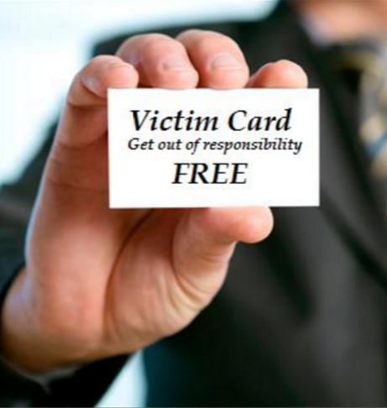
The Blame Game
Very Popular Game
Played in the World
Played in Business
Played in Politics
Played in School
Played in the Church

Slide 2
The Blame Game
Rules of the Game
Refuse to take responsibility for your own action.
Focus on yourself and how you’ve been wronged.
Make the wrong done to you greater your wrong.
Tell yourself you are powerless to overcome.
Always act morally right, not responsible or accountable, and entitled to sympathy.
Make your problem bigger than it really is.

Slide 3
The Blame Game
Many Players throughout History
First Players: Adam & Eve (Gen. 3:1-13)
  Wouldn’t admit they did wrong
  Shifted the blame
Aaron blamed the people & Moses (Exod. 32:21-24).
Saul blamed the people (1 Sam. 15:13-15).
Ahab blamed Elijah (1 Kings 18:17-18).
The older son blamed his father (Luke 15:25-32).

Slide 4
The Blame Game
Many Players Today
They blame parents or background.
  “They made me what I am!”
They blame society.
  “I am entitled!”
  “I can’t get ahead!”
They blame the church.
  “I’m discouraged!”
  “People don’t care!” (cf. Acts 6:1-6)

Slide 5
The Blame Game
How to Stop the Game
Realize wrong is wrong (1 John 3:4-6).
Realize you are responsible for you (Jas. 1:13-15).
Realize you can overcome the past (1 Cor. 6:9-11).
Realize you can do it (Phil. 4:13).
Realize you are not the only one who has suffered (1 Pet. 5:9; Heb. 2:18).

