Slide 1
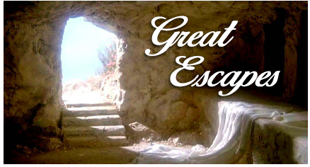
A Great Opportunity
This week we will have our fifth
Summer Bible Study
Noah Escapes the Flood
Jesus Escapes the Tomb
We Can Escape Condemnation
Thursday & Friday (7:00-8:30); Saturday 10:00-11:30

Slide 2
A Great Opportunity
This week we will have our fifth
Summer Bible Study
Classes for all ages
Opportunity to engage with young people
Encouragement, edification, enthusiasm, joyous fellowship
A reunion with men who either grew up here or went through our preacher training program.

Slide 3
Why You Should Plan to Attend?
The elders offer this to feed the flock (Acts 20:28 – ASV “feed”; Heb. 13:17).
It is a once a year opportunity (Gal. 6:10; Eph. 5:15-17).
You can support those who have worked hard to make it possible (Heb. 13:7; 1 Thess. 5:12-13).
You will leave encouraged (Phil. 4:8; Mark 10:13-14; 9:37).

Slide 4
Why You Should Plan to Attend?
The Lord’s money has been used to bring preachers here and to teach our children (Phil. 4:18).
You will grow in the knowledge of the Lord (2 Pet. 3:17-18)
Is there a better place to be? (Ps. 92:1; 147:1; 122:1; Heb. 3:6).
It will glorify the Lord (Matt. 5:16; Rom. 15:5-6).

