Slide 1
Are you a 90 or a 52?
A lesson from Nehemiah…

Slide 2
Are you a 90 or a 52?
Context matters, units matter!
  Might be thinking about grades
    An A is better than an F
  Might be thinking about salary
    Most people would prefer to make 90k vs 50k
  Maybe your thinking about age
    I’d rather be 52 years old than 90 years old
    The question doesn’t make much sense without context
  The difference is not 38, it’s 32,798!
  So choose carefully!

Slide 3
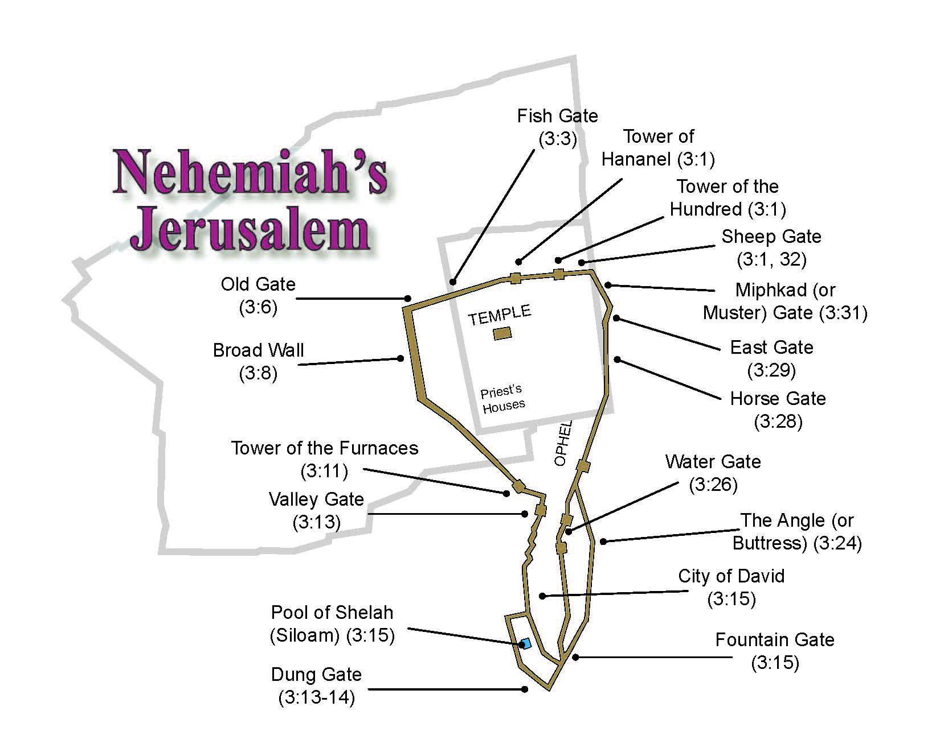
Are you a 90 or a 52?

Slide 4
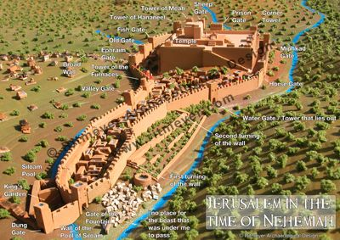
Are you a 90 or a 52?

Slide 5
Are you a 90 or a 52?
Nehemiah 2:16-18
And the officials did not know where I had gone or what I had done; I had not yet told the Jews, the priests, the nobles, the officials, or the others who did the work.
Then I said to them, “You see the distress that we are in, how Jerusalem lies waste, and its gates are burned with fire. Come and let us build the wall of Jerusalem, that we may no longer be a reproach.” And I told them of the hand of my God which had been good upon me, and also of the king’s words that he had spoken to me.
So they said, “Let us rise up and build.” Then they set their hands to this good work.

Slide 6
Are you a 90 or a 52?
Nehemiah 4:17-19
Those who built on the wall, and those who carried burdens, loaded themselves so that with one hand they worked at construction, and with the other held a weapon. Every one of the builders had his sword girded at his side as he built. And the one who sounded the trumpet was beside me.
Then I said to the nobles, the rulers, and the rest of the people, “The work is great and extensive, and we are separated far from one another on the wall. Wherever you hear the sound of the trumpet, rally to us there. Our God will fight for us.”

Slide 7
90 YEARS OR 52 DAYS?
WHICH ONE ARE YOU???

Slide 8
Our battle is not physical…
2 Corinthians 10:3-6
For though we walk in the flesh, we do not war according to the flesh. For the weapons of our warfare are not carnal but mighty in God for pulling down strongholds, casting down arguments and every high thing that exalts itself against the knowledge of God, bringing every thought into captivity to the obedience of Christ, and being ready to punish all disobedience when your obedience is fulfilled.

Slide 9
THE 2 Ps
PASSION
PRAYER

Slide 10
YOU’RE NOT ALONE!!
COMMUNITY
COOPERATION

Slide 11
REMEMBER!!
NOTHING WORTH DOING IS EASY, EXPECT ADVERSITY

Slide 12
BE A 52!
PICK AN AREA TO IMPROVE AND FIX IT!

