Slide 1
Combatting Complacency

Slide 2
2 Corinthians 13:5
Examine yourselves as to whether you are in the faith. Test yourselves. Do you not know yourselves, that Jesus Christ is in you?—unless indeed you are disqualified. (NKJV)

Slide 3
Are We Too Comfortable?
In our Routines
In our Understanding and Knowledge
With our Strength of Conscience
With our Worship

Slide 4
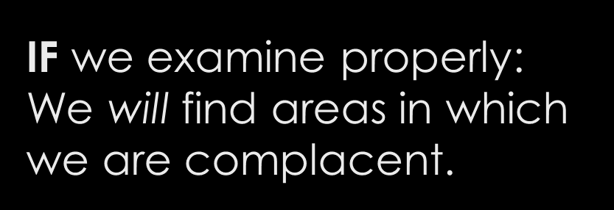
IF we examine honestly: We will find areas in which we can improve.

Slide 5
If we do not, we can easily deceive ourselves!
Galatians 6:3-5
³ For if anyone thinks himself to be something, when he is nothing, he deceives himself. ⁴ But let each one examine his own work, and then he will have rejoicing in himself alone, and not in another. ⁵ For each one shall bear his own load. (NKJV)

Slide 6
How are we to examine ourselves?
We MUST use the scriptures!
2 Timothy 2:15
We MUST trust in the word of God!
Proverbs 3:5-6
Our wisdom MUST come from God!
1 Corinthians 3:19
We must NOT rely on our conscience alone!
Acts 23:1

Slide 7
We can NOT rely on partial Bible teaching and false ideals!
Worldly Examples:
Christian Examples:
Faith Only Teaching
Gal. 2:16
Baptism After Salvation
Acts 10:44
Peter as the First Pope
Matt. 16:18
Many Others…
Limited Forgiveness
Luke 17:4
Gossip = Slander
2 Cor. 12:20, others
Man-Made Traditions
2 Thess. 2:15
Many Others…

Slide 8
Areas we need to examine regularly:
Our Conduct
Setting our minds on spiritual things (Rom. 8:5-6)
Studying the scriptures regularly (2 Tim. 2:15)
Our Relationships
Forgiving all men their trespasses (Matt. 6:14-15)
Do not cause others to fall (Rom. 14:13)
Forgive AND Forget (Luke 15:11-32)
Our Worship
We are here to serve God (Matt. 4:10)
We cannot just “go through the motions” (Matt. 15:8-9)
For we know this leads to eternal torment (Matt. 7:21)

Slide 9
Galatians 6:7-10
⁷ Do not be deceived, God is not mocked; for whatever a man sows, that he will also reap. ⁸ For he who sows to his flesh will of the flesh reap corruption, but he who sows to the Spirit will of the Spirit reap everlasting life. ⁹ And let us not grow weary while doing good, for in due season we shall reap if we do not lose heart. ¹⁰ Therefore, as we have opportunity, let us do good to all, especially to those who are of the household of faith. (NKJV)

Slide 10
“Examine me, O Lord, and prove me; Try my mind and my heart.”
- Psalm 26:2

