Slide 1
Being Wise in
Christian
Communication
1 Peter 3:8-12
Notes:
Story of John in Matthew 11

Slide 2
A Way of Dialogue
“According to the Way” Acts 24:14
“The Way” is about Communication
The Word of God – God to Man
Prayer – Man to God
Edification – Man to Man

Slide 3
A Way of Dialogue
Between people of the Way
1 Thessalonians 5:11 – Encourage one another
James 5:16 – Confess sins to one another
Romans 15:14 – Admonish one another
Matthew 18:15-18 – Confront about sin
Matthew 5:23-24 – Reconcile with one another
Colossians 3:16 – Teach one another

Slide 4
A Way of Dialogue
For many of us, talking is difficult
- Hate confrontation
- Afraid of saying the wrong thing
- Guilty of saying the wrong thing
- Don’t think about the need to say it
What is the danger of being unwise in words?

Slide 5
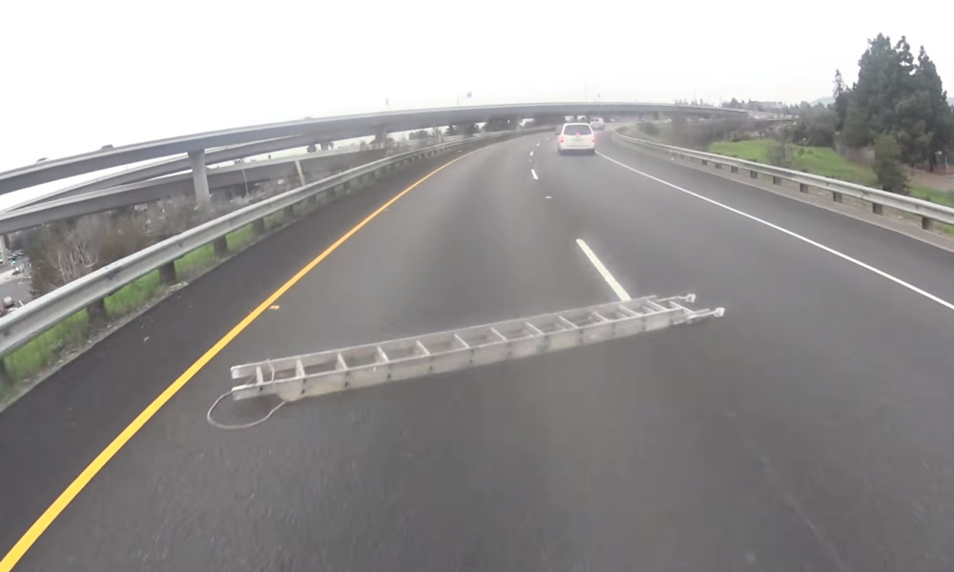
Notes:
There was a blog called “Stuff on the Road” which was nothing except reports of items that had fallen on the road
Common items are ladders, tires, mattresses.

Slide 6
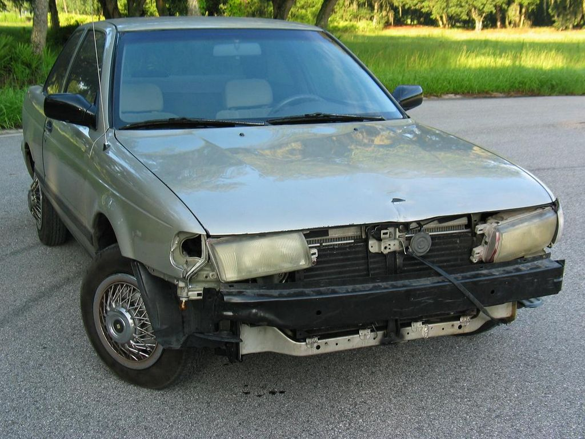
Dropping Things on the Road
Source of Dangers
Carelessly loaded trucks
Reckless driving
Unmaintained vehicles
Notes:
Intentional and malicious actions are rare. While there is the rare story of the cinderblock dropped on the highway, the exceedingly vast majority of road obstacles are unintended

Slide 7
Dropping Things on the Road
Nature of the danger
Those closest hurt worst
Minimal knowledge
Massive damage
Notes:
Most 18 wheelers are unaware when they lost tire tread

Slide 8
Dropping Things on the Road
The Scriptures call such obstacles
“Stumbling Blocks”
Christianity is called The Way
It is a path or road to Heaven
Danger: dropping things on the road

Slide 9
Stumbling Blocks
"Woe to the world because of its stumbling blocks! For it is inevitable that stumbling blocks come; but woe to that man through whom the stumbling block comes!” Matthew 18:7

Slide 10
Stumbling Blocks
He said to His disciples, "It is inevitable that stumbling blocks come, but woe to him through whom they come! It would be better for him if a millstone were hung around his neck and he were thrown into the sea, than that he would cause one of these little ones to stumble.” Luke 17:1-2

Slide 11
Stumbling Blocks
Source of Dangers
Careless communication
- An unbridled tongue
Reckless words
- Speaking with dark motives
Unmaintained behavior
- Not careful in our relationships

Slide 12
Stumbling Blocks
Nature of the danger
Those closest are hurt the worst
Husbands, Wives, Children, Brethren
Minimal knowledge of our harm
Ignorant of the great harm we cause
Massive damage to those around us
Souls are being lost!

Slide 13
Saying the Wrong Thing
It can be easy to say the wrong thing
So why even try? Isn’t silence better?
We are commanded to have communications

Slide 14
Saying the Right Thing
Consider the qualifications of a preacher
2 Timothy 2:22-25
It can be easy to say the RIGHT thing
Follow “Kingdom Rules of Communication”
Notes:
2Ti 2:22 ¶ Now flee from youthful lusts and pursue righteousness, faith, love and peace, with those who call on the Lord from a pure heart. 23 But refuse foolish and ignorant speculations, knowing that they produce quarrels.24 The Lord's bond-servant must not be quarrelsome, but be kind to all, able to teach, patient when wronged,25 with gentleness correcting those who are in opposition, if perhaps God may grant them repentance leading to the knowledge of the truth,

Slide 15
Rule 1 - PURPOSE
All things for edification
Let no unwholesome word proceed from your mouth, but only such a word as is good for edification according to the need of the moment, so that it will give grace to those who hear. Ephesians 4:29

Slide 16
Rule 2 - GENTLENESS
Speak the truth with love
but speaking the truth in love, we are to grow up in all aspects into Him who is the head, even Christ, Ephesians 4:15

Slide 17
Rule 3 - HUMILITY
Put others ahead of yourself
Do nothing from selfishness or empty conceit, but with humility of mind regard one another as more important than yourselves; do not merely look out for your own personal interests, but also for the interests of others. Philippians 2:3-4

Slide 18
Rule 4 - EMPATHY
Speak to others in the way you would want
"In everything, therefore, treat people the same way you want them to treat you, for this is the Law and the Prophets” Matthew 7:12

Slide 19
Rule 5 - DISCERNMENT
Avoid contentious conversations
But avoid worldly and empty chatter, for it will lead to further ungodliness, 2 Timothy 2:16

Slide 20
Rule 6 - FORGIVENESS
Don’t take anything personal
Bearing with one another, and forgiving each other, whoever has a complaint against anyone; just as the Lord forgave you, so also should you. Colossians 3:13
Notes:
Don’t speak contentiously; Coming across as judgmental
Do not speak against one another, brethren. He who speaks against a brother or judges his brother, speaks against the law and judges the law; but if you judge the law, you are not a doer of the law but a judge of it. James 4:11

Slide 21
Rule 7 - PATIENCE
Think about what you want to say
So then, my beloved brethren, let every man be swift to hear, slow to speak, slow to wrath; James 1:19
Notes:
Avoid being hyper critical; listen before speaking; avoid coming across as arrogant
These are grumblers, finding fault, following after their own lusts; they speak arrogantly, flattering people for the sake of gaining an advantage. Jude 1:16

Slide 22
Speaking the Truth in Love
PURPOSE
GENTLENESS
HUMILITY
EMPATHY
DISCERNMENT
FORGIVENESS
PATIENCE
Notes:
PURPOSE - All things for edification
GENTLENESS - Speak the truth with love
HUMILITY - Put others ahead of yourself
EMPATHY - Speak the way you would want
DISCERNMENT: Avoid contentious conversations
FORGIVENESS: Don’t take anything personal
PATIENCE: Think about what you want to say

Slide 23
Value of Communication
Properly expressing ourselves:
Brings the fruit of the Spirit
Satisfies our Father
Reveals Christ in us

Slide 24
What Must I Do To Be Saved?
Hear and believe – John 5:24
Confess Jesus – Romans 10:9
Repentance from sin – Acts 2:38
Baptism into Christ – Mark 16:16
Remain Faithful – Revelation 2:10

