Slide 1
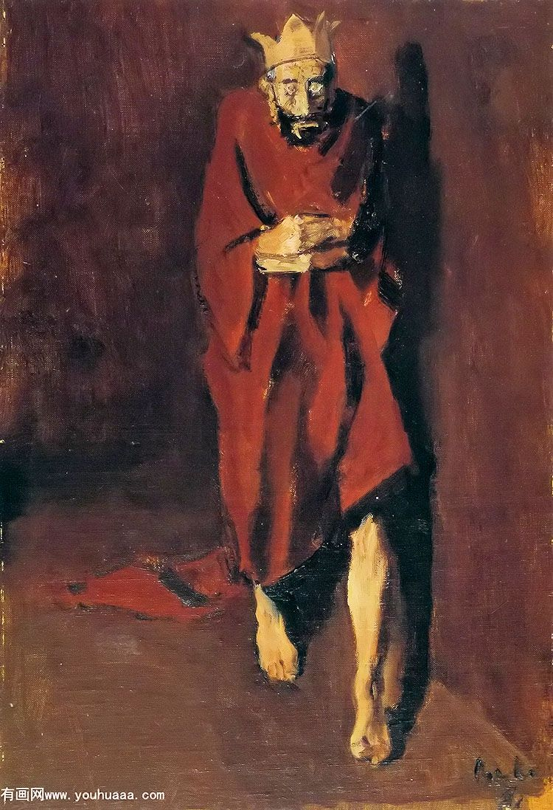
Wisdom
Vs.
Self-Destruction
Notes:
Story of Ben – kept falling over the same tendencies
Corneliu Baba
https://en.wikipedia.org/wiki/Corneliu_Baba

Slide 2
Wisdom’s Opponent
Notes:
Wisdom’s opponent is foolishness; foolishness results in self-destruction

Slide 3
Wisdom’s Opponent
Proverbs 1:32
Proverbs 10:14
Proverbs 13:20
Proverbs 19:13
1 Timothy 6:9
Notes:
Pr 1:32 "For the waywardness of the naive will kill them, And the complacency of fools will destroy them.
Pr 19:13 A foolish son is destruction to his father, And the contentions of a wife are a constant dripping.
1Ti 6:9 But those who want to get rich fall into temptation and a snare and many foolish and harmful desires which plunge men into ruin and destruction

Slide 4
Wisdom’s Opponent
Proverbs 1:32
Proverbs 10:14
Proverbs 13:20
Proverbs 19:13
1 Timothy 6:9
Foolishness
and
Destruction
self
Notes:
Pr 1:32 "For the waywardness of the naive will kill them, And the complacency of fools will destroy them.
Pr 19:13 A foolish son is destruction to his father, And the contentions of a wife are a constant dripping.
1Ti 6:9 But those who want to get rich fall into temptation and a snare and many foolish and harmful desires which plunge men into ruin and destruction

Slide 5
Saul Had It All
He had a son whose name was Saul, a choice and handsome man, and there was not a more handsome person than he among the sons of Israel; from his shoulders and up he was taller than any of the people. 1 Samuel 9:2

Slide 6
Saul Had It All
Saul the Benjaminite was the first King
- He was the most handsome
- He was the tallest of his people
- He was the son of wealthy warriors
From birth he was blessed
Notes:
1 Sam 9:1-3 tell us Saul came from a family of might men of valor who had many possessions

Slide 7
Saul Had It All
"Then the Spirit of the LORD will come upon you mightily, and you shall prophesy with them and be changed into another man. It shall be when these signs come to you, do for yourself what the occasion requires, for God is with you” 1 Samuel 10:6-7

Slide 8
Saul Had It All
Saul the Benjaminite was God’s man
- He was given the Spirit of God
- He was promised success as king
God blessed him over all others
Notes:
1 Sam 9:1-3 tell us saul came from a family of might men of valor who had many possessions

Slide 9
Saul Had It All
Saul put the people in three companies; and they came into the midst of the camp at the morning watch and struck down the Ammonites until the heat of the day. Those who survived were scattered, so that no two of them were left together. 1 Samuel 11:11
Notes:
1 Samuel 11 – when the Ammonites threatened the people of Jabesh Gilead, Saul raised an army by the power of God and defeated them

Slide 10
Saul Had It All
Now when Saul had taken the kingdom over Israel, he fought against all his enemies on every side, against Moab, the sons of Ammon, Edom, the kings of Zobah, and the Philistines; and wherever he turned, he inflicted punishment. 1 Samuel 14:47
Notes:
1 Samuel 14:48 He acted valiantly and defeated the Amalekites, and delivered Israel from the hands of those who plundered them.

Slide 11
Saul Had It All
Saul the Benjaminite overcame enemies
- He raised a national army
- He defeated all of his enemies
Saul was a mighty warrior leader
Notes:
1 Samuel 14:48 He acted valiantly and defeated the Amalekites, and delivered Israel from the hands of those who plundered them.

Slide 12
Saul Had It All
So all the people went to Gilgal, and there they made Saul king before the LORD in Gilgal. There they also offered sacrifices of peace offerings before the LORD; and there Saul and all the men of Israel rejoiced greatly. 1 Samuel 11:15
Notes:
1 Samuel 11 – when the Ammonites threatened the people of Jabesh Gilead, Saul raised an army by the power of God and defeated them

Slide 13
Saul Had It All
Saul the Benjaminite was a loved king
- Israel rejoiced in his kingship
- He was king by the people’s choice
Saul enjoyed the support of all the people
Notes:
1 Sam 9:1-3 tell us saul came from a family of might men of valor who had many possessions

Slide 14
Saul Had It All
Saul the Benjaminite had everything
Good looks and standing
God was with him
The Spirit of God in him
Victory after victory
The support of all of the people
Notes:
1 Sam 9:1-3 tell us saul came from a family of might men of valor who had many possessions

Slide 15
The Fall of Saul
1 Samuel 13:11-13
Saul offered an unauthorized sacrifice
He blamed Samuel and the people
He was told this condemned him
Notes:
1Sa 13:11 But Samuel said, "What have you done?" And Saul said, "Because I saw that the people were scattering from me, and that you did not come within the appointed days, and that the Philistines were assembling at Michmash,
12 therefore I said, 'Now the Philistines will come down against me at Gilgal, and I have not asked the favor of the LORD.' So I forced myself and offered the burnt offering."
13 Samuel said to Saul, "You have acted foolishly; you have not kept the commandment of the LORD your God, which He commanded you, for now the LORD would have established your kingdom over Israel forever.

Slide 16
The Fall of Saul
1 Samuel 13:11-13
1 Samuel 15:15-23
Saul did not obey God’s instructions
Saul blamed the people
God revoked Saul’s kingship
Notes:
1Sa 15:15 Saul said, "They have brought them from the Amalekites, for the people spared the best of the sheep and oxen, to sacrifice to the LORD your God; but the rest we have utterly destroyed." 16 Then Samuel said to Saul, "Wait, and let me tell you what the LORD said to me last night." And he said to him, "Speak!" 17 Samuel said, "Is it not true, though you were little in your own eyes, you were made the head of the tribes of Israel? And the LORD anointed you king over Israel, 18 and the LORD sent you on a mission, and said, 'Go and utterly destroy the sinners, the Amalekites, and fight against them until they are exterminated.' 19 "Why then did you not obey the voice of the LORD, but rushed upon the spoil and did what was evil in the sight of the LORD?" 20 Then Saul said to Samuel, "I did obey the voice of the LORD, and went on the mission on which the LORD sent me, and have brought back Agag the king of Amalek, and have utterly destroyed the Amalekites. 21 "But the people took some of the spoil, sheep and oxen, the choicest of the things devoted to destruction, to sacrifice to the LORD your God at Gilgal.“ 22 Samuel said, "Has the LORD as much delight in burnt offerings and sacrifices As in obeying the voice of the LORD? Behold, to obey is better than sacrifice, And to heed than the fat of rams. For rebellion is as the sin of divination, And insubordination is as iniquity and idolatry. Because you have rejected the word of the LORD, He has also rejected you from being king."

Slide 17
The Fall of Saul
1 Samuel 13:11-13
1 Samuel 15:15-23
1 Samuel 18:6-12
Saul began to become unhinged
He became paranoid of David
He tried to murder David
Notes:
1Sa 18:6 ¶ It happened as they were coming, when David returned from killing the Philistine, that the women came out of all the cities of Israel, singing and dancing, to meet King Saul, with tambourines, with joy and with musical instruments. 7 The women sang as they played, and said, "Saul has slain his thousands, And David his ten thousands." 8 Then Saul became very angry, for this saying displeased him; and he said, "They have ascribed to David ten thousands, but to me they have ascribed thousands. Now what more can he have but the kingdom?" 9 Saul looked at David with suspicion from that day on. 10 Now it came about on the next day that an evil spirit from God came mightily upon Saul, and he raved in the midst of the house, while David was playing the harp with his hand, as usual; and a spear was in Saul's hand. 11 Saul hurled the spear for he thought, "I will pin David to the wall." But David escaped from his presence twice. 12 ¶ Now Saul was afraid of David, for the LORD was with him but had departed from Saul.

Slide 18
The Fall of Saul
1 Samuel 13:11-13
1 Samuel 15:15-23
1 Samuel 18:6-12
1 Samuel 22:17-22
Saul ordered the murder of the priests
Saul used Doeg the Edomite to do this
Notes:
1Sa 18:6 ¶ It happened as they were coming, when David returned from killing the Philistine, that the women came out of all the cities of Israel, singing and dancing, to meet King Saul, with tambourines, with joy and with musical instruments. 7 The women sang as they played, and said, "Saul has slain his thousands, And David his ten thousands." 8 Then Saul became very angry, for this saying displeased him; and he said, "They have ascribed to David ten thousands, but to me they have ascribed thousands. Now what more can he have but the kingdom?" 9 Saul looked at David with suspicion from that day on. 10 Now it came about on the next day that an evil spirit from God came mightily upon Saul, and he raved in the midst of the house, while David was playing the harp with his hand, as usual; and a spear was in Saul's hand. 11 Saul hurled the spear for he thought, "I will pin David to the wall." But David escaped from his presence twice. 12 ¶ Now Saul was afraid of David, for the LORD was with him but had departed from Saul.

Slide 19
The Fall of Saul
1 Samuel 13:11-13
1 Samuel 15:15-23
1 Samuel 18:6-12
1 Samuel 22:17-22
1 Samuel 31:4
Saul takes his life after being wounded
Notes:
1Sa 31:4 Then Saul said to his armor bearer, "Draw your sword and pierce me through with it, otherwise these uncircumcised will come and pierce me through and make sport of me." But his armor bearer would not, for he was greatly afraid. So Saul took his sword and fell on it.

Slide 20
Saul’s Self-Destruction
Pride
Disobedience
Envy
Paranoia
Sadistic hatred
Total self-destruction
Notes:
Saul’s slide to total self destruction is well documented in the Scriptures

Slide 21
The Story of Self Destruction
Adam and Eve in the Garden
David in his kingdom
Solomon in his kingdom
Hezekiah and the Babylonians
An oft repeated story: destruction of paradise

Slide 22
Why Are WE Self Destructive?
The deception of worldliness
Mark 4:19, 1 John 2:15-16
The absence of the love of God
The absence of love for ourselves
The absence of love for others
Notes:
1Jo 2:15 Do not love the world nor the things in the world. If anyone loves the world, the love of the Father is not in him. 16 For all that is in the world, the lust of the flesh and the lust of the eyes and the boastful pride of life, is not from the Father, but is from the world.
Mr 4:19 but the worries of the world, and the deceitfulness of riches, and the desires for other things enter in and choke the word, and it becomes unfruitful.

Slide 23
Why Are WE Self Destructive?
The deception of worldliness
Mark 4:19, 1 John 2:15-16
Lust of the flesh
Lust of the eyes
Pride of life
Notes:
1Jo 2:15 Do not love the world nor the things in the world. If anyone loves the world, the love of the Father is not in him. 16 For all that is in the world, the lust of the flesh and the lust of the eyes and the boastful pride of life, is not from the Father, but is from the world.
Mr 4:19 but the worries of the world, and the deceitfulness of riches, and the desires for other things enter in and choke the word, and it becomes unfruitful.
Saul lost it all when his pride of life took control; Eve was tempted by all three; David lost it to the lust of the flesh;

Slide 24
Why Are WE Self Destructive?
The deception of worldliness
The absence of contentment
I Timothy 6:6-11
Desire for more makes for ruin
Pierced themselves with grief
Notes:
1Ti 6:6 ¶ But godliness actually is a means of great gain when accompanied by contentment. 7 For we have brought nothing into the world, so we cannot take anything out of it either. 8 If we have food and covering, with these we shall be content. 9 But those who want to get rich fall into temptation and a snare and many foolish and harmful desires which plunge men into ruin and destruction. 10 For the love of money is a root of all sorts of evil, and some by longing for it have wandered away from the faith and pierced themselves with many griefs. 11 But flee from these things, you man of God, and pursue righteousness, godliness, faith, love, perseverance and gentleness.

Slide 25
The Point of the Message
As A Christian YOU HAVE IT ALL!
The Spirit of God with you
The Heavenly Father’s eye on you
The Son’s intercession for you
An indescribable inheritance
Notes:
1Ti 6:6 ¶ But godliness actually is a means of great gain when accompanied by contentment. 7 For we have brought nothing into the world, so we cannot take anything out of it either. 8 If we have food and covering, with these we shall be content. 9 But those who want to get rich fall into temptation and a snare and many foolish and harmful desires which plunge men into ruin and destruction. 10 For the love of money is a root of all sorts of evil, and some by longing for it have wandered away from the faith and pierced themselves with many griefs. 11 But flee from these things, you man of God, and pursue righteousness, godliness, faith, love, perseverance and gentleness.

Slide 26
The Point of the Message
As A Christian YOU HAVE IT ALL!
Don’t fall into the trap of self destruction

Slide 27
Avoid the Trap!
1. Do the things that are best for you
2. Don’t live for self-satisfaction
3. Don’t be a victim
4. Manifest a love for God and others
5. Don’t seek worldly attention
6. Learn to be content in all things

Slide 28
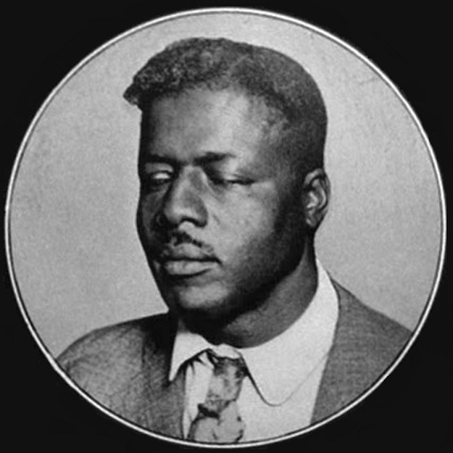
Nobody’s Fault But Mine
Father he taught me how to read
I have a bible in my home
If I don’t save my soul well,
nobody’s fault but mine
Notes:
Lyrics to “Nobodys fault but mine” by Blind Willie Johnson

Slide 29
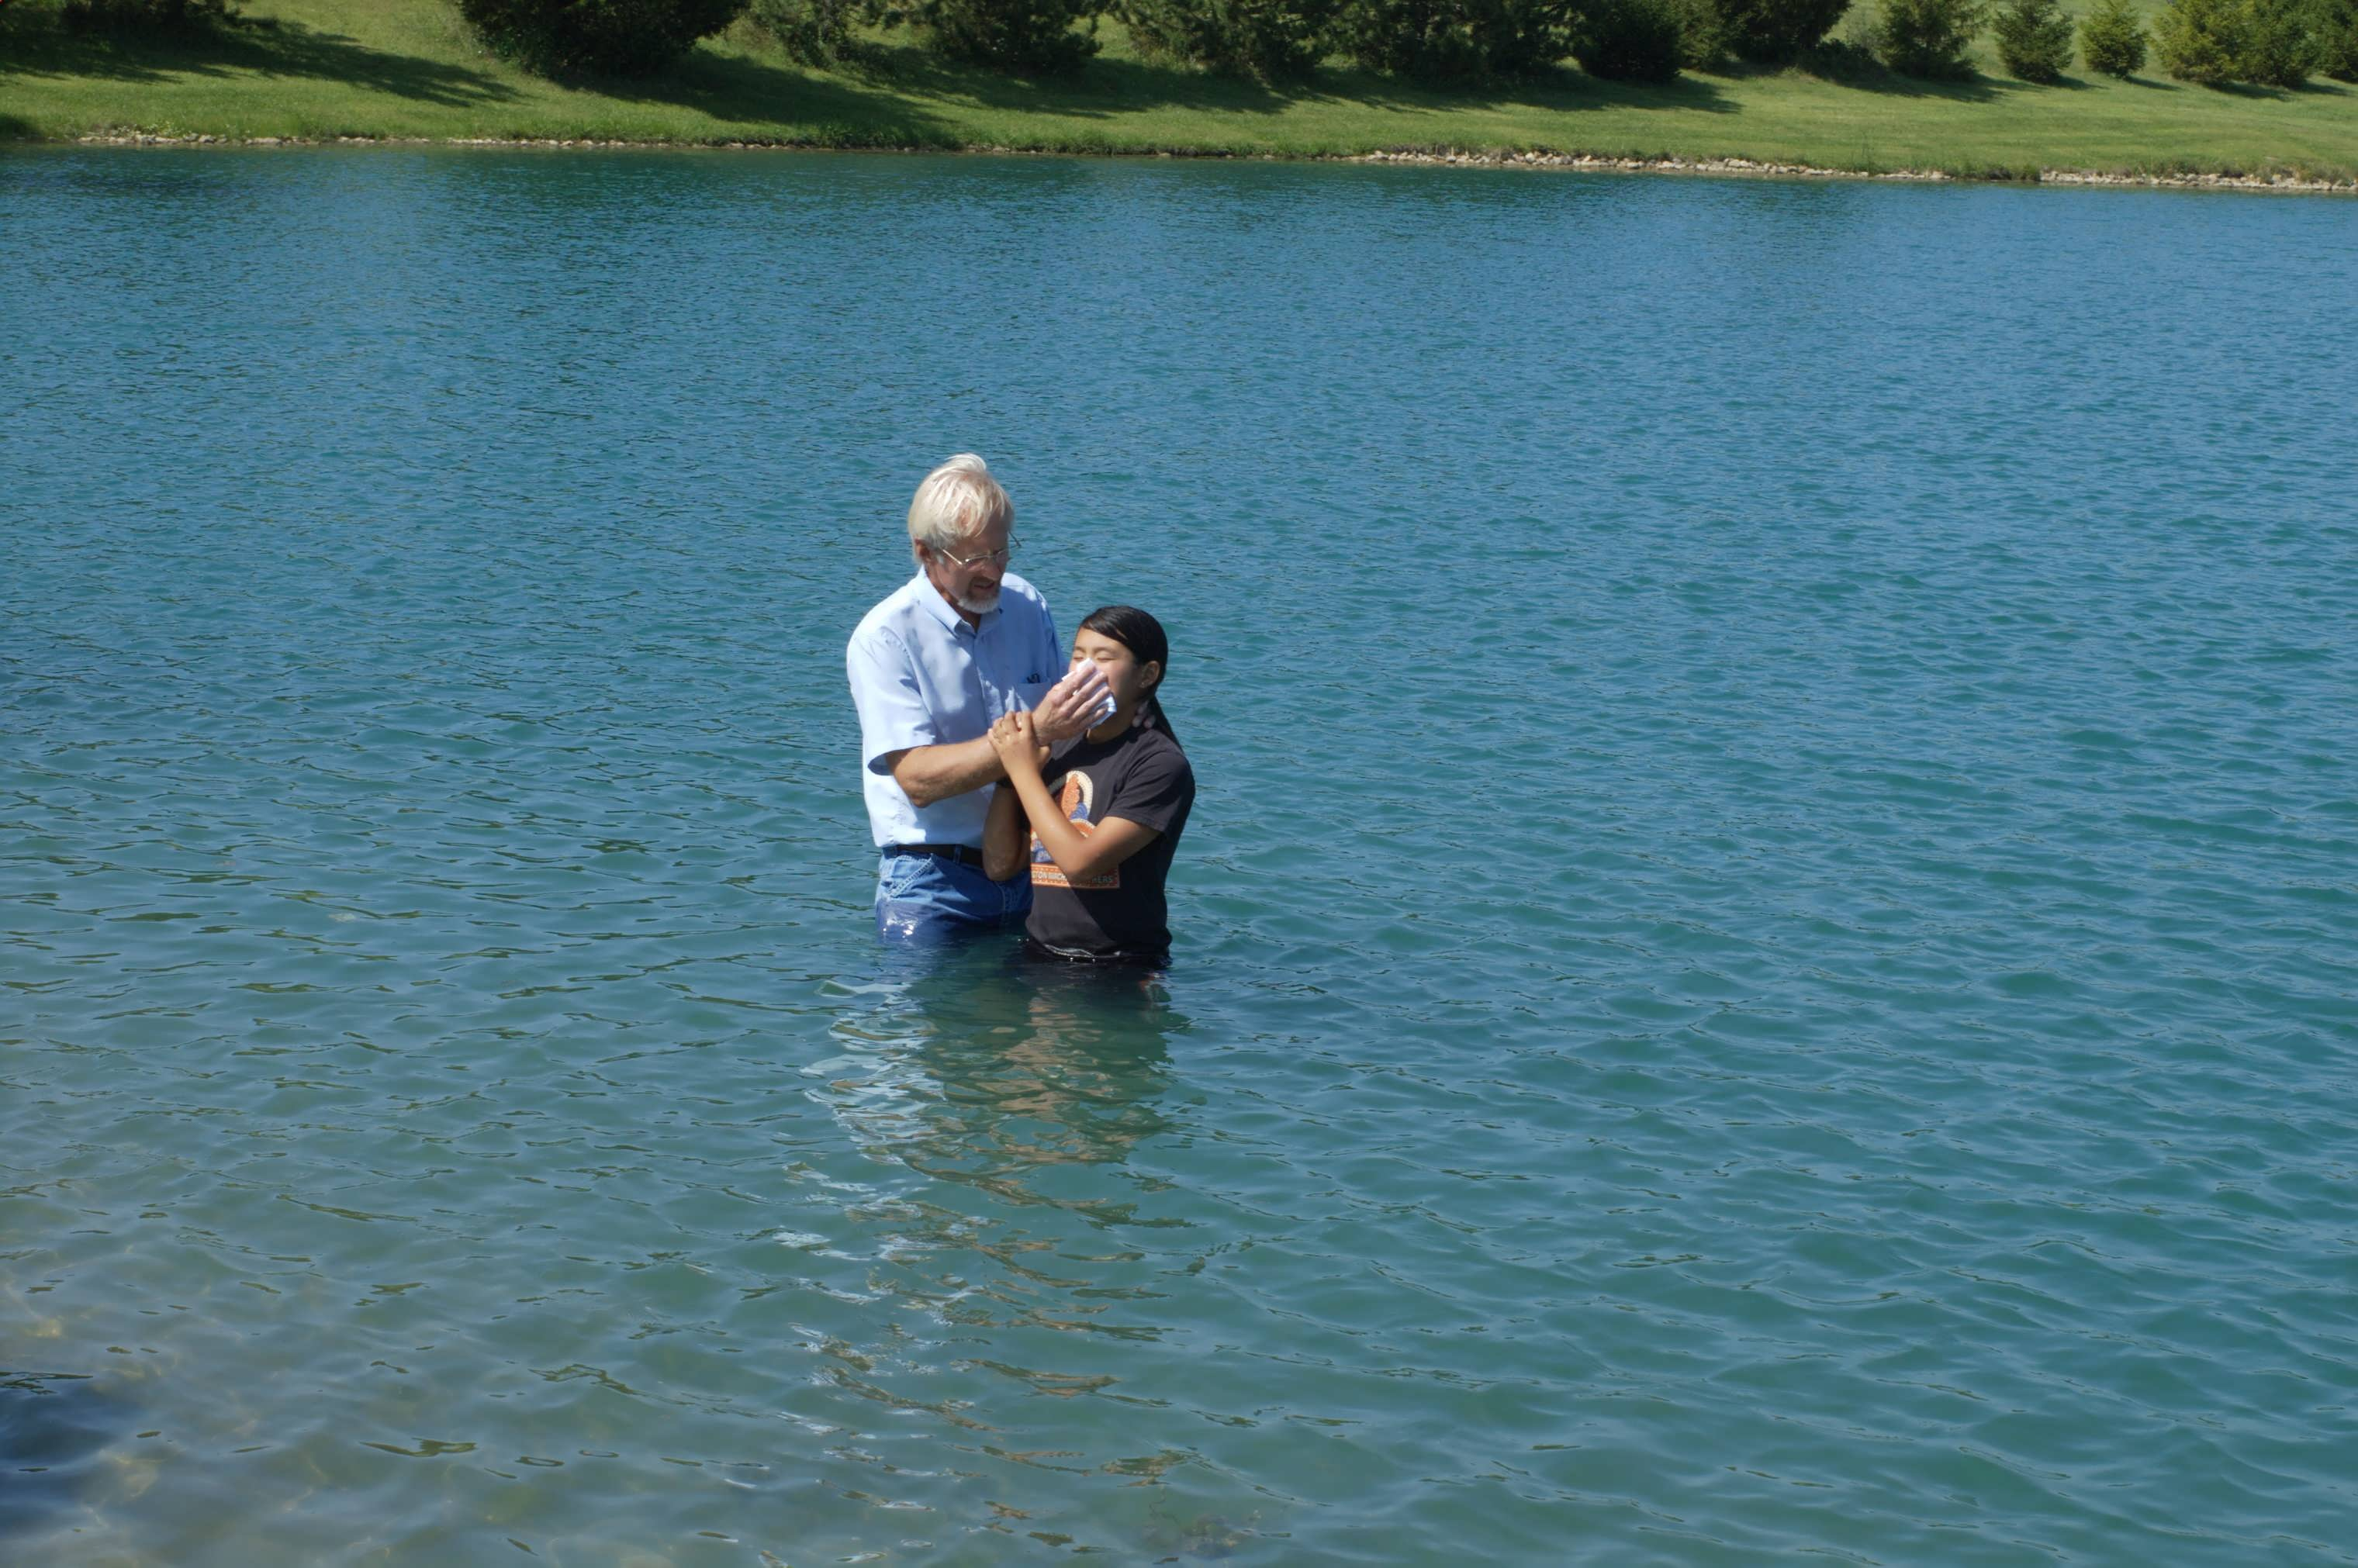
“Work out your own salvation with fear and trembling” – Philippians 2:12b
By Believing – Acts 16:31
By Confessing – Acts 8:37
By Repenting – Acts 2:38
By Being Baptized – Acts 22:16

