Slide 1
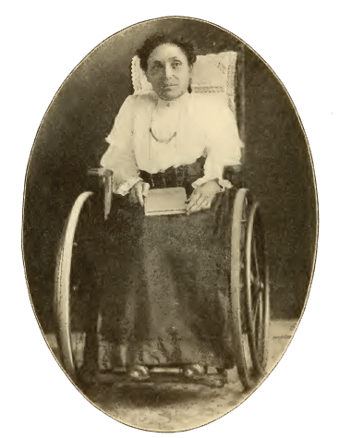
Jennie B. Wilson
Mary Jane (Jennie) Bain Wilson, was born Cleveland, IN, 1857.
Father, Robert died when she was an infant.
At four, spinal illness left her in bed, or a wheelchair for her 56 year life.
Unable to attend school, at home she learned a love of music and poetry.

Slide 2
Jennie B. Wilson
At 24 was baptized, being carried on a chair to a stream.
Wrote about 2200 poems and hymns.
Since 1940, 21 hymnals by members of churches of Christ include “Hold to God’s Unchanging Hand.”

Slide 3
Jennie B. Wilson
Likely penned in 1904, when she sent it to Franklin Eiland.
1905 he conceived tune while sitting in backyard of his Texas home.
Published in 1906 in the New Hosannas hymnal (Quartet Music Company of Fort Worth, TX, ed. John E. Thomas).

Slide 4
Jennie B. Wilson
“A paraphrase of how she felt about her life up until that point”
David Cain

Slide 5
“Hold to God’s Unchanging Hand” By Jennie B. Wilson
Time is filled with swift transition,
Naught of earth unmoved can stand,
Build your hopes on things eternal,
Hold to God’s unchanging hand.

Slide 6
“Hold to God’s Unchanging Hand” By Jennie B. Wilson
Trust in Him who will not leave you,
Whatsoever years may bring,
If by earthly friends forsaken
Still more closely to Him cling.

Slide 7
“Hold to God’s Unchanging Hand” By Jennie B. Wilson
When your journey is completed,
If to God you have been true,
Fair and bright the home in glory
Your enraptured soul will view.

Slide 8
“Hold to God’s Unchanging Hand” By Jennie B. Wilson
Chorus:
Hold to God’s unchanging hand,
Hold to God’s unchanging hand;
Build your hopes on things eternal,
Hold to God’s unchanging hand.

Slide 9
Holding onto “God’s Unchanging Hand”
Life was never intended to be lived alone
Genesis. 2:18b
Ecclesiastes 4:9
Acts 17:26-27
Jeremiah 10:23

Slide 10
Holding onto “God’s Unchanging Hand”
Some challenging choices
1 Kings 11:4
Proverbs 24:1-2
Ezekiel 13:3
Philippians 3:18-19

Slide 11
Where can we turn for companionship that is truly helpful?

Slide 12
How can we reach out to God in the assurance that we are actually taking hold of His hand of guidance?

Slide 13
Holding onto “God’s Unchanging Hand”
The word of God in Scripture
Psalm 119:133
2 Timothy 3:16-17
“Direct”
Profitable for “every good work”

Slide 14
Holding onto “God’s Unchanging Hand”
Those who allow their lives to be governed by what God teaches
Those of common faith can strengthen us toward the goal of eternal life.
These are the relationships we should seek.
These are the companions that will prove to be truly helpful to our souls.

Slide 15
Holding onto “God’s Unchanging Hand”
Following God, through the guidance and revelation of His word is how we “hold” His hand.
Isaiah 41:10
Isaiah 41:13

