Slide 2
Pilate underestimated the hatred of the Jewish leadership toward Jesus (Matthew 27:21-23).
He believed in the innocence of Jesus (Luke 23:14-15).
He even sent Jesus to Herod to escape the situation (Luke 23:6-12).
Pilate desired to release Jesus (Luke 23:20; John 19:12).

Slide 3
“When Pilate saw that he was accomplishing nothing, but rather a riot was starting, he took water and washed his hands in front of the crowd, saying, ‘I am innocent of this man’s blood; see to it yourselves.’ And all the people said, ‘His blood be on us and on our children’”
(Matthew 27:20-25).

Slide 4
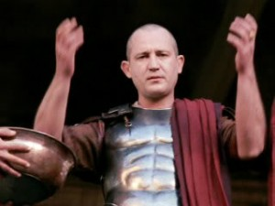
Perhaps, Pilate was using a familiar Jewish ceremony to claim innocence (Deut. 21:1-9).
The fact was, however, that the ceremony did not apply to Pilate.
He did know the merits of the case and was still guilty of consenting to the Jewish mob in the murder of Christ (Acts 2:22-24).

Slide 5
We Must Make A Choice About The Claims of Jesus
Divine King (John 18:36-37; cf. Matt. 3:16-17).
True Messiah (John 18:32).
Witness to the Truth (John 18:36-38).
Son of God (John 19:7; cf. Luke 23:35; Matthew 1:23).
There is no room biblically to consider Jesus as merely a good teacher, only a man, a social reformer, or one of many ways!

Slide 6
We Must Make A Choice About The Claims of Jesus
    “Now, therefore fear the Lord and serve Him in sincerity and truth; and put away the gods which your fathers served beyond the River and in Egypt, and serve the Lord. If it is disagreeable in your sight to serve the Lord, choose for yourselves today whom you will serve…but as for me and my house we will serve the Lord”
    (Joshua 24:14-16).

Slide 7
We Must Make A Choice About The Claims of Jesus
    “Elijah came near to all the people and said, ‘How long will you hesitate between two opinions? If the Lord be God follow Him; but if Baal follow Him’”
    (I Kings 18:21).

Slide 8
We Must Make A Choice About The Claims of Jesus
    “No one can serve two masters; for either he will hate the one and love the other, or he will be devoted to one and despise the other. You cannot serve God and wealth.”
    (Matthew 6:24)

Slide 9
We Must Make A Choice About The Claims of Jesus
    “He who is not with me is against me; and he who does not gather with me scatters.”
    (Matthew 12:30)

Slide 10
We Must Make A Choice About The Claims of Jesus
    “I am the way, the truth, and the life; no man comes to the Father but through Me.”
    (John 14:6)

Slide 11
We Must Make A Choice About The Confession of the Gospel
The gospel is the power of God to salvation (Romans 1:16).
In order for the gospel to save our souls we must obey it (Mark 16:15-16; Romans 1:5; 6:16,17; 16:26).
We must place our absolute trust in Jesus Christ as Lord (Heb. 11:6; John 3:16).

Slide 12
We Must Make A Choice About The Confession of the Gospel
We must express our allegiance to Jesus as the resurrected Redeemer (Matthew 10:32,33; Romans 10:9-10).
We must surrender to Christ in baptism for the forgiveness of our sins (Acts 2:38; Romans 6:3, 4; Gal. 3:26-27; Col. 2:11-13; I Peter 3:21).
To refuse to make a choice – is to make a choice!

Slide 13
We Must Make A Choice About Commitment To the Holiness of Christ
The call of the repentance of the Kingdom (Matt. 5:27-30).
The value of the soul (Matthew 16:24-27).
The blessing of fellowship with God (2 Cor. 6:14-18).

Slide 14

We Must Make A Choice About Commitment To the Holiness of Christ
Our active role in discipleship (Romans 6:11-13; 2 Cor. 7:1).
Embracing the pilgrimage (I Pet. 1:13-18).

Slide 15
We Must Make A Choice About The Coronation or Crucifixion of Jesus In Our Lives
We must remove “self” from the throne of our lives and coronate Jesus as the King of our heart (Matt. 16:24; Galatians 2:20; Romans 6:3-7).
We can shame and crucify Jesus all over again in our lives (Heb. 6:4-6; 10:26-31).
Or we can coronate Jesus as the King of our lives (Acts 2:36-38; Colossians 3:1,2; Eph. 1:22-23; Phil. 2:9-11).

Slide 16
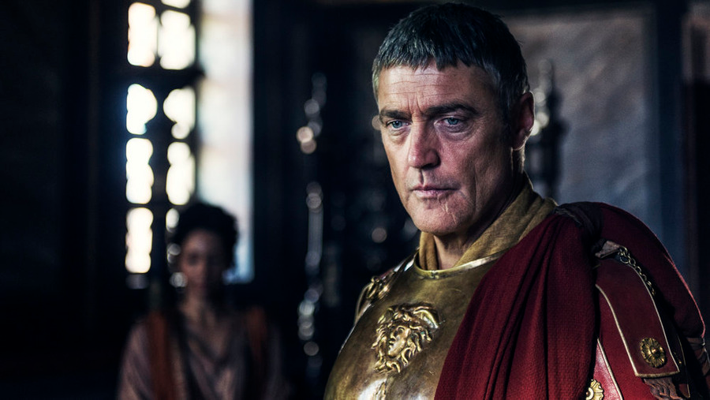
Our Choice!
It Is Decision Time!
What Choice Will You Make?
Pilate Could Not Be Neutral and Neither Can We!

