Slide 1
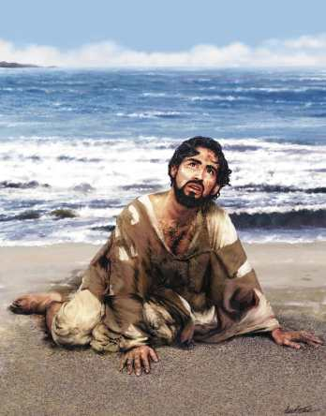
Jonah 1:1-3
Flight From Duty
Jonah and his duty
The Christian’s duty
The truth regarding duty
Life is not pleasure nor popularity, but purpose – life is duty!
Richie Thetford www.thetfordcountry.com

Slide 2
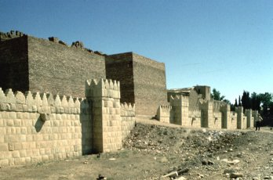
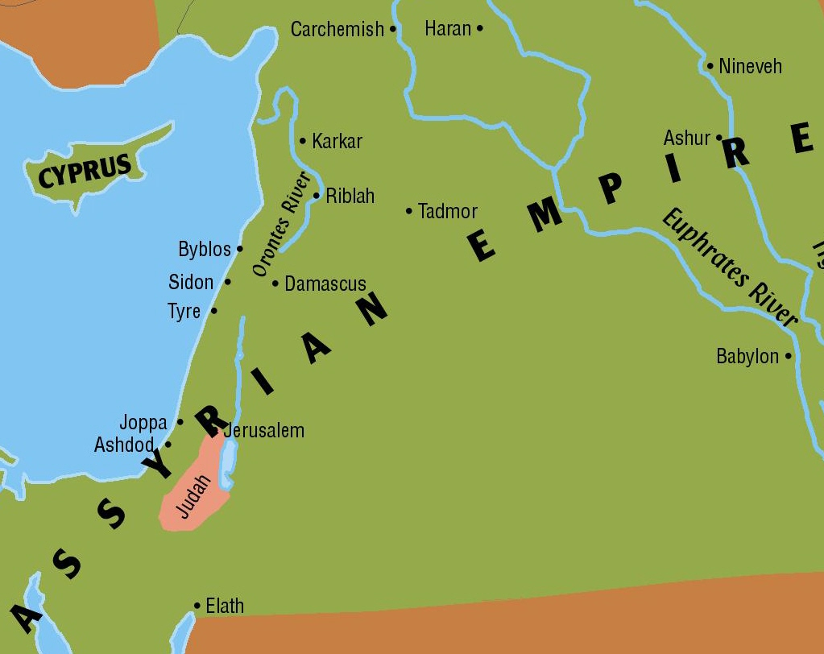
Jonah and His Duty
“Arise, go to Nineveh, that great city, and cry out against it;
for their wickedness has come up before Me.” Jonah 1:2
His duty was clear
  Command
His duty was disagreeable
His duty was evaded
  Tarshish
  Circumstances
Tarshish
Spain?
550 Miles
2,500 miles
Richie Thetford www.thetfordcountry.com

Slide 3


The Christian’s Duty
“So likewise you, when you have done all those things which
you are commanded, say, ‘We are unprofitable servants.
We have done what was our duty to do.” Luke 17:10
Life of duty and service
  Luke 17:10
  Romans 15:27
  Our duties found on
  every page of the Bible
Richie Thetford www.thetfordcountry.com

Slide 4

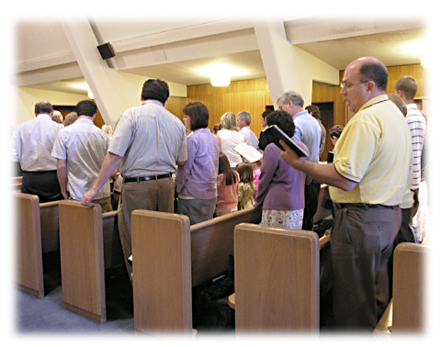
The Christian’s Duty
Love one another
  1 Corinthians 13:1-13
  1 John 4:11, 20
  John 13:34
Worship
  John 4:24
  Hebrews 10:25
  1 Corinthians 16:1-2
Examples of duty and application
of the lesson
Richie Thetford www.thetfordcountry.com

Slide 5

The Christian’s Duty
Personal Evangelism
  Acts 20:20
  Ezekiel 33:8
Growth and
Development
  Hebrews 5:12-14
  2 Timothy 2:15
  Hebrews 6:1
Examples of duty and application
of the lesson
Richie Thetford www.thetfordcountry.com

Slide 6

The Christian’s Duty
Benevolence
  James 1:27
  Galatians 6:10
  Titus 3:1
Examples of duty and application
of the lesson
Richie Thetford www.thetfordcountry.com

Slide 7



The Truth Regarding Duty
Duty is inescapable
  Once under duty – no escape
Duty is non-transferable
  Christianity is personal
Duty is revealing
  Love; Character; Destiny
Richie Thetford www.thetfordcountry.com

Slide 8

“So likewise you, when you have
done all those
things which you
are commanded, say, ‘We are unprofitable servants. We have done what was
our duty to do.”
Luke 17:10
Life Is Duty
Richie Thetford www.thetfordcountry.com

