Slide 1
1 Peter 2:1-3
“Therefore, laying aside all malice, all deceit, hypocrisy, envy, and all evil speaking, as newborn babes, desire the pure milk of the word, that you may grow thereby, if indeed you have tasted that the Lord is gracious” (NKJV).

Slide 2
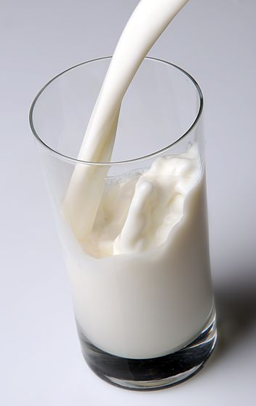

“Desire the Pure Milk of the Word”
“Milk” symbolizes innocence
Before the rise of lactose intolerance, milk was the drink of children—whether a nursing child, or preteen.
Sometimes a figure of immaturity (Heb. 5:12-15)
That is not Peter’s emphasis.

Slide 3
“Desire the Pure Milk of the Word”
“As newborn babes”
Not a negative quality
“Desire the pure milk of the word”
This is the focus—our attitude towards God’s word

Slide 4
“Desire the Pure Milk of the Word”
Why?
“That you may grow thereby”
This is what will help us put aside…
“malice, all deceit, hypocrisy, envy, and all evil speaking”

Slide 5
“Desire the Pure Milk of the Word”
Could your attitude toward God’s word be described as
“Desire”
Let’s consider what this means and how it will look in our lives

Slide 6
“Desire the Pure Milk of the Word”
Things We Desire Are Important to Us.
  Romance
  Competition
  Hobby
  Possession
  Career

Slide 7
“Desire the Pure Milk of the Word”
Things We Desire Are Important to Us.
  Is God’s word important to you? (Acts 10:30-33)
  Anxious to hear it
  Ready to apply it

Slide 8
“Desire the Pure Milk of the Word”
We Talk about Things We Desire.
New Car
New Gadget
New Opportunity

Slide 9
“Desire the Pure Milk of the Word”
We Talk about Things We Desire.
Do you tell others about God’s word? (John 1:38-41, 43-45)
When mocked?
When Persecuted?

Slide 10
“Desire the Pure Milk of the Word”
We Make Time for Things We Desire.
When dating
Stand in line
Get up early—stay up late

Slide 11
“Desire the Pure Milk of the Word”
We Make Time for Things We Desire.
Do you make time for God’s word? (Acts 20:27)
Regular times
Gospel Meetings
Home studies

Slide 12
“Desire the Pure Milk of the Word”
We Learn about Things We Desire.
  College degree
  User manual
  Magazines
  Personal development

Slide 13
“Desire the Pure Milk of the Word”
We Learn about Things We Desire.
  Do you seek to learn more about God’s word? (Acts 17:10-12)
  “Oh, I know that!”
  Really?

Slide 14
“Desire the Pure Milk of the Word”
We Make Changes for Things We Desire.
  Lose weight
  Get in shape
  Change habits
  Change behavior

Slide 15
“Desire the Pure Milk of the Word”
We Make Changes for Things We Desire.
  Do you allow God’s word to change you? (Jas. 1:23-25; Acts 19:18-20)
  “That’s too much!”
  “That’s legalistic!”

Slide 16
“Desire the Pure Milk of the Word”
What Does It Indicate If We Do Not “Desire” the Word?
“…if indeed you have tasted that the Lord is gracious” (1 Pet. 2:3b)
Do You Truly Appreciate the graciousness of God?
1 Corinthians 15:10

