Slide 1
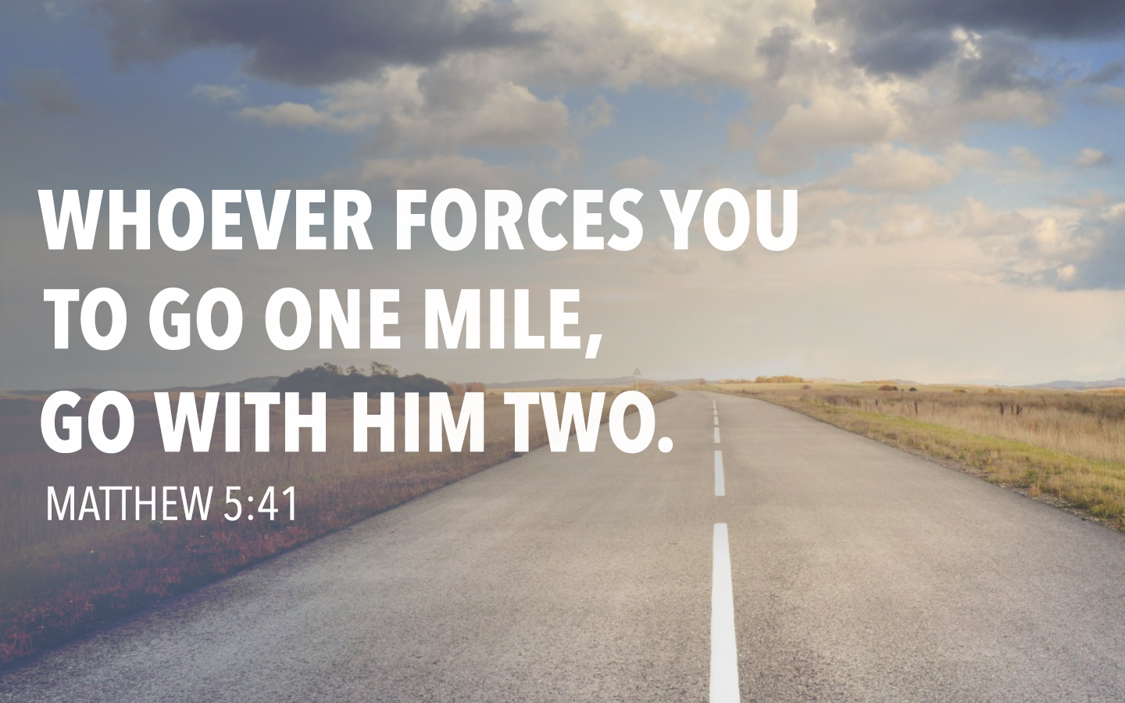

Slide 2
The Context of Jesus’ Command
Key Text: Matthew 5:38-48
In Personal Injury—Meekness (38-39)
In Property Loss—Generosity (40-42)
In Personal Liberties—Kindness (43-48)
Disciples of Christ may need to forfeit personal rights to advance the cause of Christ.

Slide 3
What’s Unique about Jesus’ Command to Go the Second Mile?
“Whoever” vs. Roman Law
  Christians serve a broader range of people than simply the soldiers of Rome (Mark 9:356).
“Compels You” vs. Going for God
  We know our true Master. (Col. 3:23)
“Go with him two” vs. Resisting
  You will be twice as inconvenienced by going twice as far (2 Cor. 8:1-5).

Slide 4
Traveling the Second Mile
Exhibits a Christian’s Unique Nature.
  Helpfulness, Freedom, Love for Our Neighbors
Provides More Than Was Expected.
Creates a New Mindset in Christians.
  Helps Us Learn Not to Count the Small Troubles of Life a Burden.

Slide 5
Jesus Shows Us a Second Mile Mindset
We Can Go the Second Mile in Prayer
  Pray for those who mistreat us (Matt. 5:44).
We Can Go the Second Mile in God’s Steps
  God does good to just and unjust (Matt. 5:45).
We Can Go the Second Mile in Love
  Don’t just love those who love us (Matt. 5:46).
We Can Go the Second Mile in Kindness
  Greet even those who don’t greet us (Matt. 5:47).

Slide 6
The Power of One Person
Going the Second Mile
One Person with a Second Mile Mindset Will Change Their Surroundings for the Better.
• Acts 9:36-43 • Philippians 1:12-14
I’ll Go The Second Mile by…
  In the home
  In the workplace
  In the church

Slide 7
Ways We Can Go the Second Mile
Share a Meal or Activity with Someone New.
Help Someone without Being Asked.
Volunteer to Help with Some New Work.
Host or Teach a Home Bible Study.
Ask a New Member to Work with You.
Invite Someone to Worship or Study the Bible with You.

