Slide 1
With a Whole Heart
Lessons from King Amaziah

Slide 3
King Amaziah
Not with a whole heart.
¹ Amaziah was twenty-five years old when he became king, and he reigned twenty-nine years in Jerusalem. And his mother’s name was Jehoaddan of Jerusalem. ² He did right in the sight of the Lord, yet not with a whole heart. (2 Chronicles 25:1-2)
Amaziah was a just king.
³ Now it came about as soon as the kingdom was firmly in his grasp, that he killed his servants who had slain his father the king. ⁴ However, he did not put their children to death, but did as it is written in the law in the book of Moses, which the Lord commanded, saying, “Fathers shall not be put to death for sons, nor sons be put to death for fathers, but each shall be put to death for his own sin.” (2 Chronicles 25:3-4)

Slide 4
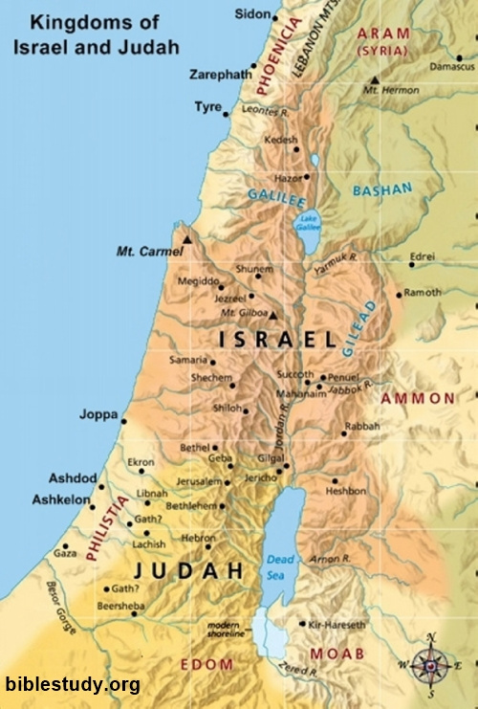
King Amaziah

Slide 5
King Amaziah
“He did right in the sight of the Lord,
yet not with a whole heart.”

Slide 6
With a Whole Heart
As water reflects the face, so one’s life reflects the heart. (Proverbs 27:19)
Above all else, guard your heart, for everything you do flows from it.(Proverbs 4:23)
“Blessed are the pure in heart, for they shall see God. (Matthew 5:8)
One of the scribes came and heard them arguing, and recognizing that He had answered them well, asked Him, “What commandment is the foremost of all?” ²⁹ Jesus answered, “The foremost is, ‘Hear, O Israel! The Lord our God is one Lord; ³⁰ and you shall love the Lord your God with all your heart, and with all your soul, and with all your mind, and with all your strength.’ ³¹ The second is this, ‘You shall love your neighbor as yourself.’ There is no other commandment greater than these.” (Mark 12:28-31)

Slide 7
With a Whole Heart
In Prayer
⁶ Be anxious for nothing, but in everything by prayer and supplication with thanksgiving let your requests be made known to God. ⁷ And the peace of God, which surpasses all comprehension, will guard your hearts and your minds in Christ Jesus. (Philippians 4:6-7)
¹⁴ This is the confidence which we have before Him, that, if we ask anything according to His will, He hears us. ¹⁵ And if we know that He hears us in whatever we ask, we know that we have the requests which we have asked from Him. (1 John 5:14-15)
Therefore, confess your sins to one another, and pray for one another so that you may be healed. The effective prayer of a righteous man can accomplish much. (James 5:16)

Slide 8
With a Whole Heart
In Study
For the word of God is living and active and sharper than any two-edged sword, and piercing as far as the division of soul and spirit, of both joints and marrow, and able to judge the thoughts and intentions of the heart. (Hebrews 4:12)
¹⁶ All Scripture is inspired by God and profitable for teaching, for reproof, for correction, for training in righteousness; ¹⁷ so that the man of God may be adequate, equipped for every good work. (2 Timothy 3:16-17)
Be diligent to present yourself approved to God as a workman who does not need to be ashamed, accurately handling the word of truth. (2 Timothy 2:15)

Slide 9
With a Whole Heart
In Action
¹⁴ What use is it, my brethren, if someone says he has faith but he has no works? Can that faith save him? ¹⁵ If a brother or sister is without clothing and in need of daily food, ¹⁶ and one of you says to them, “Go in peace, be warmed and be filled,” and yet you do not give them what is necessary for their body, what use is that? ¹⁷ Even so faith, if it has no works, is dead, being by itself. (James 2:14-17)
²³ Whatever you do, do your work heartily, as for the Lord rather than for men, ²⁴ knowing that from the Lord you will receive the reward of the inheritance. It is the Lord Christ whom you serve. (Colossians 3:23-24)

Slide 10
With a Whole Heart
In Turning From Sin.
No temptation has overtaken you but such as is common to man; and God is faithful, who will not allow you to be tempted beyond what you are able, but with the temptation will provide the way of escape also, so that you will be able to endure it. (1 Corinthians 10:13)
Therefore I urge you, brethren, by the mercies of God, to present your bodies a living and holy sacrifice, acceptable to God, which is your spiritual service of worship. ² And do not be conformed to this world, but be transformed by the renewing of your mind, so that you may prove what the will of God is, that which is good and acceptable and perfect. (Romans 12:1-2)

Slide 11
With a Whole Heart
King Amaziah was made a captive for turning away from God. (2 Chronicles 25:23)
Let us not become captives for turning away from God.
³⁴ Jesus answered them, “Truly, truly, I say to you, everyone who commits sin is the slave of sin. (John 8:34)
Therefore, since we have so great a cloud of witnesses surrounding us, let us also lay aside every encumbrance and the sin which so easily entangles us, and let us run with endurance the race that is set before us, ² fixing our eyes on Jesus, the author and perfecter of faith, who for the joy set before Him endured the cross, despising the shame, and has sat down at the right hand of the throne of God. ³ For consider Him who has endured such hostility by sinners against Himself, so that you will not grow weary and lose heart. (Hebrews 12:1-3)

