Slide 1
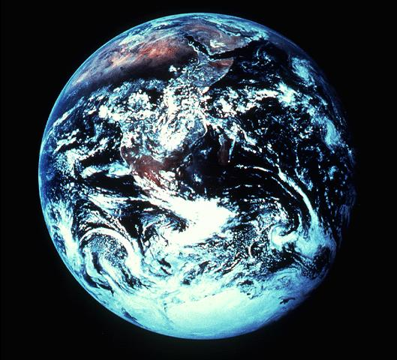

Slide 2
Surface Area
196 Million Square Miles

Slide 3
7,800,000,000
People
March 2020
"World Population Clock:
7.8 Billion People (2020)"

Slide 4
Psalm 8:3-4
“When I consider Your heavens, the work of Your fingers, the moon and the stars, which You have ordained, what is man that You are mindful of him, and the son of man that You visit him?”

Slide 5
How Concerned Is God about Me?
1. He is Concerned Enough That He Provides For My Needs.
Acts 14:14-17
Matthew 5:44-45

Slide 6
How Concerned Is God about Me?
2. He is Concerned Enough That He Gives Me Joys.
Galatians 5:22
Matthew 7:7-11
James 1:17

Slide 7
How Concerned Is God about Me?
3. He is Concerned Enough That He Helps Me Through Life.
Hebrews 2:14-18
Hebrews 13:5-6
2 Timothy 4:16-18

Slide 8
How Concerned Is God about Me?
4. He is Concerned Enough That He Listens to Me.
1 John 5:14-15
1 Peter 3:10-12

Slide 9
How Concerned Is God about Me?
5. He is Concerned Enough That He Feels Emotion for Me.
Luke 15:8-10
Ephesians 4:29-30
Hebrews 4:14-16

Slide 10
How Concerned Is God about Me?
6. He is Concerned Enough That He Gave His Son for Me.
John 3:13-17
I Peter 1:17-19
Romans 8:31-34

