Slide 1
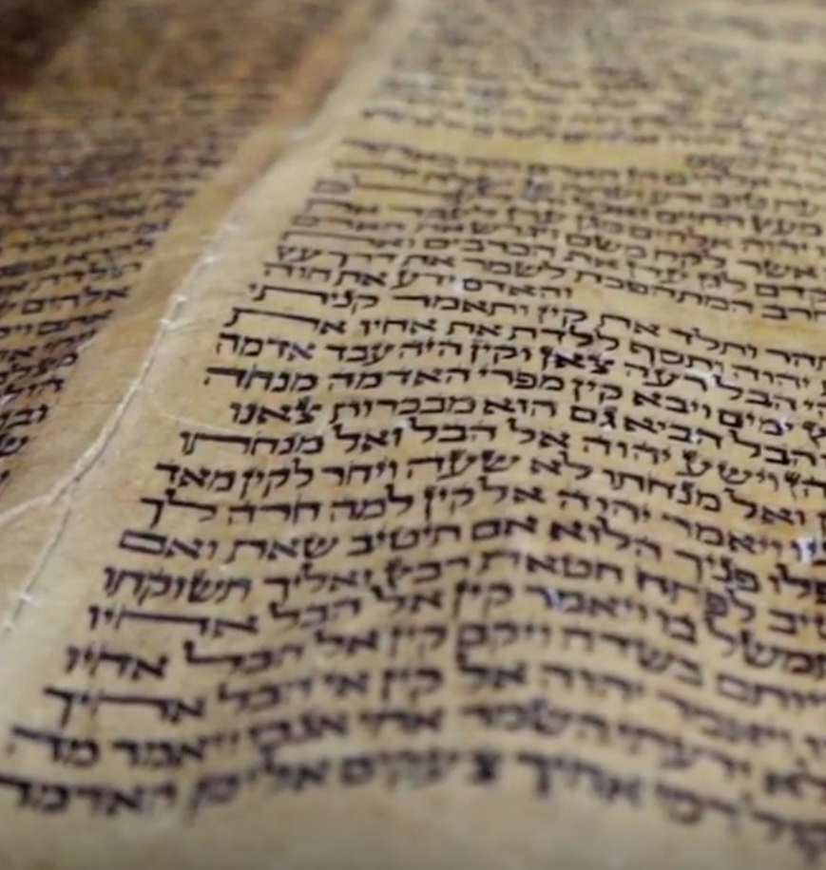
How Did Jesus View Scripture?

Slide 2
How Some View Scripture
The product of man. It is “God’s Word” because it is about God, not from God.
Love Letter—not authoritative
The stories are myths—not history.
The Bible (with tradition and experience) determine personal truth—not objective truth.

Slide 3
1. He Considered Scriptures as Inspired by God.
How Jesus Viewed Scripture
2 Timothy 3:16
2 Peter 1:20-21
Mark 7: 10, 13

Slide 4
2. He Considered Scriptures as Historically Accurate.
How Jesus Viewed Scripture
Creation (Matt. 19:4)
Flood (Matt. 24:36-39)
Sodom and Gomorrah (Matt. 10:15)
Lot’s Wife (Luke 17:32)

Slide 5
2. He Considered Scriptures as Historically Accurate.
How Jesus Viewed Scripture
Manna (John 6:48-51)
Jonah and the Great Fish (Matt. 12:38-41)

Slide 6
3. He Considered Scriptures as Authoritative.
How Jesus Viewed Scripture
“The Scripture cannot be broken” (John 10:35).
“How then could the Scriptures be fulfilled, that it must happen thus?” (Matt. 26:54).

Slide 7
3. He Considered Scriptures as Authoritative.
How Jesus Viewed Scripture
Jesus spoke against dismissing the slightest part of God’s word (Matt. 5:17-19).
Jesus made a clear distinction between God’s word and the traditions of men (Matt. 15:2-6).

Slide 8
3. He Considered Scriptures as Authoritative.
How Jesus Viewed Scripture
Recognized the tense of a verb as being authoritative (Matt. 22:31-32).

Slide 9
4. He Considered Scriptures as Essential.
How Jesus Viewed Scripture
Matthew 4:4
Matthew 23:23
He endorsed the entirety of Old Testament Scriptures (Matt. 23:35; Gen. 4:8; 2 Chron. 24:20-21).

Slide 10
How Jesus Viewed Scripture
God’s Inspired Word
Historically True and Accurate
Authoritative and Obligatory
Essential and Relevant

