Slide 1
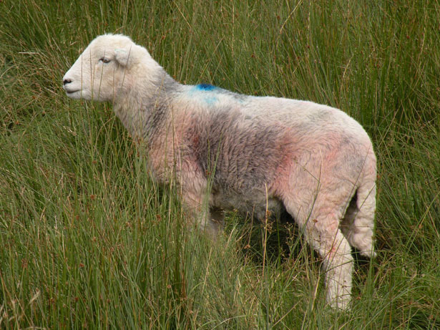
Matthew 18:12-14
“What do you think? If a man has a hundred sheep, and one of them goes astray, does he not leave the ninety-nine and go to the mountains to seek the one that is straying? And if he should find it, assuredly, I say to you, he rejoices more over that sheep than over the ninety-nine that did not go astray. Even so it is not the will of your Father who is in heaven that one of these little ones should perish.”

Slide 2
Context of the Passage
“Who is the Greatest in the kingdom of heaven?” (Matt. 18:1).
Discussion about children (Matt. 18:2-6).
Causing “little ones” to sin (Matt. 18:7-10).
Why Jesus came (Matt. 18:11).

Slide 3
Matthew 18:15-20
“Moreover if your brother sins against you, go and tell him his fault between you and him alone. If he hears you, you have gained your brother. But if he will not hear, take with you one or two more, that 'by the mouth of two or three witnesses every word may be established.' And if he refuses to hear them, tell it to the church. But if he refuses even to hear the church, let him be to you like…”

Slide 4
Matthew 18:15-20
“… a heathen and a tax collector. Assuredly, I say to you, whatever you bind on earth will be bound in heaven, and whatever you loose on earth will be loosed in heaven. Again I say to you that if two of you agree on earth concerning anything that they ask, it will be done for them by My Father in heaven. For where two or three are gathered together in My name, I am there in the midst of them."

Slide 5
I. Three Key Texts.
Church Discipline
“Lost Sheep Context” (Matt. 18:15-20).
To the Corinthians (1 Cor. 5:1-13).
To the Thessalonians (2 Thess. 3:6-15).

Slide 6
II. Considering the Teaching.
Church Discipline
When Should this Happen?
Unrepentant sin, not just any sin.
“Refuses to hear the church” (Matt. 18:17).
“Has his father’s wife” (1 Cor. 5:1).
“A brother who is…” (1 Cor. 5:11).
“Brother who walks disorderly” (2 Thess. 3:6).

Slide 7
II. Considering the Teaching.
Church Discipline
When Should this Happen?
Unrepentant sin, not just any sin.
Includes divisiveness (Titus 3:9-11; 1:10-11; Rom. 16:17-18).
False doctrine (1 Tim. 6:3-5; 2 John 9-10; 2 Tim. 2:16-18)

Slide 8
II. Considering the Teaching.
Church Discipline
When Should this Happen?
After rebuke and time to repent.
“Time to repent” (Rev. 2:21).
Private efforts to restore (Matt. 18:15-17a).
“Restore such a one” (Gal. 6:1-2).
Textual issue – “against You” (Matt. 18:15).

Slide 9
II. Considering the Teaching.
Church Discipline
When Should this Happen?
Public vs. Private Sin.
Are steps of Matthew 18:15-20 always required?
Not commanded in 1 Cor. 5 and 2 Thess. 3.
“Puffed up” (1 Cor. 5:2) “glorying” (5:11).
“Walk among you” (2 Thess. 3:11).

Slide 10
II. Considering the Teaching.
Church Discipline
What Does it Involve?
Not rudeness, hateful words, or corporal punishment.
“Do not count him as an enemy” (2 Thess. 3:15).
Restore “In a spirit of gentleness” (Gal. 6:1).
This is not an “Inquisition.”

Slide 11
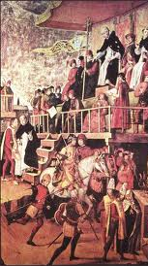
Spanish Inquisition
Religious tribunals conducted by the Spanish crown from 1540-1699 under the authority of the Catholic church. 1294 people were executed, countless others were tortured and compelled to renounce beliefs.

Slide 12
II. Considering the Teaching.
Church Discipline
What Does it Involve?
Withdrawal of social contact.
“Like a heathen and tax collector” (Matt. 18:17).
“A religious man, who becomes a publican, is to be driven out of the society of religion”
(Jerusalem Talmud, Demai 23.1).

Slide 13
II. Considering the Teaching.
Church Discipline
What Does it Involve?
Withdrawal of social contact.
“Like a heathen and tax collector” (Matt. 18:17).
“Deliver such a one to Satan” (1 Cor. 5:5a).
“Not to keep company with…” (1 Cor. 5:9).
“Withdraw from…walks disorderly” (2 Thess. 3:6).

Slide 14
II. Considering the Teaching.
Church Discipline
What Does it Involve?
Withdrawal of social contact.
“Note that person and do not keep company with him” (2 Thess. 3:14).
“Not even to eat with such a person” (1 Cor. 5:11).

Slide 15
II. Considering the Teaching.
Church Discipline
What Does it Involve?
Withdrawal of social contact.
To lead one to “be ashamed” (2 Thess. 3:15).
A type of “punishment” (2 Cor. 2:6).
Considered “the destruction of the flesh” (1 Cor. 5:5b).

Slide 16
II. Considering the Teaching.
Church Discipline
What Does it Involve?
“Disfellowship” is not a scriptural term.
“Fellowship in the gospel” (Phil. 1:5).
“Fellowship” is a bond of faith (1 John 1:1-3).
One withdrawn from is still a “brother” (2 Thess. 3:15).

Slide 17
II. Considering the Teaching.
Church Discipline
What Does it Involve?
This is congregational action.
There is no withdrawal in the church universal.
A local church can be wrong (3 John 9-10).
Those outside we must “note” and “avoid” (Rom. 16:17-18).

Slide 18
II. Considering the Teaching.
Church Discipline
What Does it Involve?
How does this affect family?
No command of God requires disobedience to another command (cf. 1 Cor. 14:34; Col. 3:16).
Commands within the family (1 Cor. 7:5; Eph. 6:4; 6:2).

Slide 19
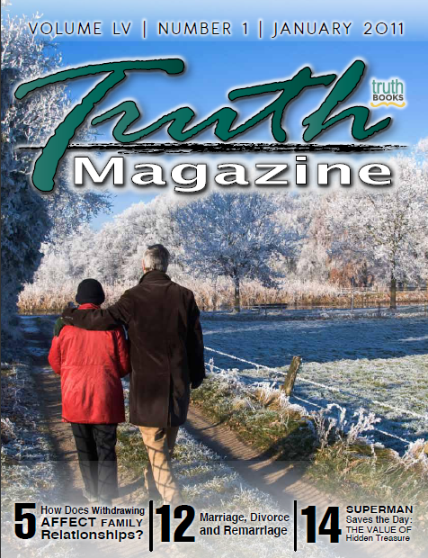
Bro. Bill Cavender
“A family has to deal with its own family members and is not necessarily bound by what a congregation has done.”
“How Does Withdrawing Affect Family Relationships?” Truth Magazine 55.1 (Jan. 2011) 8-10

Slide 20
Bro. Bill Cavender
“A Christian cannot condone, and participate in sinful words, deeds, and conduct, as we walk by faith in this sinful world. Each family member will have to determine, for himself/herself, how we deal with misconduct in the family relationship, according to our personal knowledge of God’s will for us.”
“How Does Withdrawing Affect Family Relationships?” Truth Magazine 55.1 (Jan. 2011) 8-10

Slide 21
II. Considering the Teaching.
Church Discipline
Why is this commanded?
To produce godly sorrow leading to repentance (2 Cor. 7:8-12).
To protect the flock (1 Cor. 5:7-8).
To restore the erring (1 Cor. 5:5; 2 Cor. 2:5-9).

Slide 22
Hebrews 12:6-11
“For whom the LORD loves He chastens, and scourges every son whom He receives. If you endure chastening, God deals with you as with sons; for what son is there whom a father does not chasten? But if you are without chastening, of which all have become partakers, then you are illegitimate and not sons. Furthermore, we have had human fathers who corrected us, and we paid them respect…”

Slide 23
Hebrews 12:6-11
“…Shall we not much more readily be in subjection to the Father of spirits and live? For they indeed for a few days chastened us as seemed best to them, but He for our profit, that we may be partakers of His holiness. 11 Now no chastening seems to be joyful for the present, but painful; nevertheless, afterward it yields the peaceable fruit of righteousness to those who have been trained by it.”

