Slide 1

Matthew 13:1-9
“On the same day Jesus went out of the house and sat by the sea. And great multitudes were gathered together to Him, so that He got into a boat and sat; and the whole multitude stood on the shore . . .”

Slide 2
Matthew 13:1-9
“. . . Then He spoke many things to them in parables, saying: ‘Behold, a sower went out to sow. And as he sowed, some seed fell by the wayside; and the birds came and devoured them . . .’”

Slide 3
Matthew 13:1-9
“‘. . . Some fell on stony places, where they did not have much earth; and they immediately sprang up because they had no depth of earth. But when the sun was up they were scorched, and because they had no root they withered away. . .’”

Slide 4
Matthew 13:1-9
“‘. . . And some fell among thorns, and the thorns sprang up and choked them. But others fell on good ground and yielded a crop: some a hundredfold, some sixty, some thirty. He who has ears to hear, let him hear!’” (NKJV).

Slide 5
A parable in Matthew, Mark, and Luke
A parable with an explanation
“Do you not understand this parable? How then will you understand all the parables?” (Mark 4:13)

Slide 6
The Parable of the Sower
Some have called this “The Parable of the Soils”—Emphasizes Hearers
Jesus calls it “The Parable of the Sower” (Matt. 13:18)—Emphasizes Word and the One Who Sows It

Slide 7
The Parable of the Sower
Unlike the Parable of the Wheat and Tares (Matt. 13:37), the Sower is not said to be the “Son of Man” (i.e. Jesus).
This may indicate that this parable is intended to help us understand what anyone who sows the seed can expect.

Slide 8
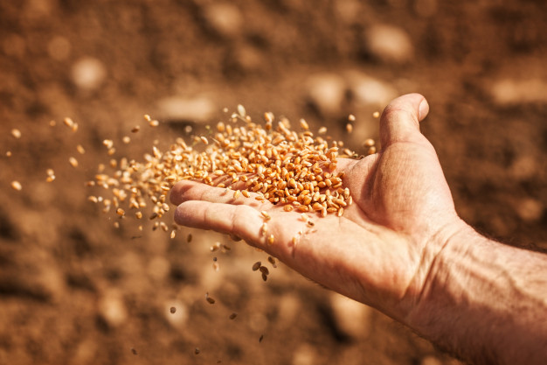
The Parable of the Sower
The Parable
Sowing
Wayside Trampled / Birds
Rock (Luke), Stony Places (Matt.), Stony Ground (Mark) Sprang-up / Scorched / Withered
Thorns Sprang-up / Chocked
Good Ground Yielded Crop

Slide 9
The Parable of the Sower
The Parable
Sowing
Familiar Conditions
Not All Sowing Has the Same Results
Answers the Questions:
“Why Do Some Crops Grow?”
“Why Doesn’t All Sowing Produce a Good Crop?

Slide 10
The Parable of the Sower
The Parable
Sowing
It’s not the sower.
It’s not the seed.
It’s the reception of the seed.
It’s the condition of the soil.

Slide 11
Matthew 13:18-23
“‘Therefore hear the parable of the sower: When anyone hears the word of the kingdom, and does not understand it, then the wicked one comes and snatches away what was sown in his heart. This is he who received seed by the wayside. . . .’”

Slide 12
Matthew 13:18-23
“‘. . . But he who received the seed on stony places, this is he who hears the word and immediately receives it with joy; yet he has no root in himself, but endures only for a while. For when tribulation or persecution arises because of the word, immediately he stumbles. . . ’”

Slide 13
Matthew 13:18-23
“‘. . . Now he who received seed among the thorns is he who hears the word, and the cares of this world and the deceitfulness of riches choke the word, and he becomes unfruitful. . . ’”

Slide 14
Matthew 13:18-23
“‘. . . But he who received seed on the good ground is he who hears the word and understands it, who indeed bears fruit and produces: some a hundredfold, some sixty, some thirty.’”

Slide 15
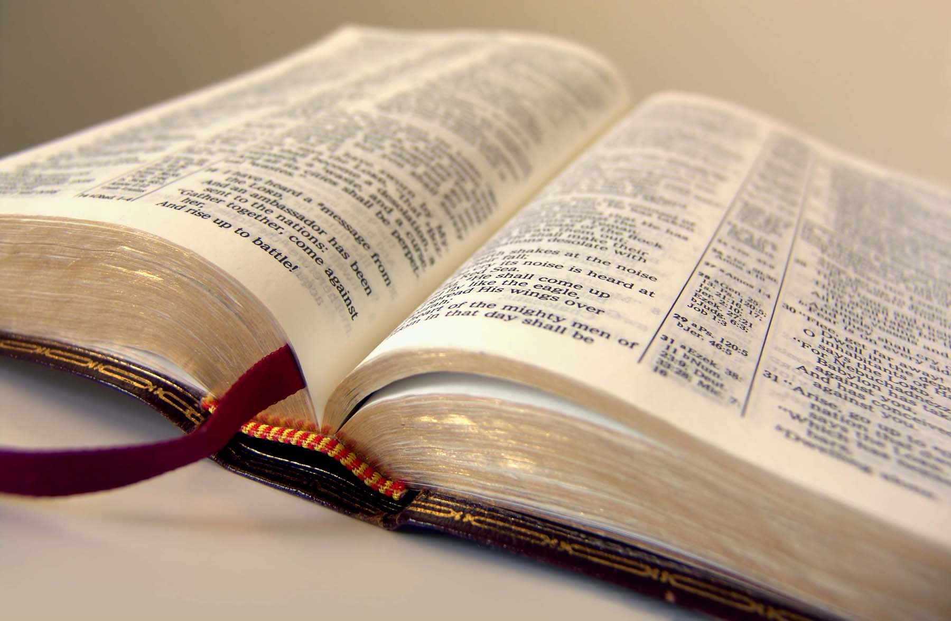
The Parable of the Sower
The Explanation
Seed
Word of the Kingdom (Matt.), Word (Mark), Word of God (Luke)
Power of word (Heb. 4:12-13; Isa. 55:8-11; Rom. 1:16-17)
Kingdom (Matt. 4:23; 9:35; 24:14).

Slide 16
The Parable of the Sower
The Explanation
Seed
Jesus taught the importance of understanding this parable
We must understand the power of God’s word

Slide 17
The Parable of the Sower
The Explanation
Seed
Wayside
Hears—does not understand (cf. Rom. 10:17)
Satan—snatches word away (cf. Job 1—external; Job 2—health)

Slide 18
The Parable of the Sower
The Explanation
Seed
Wayside
Life circumstances can take away the word.
That is Satan taking away the word.
Don’t allow that!

Slide 19
The Parable of the Sower
The Explanation
Seed
Stony Ground
Receive with joy
Have no root (Mark, Luke)
Believe for awhile (Luke), Endure only awhile (Matt., Mark)

Slide 20
The Parable of the Sower
The Explanation
Seed
Stony Ground
Temptation (Luke), tribulation, persecution (Matt., Mark)
Stumble (Matt., Mark), Fall away (Luke)
1 Cor. 10:13; Jas. 1:12-16; 1 Cor. 10:12; 2 Pet. 1:5-11; 2:20-22

Slide 21
The Parable of the Sower
The Explanation
Seed
Thorns
Hears—“sprang up,” in parable—word choked
Cares of THIS world, deceitful riches (Matt., Mark)
Pleasures (Luke)

Slide 22
The Parable of the Sower
The Explanation
Seed
Thorns
We should care about things (Col. 3:1-4)
But cares of THIS world must be guarded (1 John 2:15-17; Matt. 6:24-34)

Slide 23
The Parable of the Sower
The Explanation
Seed
Good Ground
Hear—accept it—Noble and good heart (Luke)—(1 Thess. 2:13)
Keep It (Luke)—(John 14:23)
Bear fruit with patience (Luke), 30, 60, 100 (Matt., Mark—(cf. 1 Cor. 3:11-15)

Slide 24
The Parable of the Sower
“He who has ears to hear, let him hear!”

