Slide 1
2 Corinthians 10:3-6

Slide 2
“Weapons of Our Warfare”

Slide 3
Judges 7:16-22

Slide 4
There is transforming power in the word of God (Rom. 1:16).
God’s word will:
• Free (John 8:32)
• Sanctify (John 17:17)
• Enlighten (Ps. 119:130)
It needs to be preached (2 Tim. 4:1-4).
TRUMPET

Slide 5
Jesus was a servant (Matt. 20:25-28).
We too, must serve.
• (Gal. 6:10)
• (Titus 2:7,14; 3:8, 14)
• (Eph. 2:8-10)
A willingness to serve has a great impact on others.
PITCHER

Slide 6
We are to be lights and examples to the world.
• (Matt. 5:14-16)
• (1 Tim. 4:12)
• We will influence others whether we want to or not.
• (Rom. 14:7)
TORCH

Slide 7
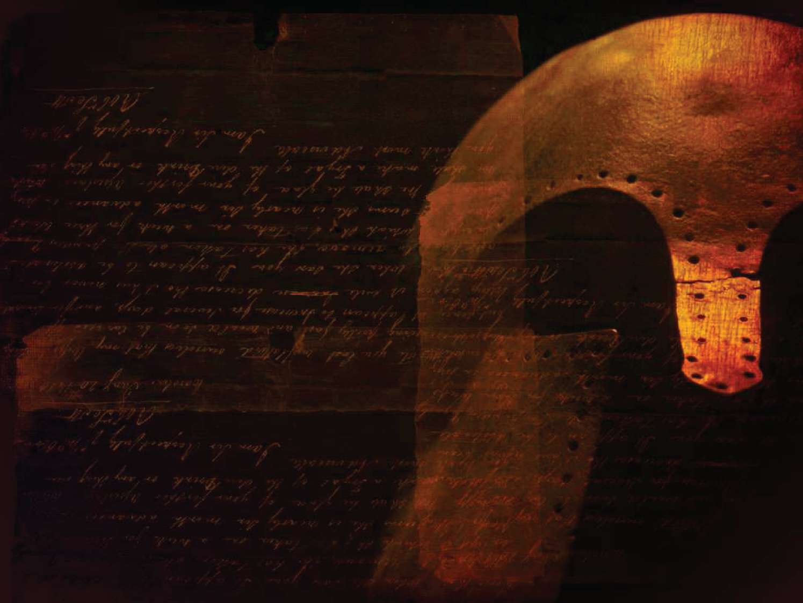
The weapons of our warfare are indeed strange, but they are what God has placed in our hands.
To doubt their effectiveness is to doubt God’s power.
Pick up your trumpet, pitcher, and torch and engage the enemy in battle.

