Slide 2
Men and Women
The Same – but Different

Slide 3
Identification of Feminism
Secular
Feminist
Without God
Goddess Feminist
Nature worship
Liberal Critical Feminist
Loose regard for Scripture
Biblical Feminist
Inspiration
Wiccans and Druids
Men have mis-defined
Usually superior
Not the sum of its terms
Historically defined
Not just for women

Slide 4
God Created Equally
The term “man” is most often inclusive
Genesis 1:27; Acts 17:30; Romans 5:12
Context defines if distinctive
John 18:30; I Corinthians 11:14-15

Slide 5
Equal Value- Galatians 3:28
Various roles

Slide 6
The Same
Different
Blood-
  transfusion
  medication
  hormones
Organs- transplant
  brain...
Psychology and Emotion
  existence
    dosages
    amounts
  Sexed organs
    brain
      structure
      operation
    dominance

Slide 7
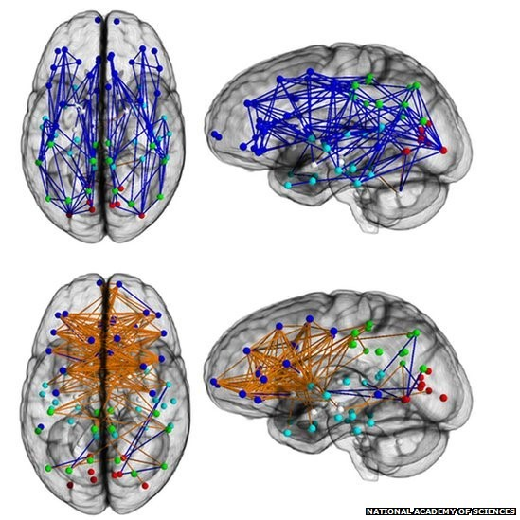
Brain Scans
Male
Female

Slide 8
Personality
Points
The likes and dislikes of men and women track with their gender more than 82% of the time.
True of Male and Female

Slide 9
Personality does not define gender
variation is a reflection of individuality

Slide 10
Logical Conclusion
God’s instructions for all people are both
Universal and Specific

Slide 11
The Same
Different
Standards-
  Acts 17:30
Accountability-
  2 Corinthians 5:10
Receive the Gospel-
  Acts 2:18; 8:3 and 1 Timothy 2:3,4
Roles-
  Titus 2:3-5
Leadership-
  1 Timothy 2:11-12; 3
Vocal Activities-
  1 Corinthians 14:34

Slide 12
The Church is a Collective
All under a unifying Head
Various working parts with their own irreplaceable specialties
Romans 12; 1 Corinthians 12

Slide 13
Logical Conclusion
We should not expect to function alike
We should expect to work together, not in competition, but compliment

