Slide 2

Women of Praise
A shining light that testifies to the working of God

Slide 3


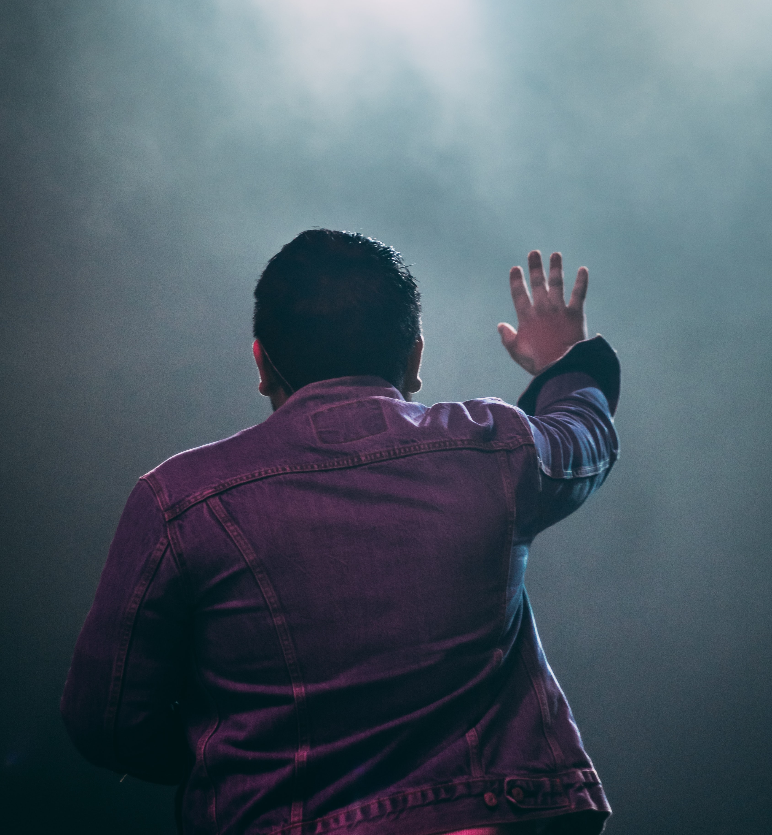

God Blesses
The grateful acknowledge this
Sing to the Lord, for He is Good- Psalm 135:3

Slide 4

My Place in God’s Plan
Psalm 68:11
The Lord gave the command;
a great company of women brought the Good News: ...

Slide 5
Who Praises?
Miriam
Deborah
Naomi’s neighbors

Slide 6

Mary
Belief
Humility- Acceptance of her role
Knowledge of Biblical history
Fellowship with God
Bless the Lord

Slide 7
Magnify
O, Magnify

Slide 8

Motivation
Patience in adversity
Humility
Rely on God

Slide 9


Everything happens for a reason
Be prone to praise
Glorify God in all things
Connect the dots and remember:
Art thanks to Jeorge Bermudez; Claudia Raya

