Slide 1
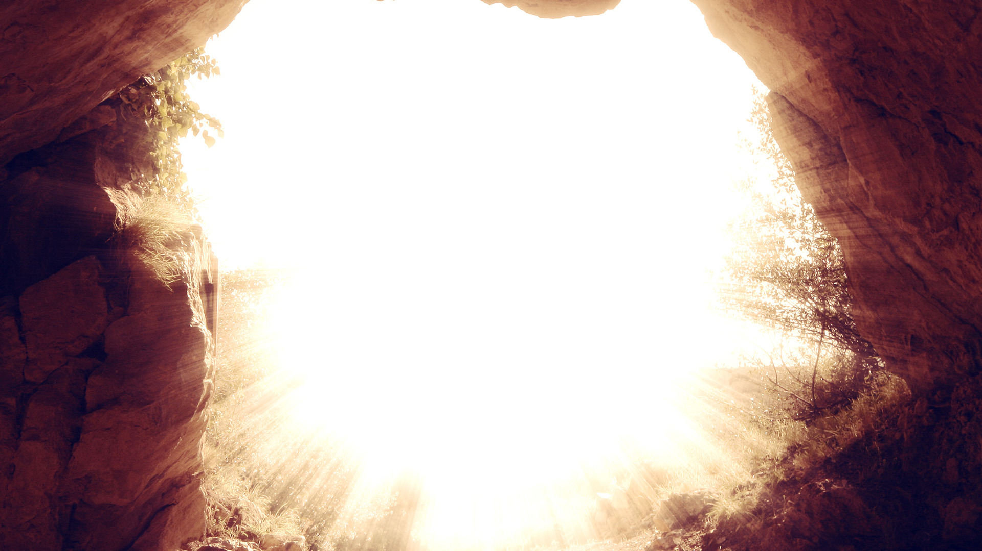
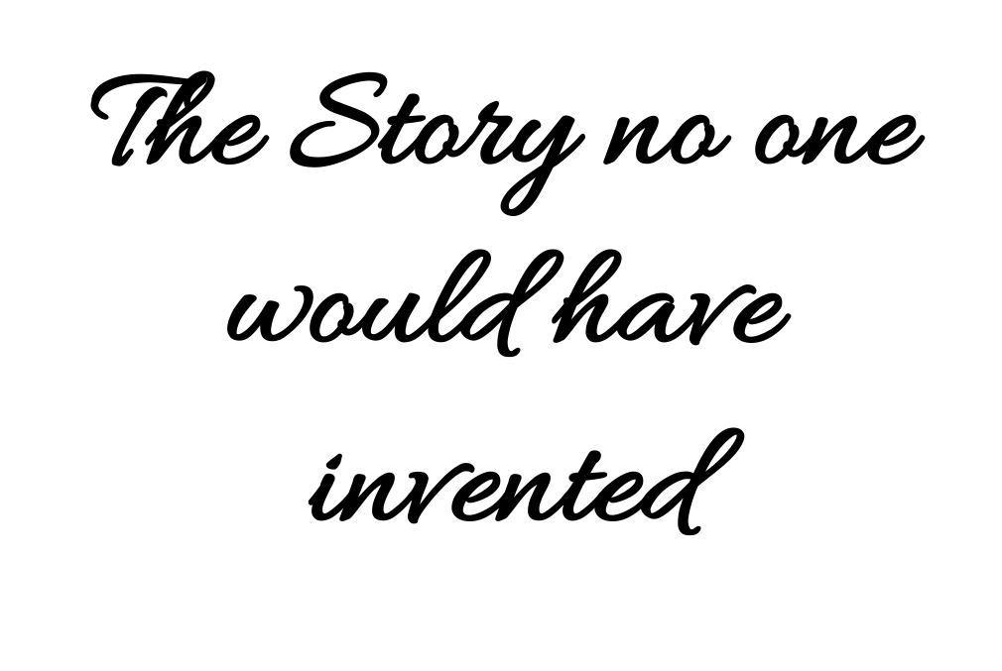

Slide 2
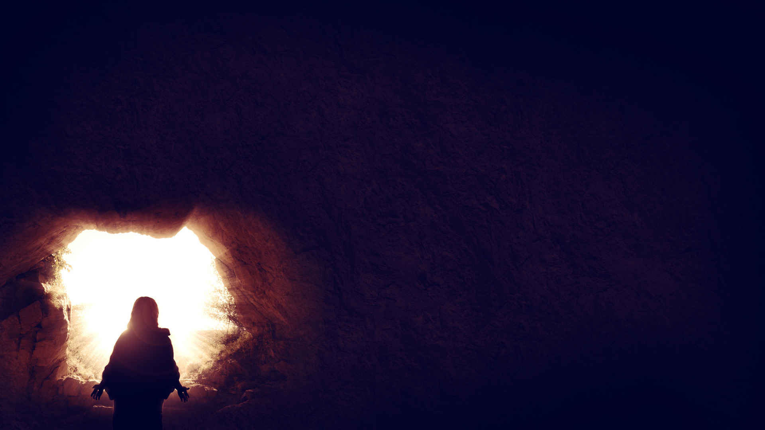

“Look, you scoffers,
marvel and vanish away,
because I am doing a work in your days,
a work that you will never believe,
even if someone were to explain it to you.” (Acts 13:41)

Slide 3
“And I, when I came to you, brothers, did not come proclaiming to you the testimony of God with lofty speech or wisdom. For I decided to know nothing among you except Jesus Christ and him crucified.”
1 Cor 2:1-2

Slide 4
…but we preach Christ crucified, a stumbling block to Jews and folly to Gentiles, but to those who are called, both Jews and Greeks, Christ the power of God and the wisdom of God. For the foolishness of God is wiser than men, and the weakness of God is stronger than men. (1 Cor 1:18-24)

Slide 5
Deuteronomy 21:22-23:
“And if a man has committed a crime punishable by death and he is put to death, and you hang him on a tree, his body shall not remain all night on the tree, but you shall bury him the same day, for a hanged man is cursed by God. You shall not defile your land that the Lord your God is giving you for an inheritance.”

Slide 6
An uneducated Jewish peasant from a small, obscure town in Galilee is born of a virgin, claims to be the Son of God, works miracles, and teaches with authority, thereby silencing His opposition. His enemies, prominent Jewish leaders from Jerusalem, manage to get Him arrested, charged, and crucified as a criminal by Roman authorities. Three days later He is risen. His disciples soon after begin to proclaim the death, burial, and resurrection of Jesus, and from this point the disciples grow and spread to the rest of the world.

Slide 7
As one pagan named Caecilius, late in the second century, said in derision of Christianity, “he who explains their ceremonies by reference to a man punished by extreme suffering for his wickedness, and to the deadly wood of the cross, appropriates fitting altars for reprobate and wicked men, that they may worship what they deserve” (The Octavius of Minucius Felix).

Slide 8
The Gospel Defends Itself
What Gentile community would have invented this story?
Which Jewish community would have invented this story?
When the story is folly, a stumbling block, a curse, and contains major elements that neither Jew nor Gentile would have normally accepted, what accounts for it?

Slide 9
What People Thought about Crucifixion
“Crucifixion was not only physically agonizing, but it was associated in the ancient world with the most horrific degradation and shame” (D. A. Carson).

Slide 10
“How on earth did something so obviously crazy or scandalous or foolish become so central so quickly? The very mention of crucifixion was taboo in polite Roman circles, since it was the lowest form of capital punishment, reserved for slaves and rebels. As for the Jews, the very idea of a crucified Messiah was scandalous. A crucified Messiah was a horrible parody of the kingdom-dreams that many were cherishing. It immediately implied that Israel’s national hope was being radically redrawn downward. But if the Messiah’s crucifixion was scandalous to Jews, it was sheer madness to non-Jews. The early cultured despisers of Christianity had no trouble mocking the very idea of worshipping a crucified man” (Wright).

Slide 11
“Wretched is the loss of one’s good name in the public courts, wretched, too, a monetary fine exacted from one's property, and wretched is exile, but, still, in each calamity there is retained some trace of liberty. Even if death is set before us, we may die in freedom. But the executioner, the veiling of heads, and the very word ‘cross,’ let them all be far removed from not only the bodies of Roman citizens but even from their thoughts, their eyes, and their ears. The results and suffering from these doings as well as the situation, even anticipation, of their enablement, and, in the end, the mere mention of them are unworthy of a Roman citizen and a free man.” (Cicero, ca. 63 BC)

Slide 12
“It is a crime to bind a Roman citizen; to scourge him is a wickedness; to put him to death is almost parricide. What shall I say of crucifying him? So guilty an action cannot by any possibility be adequately expressed by any name bad enough for it.” (Cicero, ca. 70 BC)

Slide 13
“I see before me crosses not all alike, but differently made by different peoples: some hang a man head downwards, some force a stick upwards through his groin, some stretch out his arms on a forked gibbet. I see cords, scourges, and instruments of torture for each limb and each joint: but I see Death also.” (Seneca, contemporary of Jesus, ca. 4 BC - 65 AD)

Slide 14
“Can anyone be found who would prefer wasting away in pain, dying limb by limb, or letting out his life drop by drop, rather than expiring once for all? Can any man be found willing to be fastened to the accursed tree, long sickly, already deformed, swelling with ugly tumors on chest and shoulders, and draw the breath of life amid long-drawn-out agony? I think he would have many excuses for dying even before mounting the cross!” (Seneca, contemporary of Jesus, ca. 4 BC - 65 AD)

Slide 15
“If there’s any aspect of the life of Jesus that has given rise to doubts about whether he really was the Messiah and the divine Son of God, it is the fact that he was crucified. … in the first century AD, Roman crucifixion was nothing less than the most brutal, most shameful, most despicable way to die that could be imagined. In the words of both Jewish and Roman writers: crucifixion was “the most wretched of deaths” (Josephus, War 7.203) and “the most severe punishment” possible (Paulus, Sententiae, 5.21.3).” (Brant Pitre)

Slide 16
“Jesus suffered crucifixion, known as an intentionally degrading death, fixing the criminal’s honor at the lowest end of the spectrum and serving as an effective deterrent to the observers, reminding them of the shameful end that awaits those who similarly deviate from the dominant culture’s values. Paul no doubt understated the case when he referred to the proclamation of this cross as the wisdom of God as a “stumbling block” to Jews and “folly” to Gentiles. No member of the Jewish community or the Greco-Roman society would have come to faith or joined the Christian movement without first accepting that God’s perspective on what kind of behavior merits honor differs exceedingly from the perspective of human beings.” (David deSilva)

Slide 17
What People Thought about Resurrection
“In shame, ignominy, and powerlessness he died in suffering and agony and rose in power to become the risen temple of God, the living meeting place between God and his people” (Carson).

Slide 18
What People Thought about Resurrection
Resurrection = one who died came back to life (not just “after-life.” Think of Jesus’ resurrection). It was NOT a common belief.

Slide 19
“Christianity was born into a world where its central claim was known to be false. Many believed that the dead were non-existent; outside Judaism, nobody believed in resurrection.”
“Lots of things could happen to the dead in the beliefs of pagan antiquity, but resurrection was not among the available options.” (Wright)

Slide 20
The disciples had to be convinced: “but these words seemed to them an idle tale, and they did not believe them” (Luke 24:11)
Thomas: “Unless I see in his hands the mark of the nails, and place my finger into the mark of the nails, and place my hand into his side, I will never believe” (John 20:24-25)
The Athenians had to be convinced: “Now when they heard of the resurrection of the dead, some mocked. But others said, ‘We will hear you again about this.’” (Acts 17:32)

Slide 21
The Conversion of the Gentiles: nothing short of astounding!
The Cross Confronts Sin Head On.
God’s wisdom in the cross:
Shows the horrors of sin.
Shows the message came from Him.
Has great future implications (resurrection)

