Slide 1
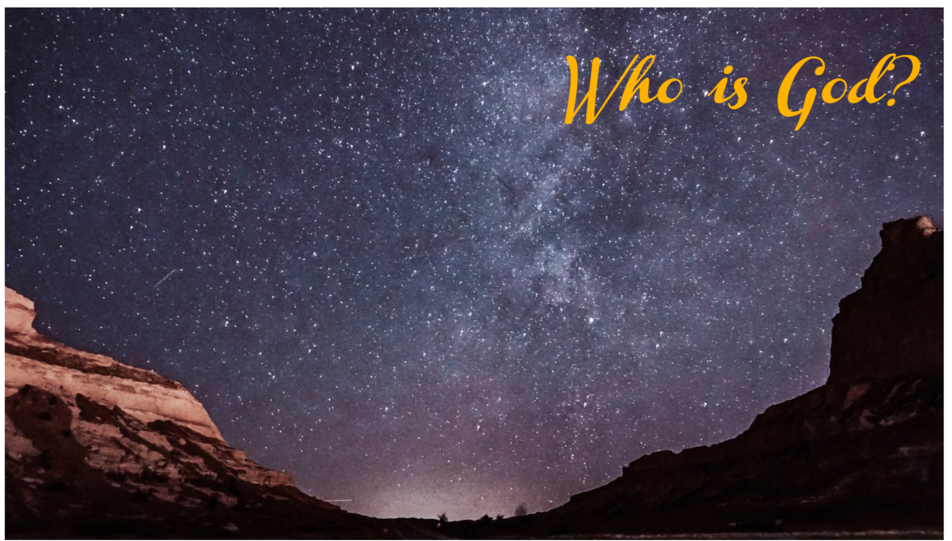
Who is God?

Slide 2
“There is no wisdom and no understanding and no counsel against the Lord.” (Prov. 21:30)

Slide 3
“In the beginning, God…” (Gen 1:1)

Slide 4
“as though he needed anything” (Acts 17:25)

Slide 5
Reaching for something higher
“He has also set eternity in their heart, yet so that man will not find out the work which God has done from the beginning even to the end” (Ecc 3:11)

Slide 6
“Moses and Aaron said to Pharaoh, ‘Thus says Yahweh, the God of Israel, ‘Let My people go that they may celebrate a feast to Me in the wilderness.’” But Pharaoh said, “Who is Yahweh that I should obey His voice to let Israel go? I do not know Yahweh, and besides, I will not let Israel go.” (Exodus 5:1-2)

Slide 7
Who is the Biblical God?
What are people actually denying?
What is our conception of God?

Slide 8
“as though he needed anything” (Acts 17:25)
“no one greater” (Heb 6:13)

Slide 9
“Who has measured the waters in the hollow of His hand,
And marked off the heavens by the span,
And calculated the dust of the earth by the measure,
And weighed the mountains in a balance
And the hills in a pair of scales?”
(Isaiah 40:12)

Slide 10
Creator
All Wisdom and Knowledge
Love, Goodness, Holiness
Right to Judge (justice)
God of Fellowship and Grace
“as though He needed anything…”

Slide 11
This is the God who has reached out to us!

