Slide 2
1. God indicated that:
a. Some would find the gospel story unbelievable.
b. Nothing out of the norm would happen in the gospel story.
2. The Jews considered that anyone hanged on a tree is:
a. Blessed b. Cursed
c. To be pitied d. Unfortunate
3. Crucifixion was associated with:
a. Mercy
b. Quick Death
c. Shame
4. T F Roman citizens were not permitted to be crucified.
5. The Roman statesman before Jesus who talked about the horrors of crucifixion:
a. Tacitus b. Pliny
c. Philo d. Cicero
6. T F Resurrection was a commonly held belief among both Jews and Greeks.

Slide 3
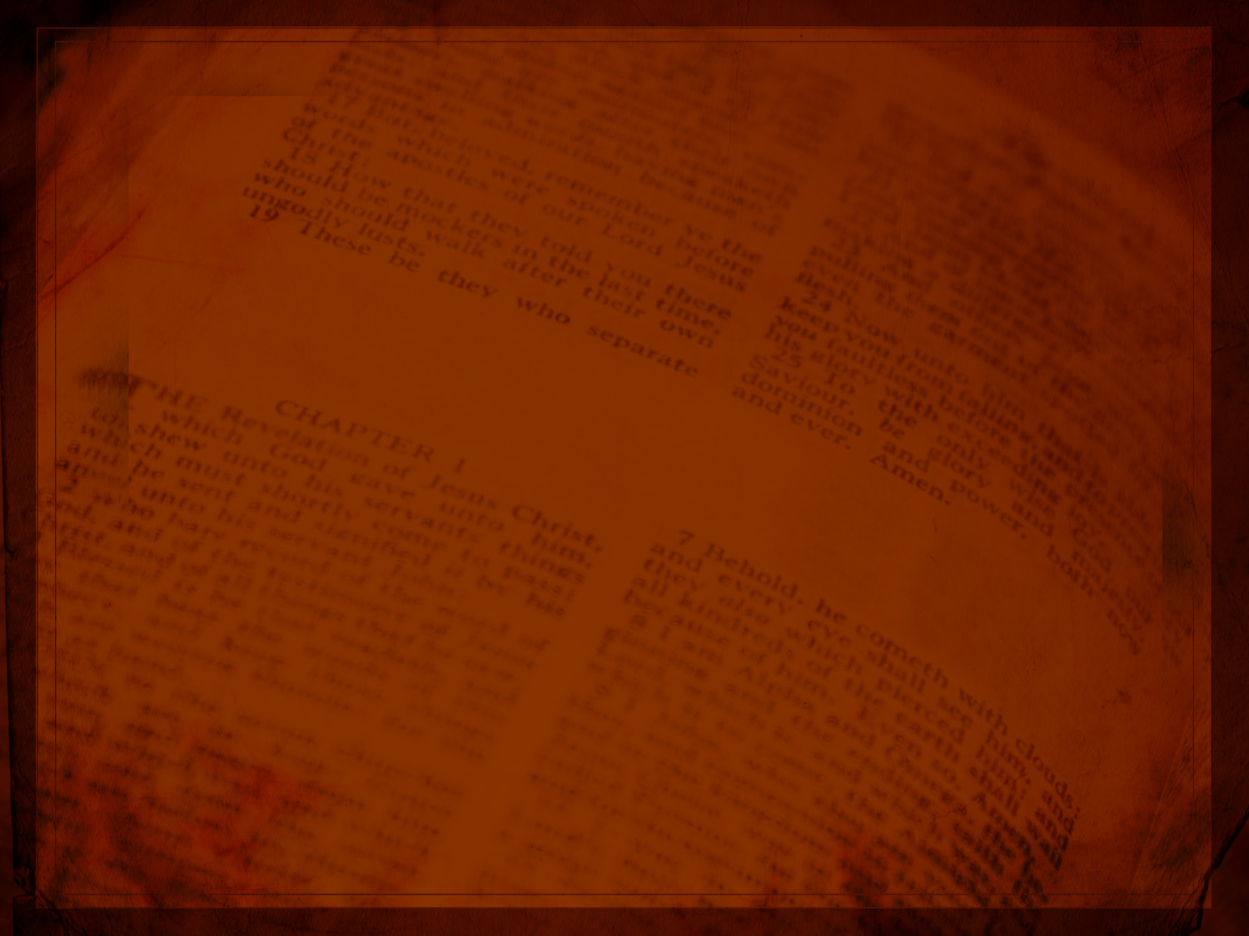
On Using the Bible to Prove the Bible

Slide 4
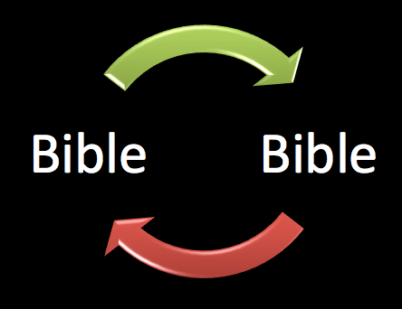
The Charge: Using the Bible to prove the Bible is circular (a logical no-no)

Slide 5
Many books, not one
History and Inspiration
Outside sources: Unbelievers in a better position?
Potential Conflicts?
Gospel as its own apologetic

Slide 6
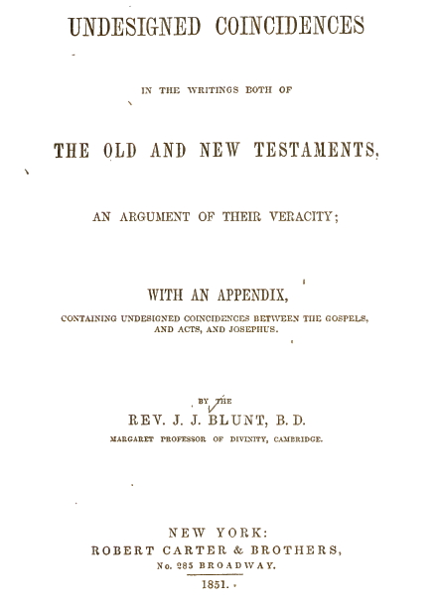
“Undesigned Coincidences” credit goes to
Dr. Tim McGrew for bringing to attention

Slide 7
“Sometimes two works by different authors interlock in such a way that would be very unlikely if one of them were copied from the other or both were copied from a common source. For example, one book may mention in passing a detail that answers some question raised by the other. The two records fit together like pieces of a jigsaw puzzle. Fictions and forgeries aren’t like this.” (McGrew)

Slide 8
Coincidence without design “establishes the authors of the several books of Scripture as independent witnesses to the facts they relate; and this, whether they consulted each other's writings, or not; for the coincidences, if good for anything, are such as could not result from combination, mutual understanding, or arrangement.” (Blunt)

Slide 9
﻿In an undesigned coincidence, writers show agreement of a kind that it is hard to imagine as deliberately contrived by either author to make the story look authentic. Often the agreement is so subtle and indirect that all but the most careful reader are likely to miss it. If you suppose that Gospel writers put in such agreements to make their narratives appear authentic, then you imagine that they are among the most brilliant of all ancient authors. The idea that several of the Gospel writers might have done this independently is even less plausible.
Peter J. Williams, Can We Trust the Gospels?

Slide 10
Old Testament Examples
Numbers 9; Exodus 40; Leviticus 8-10
Why were the men concerned about the Passover and not being able to participate?
Who were they?
1 Samuel 22:3-4 and protection from Moab?
2 Samuel 6, the Ark, and Obed-edom the Gittite
Why does it matter that he was a Gittite?
2 Samuel 15, Absalom, and Ahithophel

Slide 11
Matt 4:18-22
Why mending nets?
Why follow so quickly?
See Luke 5:6, 9

Slide 12
Matt 9:9-10 and “the house”
Whose house?
What is the occasion?
See Mark 2:15; Luke 5:29

Slide 13
Matt 26:67-68
Why “Prophesy”?
See Luke 22:64

Slide 14
Matt 8:14-16
Why evening?
See Mark 1:21, 29-32

Slide 15
Luke 9:36
Why were they silent?
See Mark 9:9

Slide 16
Mark 6:31, 39
Why the crowds?
See John 6:4

Slide 17
Matt 14:1-2
Why was Herod speaking about this to servants?
How did Matthew know?
See Luke 8:3

Slide 18
Mark 14:58; 15:29
Why are they making this charge?
See John 2:18-19

Slide 19
John 21:25
Why is Jesus asking Peter?
See Matthew 26:33-34

Slide 20
Luke 23:2-4
Sequence:
1. Jews accuse Jesus.
2. Pilate questions Jesus.
3. Jesus admits to charge.
4. Pilate declares Jesus innocent.
Huh?
See John 18:33-38

Slide 21
John 18:10, 36
Doesn’t Peter fight?
Why wasn’t Peter arrested?
See Luke 22:51

Slide 22
Matt 11:21 — what miracles?
John 6:5 — why Philip?
Luke 9:10-11
John 12:21
Luke doesn’t mention Philip
John doesn’t mention Bethsaida
Why ask Philip? He was from Bethsaida

Slide 23
Mark 3:17 – James and John called “sons of thunder.” No reason given as to why.
Luke 9:51-55 – James and John ask if they should call fire down from heaven…
One records a name based on character; the other reports a character that fits the name.

Slide 24
Cumulative Force
One? perhaps accidental
Many? It is a “cumulative argument from simplicity” (Williams). Attempts to explain them away add levels of unwarranted complexity. The simplest explanation is that they were telling what really happened.
“it becomes ridiculous to insist that they are all just accidental” (McGrew)

