Slide 1
Does God Exist?
What is the most important question you will ever answer?
10 or 20 Year Mortgage?
Will You Marry Me?
When Can You Start?

Slide 2
Does God Exist?
Arguments for Existence
1. Ontological Argument.
The concept of God attests to the existence of God.

Slide 3
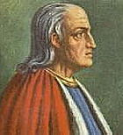
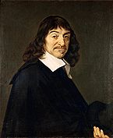
Does God Exist?
If “God” is defined as “something than which nothing greater is possible to conceive,” since it is not possible to think of something greater than can be conceived, God must exist (Anselm of Canterbury).
As the concept of a mountain implies a valley, reality of existence is a quality implied by the concept of God (René Descartes).
Is it possible to conceive of something that does not have some basis in reality?

Slide 4
Does God Exist?
The fool says, “There is no God” (Ps. 14:1).
Denying something acknowledges the existence the concept of it.
Where does this concept come from?
God has shown it to them (Rom. 1:18-19).

Slide 5
Does God Exist?
Arguments for Existence
1. Ontological Argument.
2. Cosmological Argument.
Every cause has an effect—God is the “uncaused cause”

Slide 6
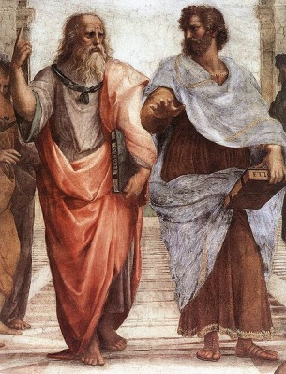
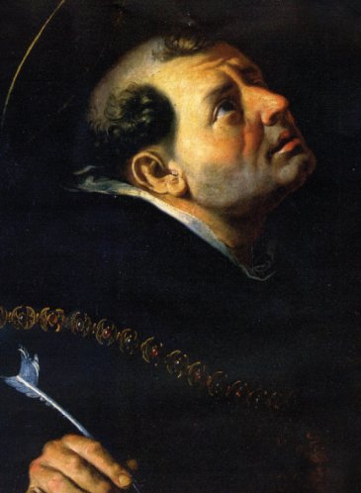
Does God Exist?
“To conceive that anything can be moved without a mover is hard or indeed impossible, and equally impossible to conceive that there can be a mover unless there be something which can be moved” (Plato).
The fact that things undergo change, means that there must be a cause of change which is not itself caused to change by anything (Thomas Aquinas).

Slide 7
Does God Exist?
What is inferred when we see this image?
Something pushed the dominoes!

Slide 8
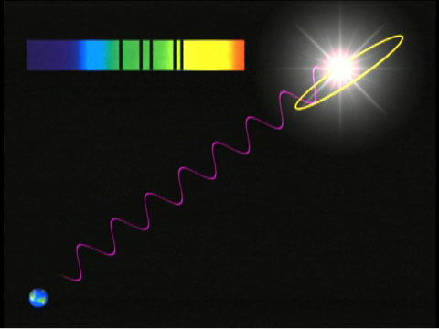
Does God Exist?
The Red Shift
If everything is expanding it once was together—it had a beginning.

Slide 9
Does God Exist?
“In the beginning God created” (Gen. 1:1-3).
“I laid the foundation of the earth” (Job 38:1-14).
Things seen came from things which did not exist (Hebrews 11:1-3).
The God of the Bible is Transcendent
(Above and distinct from this universe)
The “Unmoved Mover”—the “Uncaused Cause”

Slide 10
Does God Exist?
Arguments for Existence
1. Ontological Argument.
2. Cosmological Argument.
3. Argument from Natural Law.
The universe functions under predictable and measureable laws—God established these laws.

Slide 11
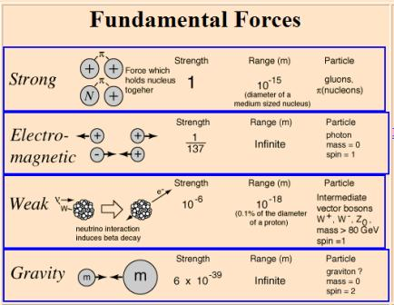
Does God Exist?

Slide 12
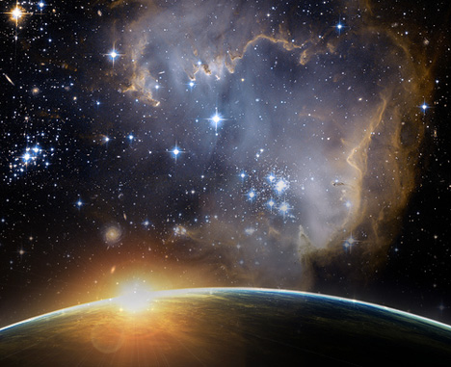
Does God Exist?
Without these forces the universe could not exist!

Slide 13
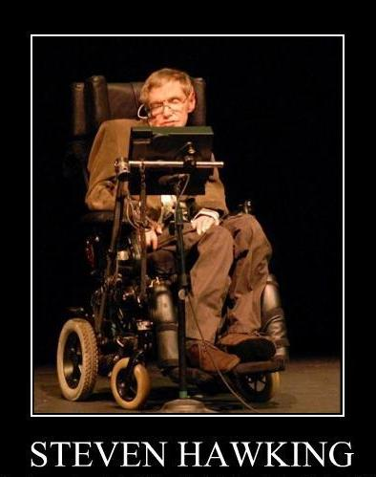
Does God Exist?
Why do these laws exist?
"Because there is a law such as gravity, the universe can and will create itself from nothing. Spontaneous creation is the reason there is something rather than nothing, why the universe exists, why we exist" (The Grand Design).

Slide 14
Does God Exist?
God established the laws of nature (Psalm 119:89-91).
In Him all things consist (Col. 1:16-17). “Hold together” (NASB).
“Upholding all things by the word of His power” (Heb. 1:3).

Slide 15
Does God Exist?
Arguments for Existence
1. Ontological Argument.
2. Cosmological Argument.
3. Argument from Natural Law.
4. Argument from Morality.
All human beings have some concept of “right” and “wrong”—this must have its origin in a moral source.

Slide 16
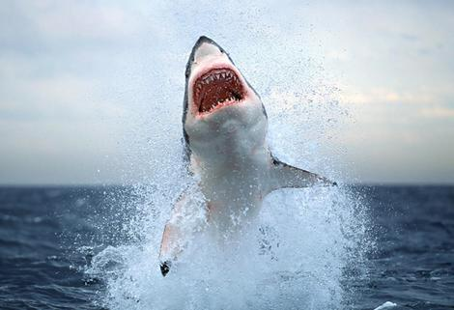
Does God Exist?
Why Does Man Have a Concept of Morality?
Animals are not moral creatures. They feel no guilt or moral duty.
Where Did Our Sense of Morality Come From?

Slide 17
Does God Exist?
“The breath of the Almighty gives him understanding” (Job 32:8).
Mature human beings (since the Fall) have a “knowledge of good and evil” (Gen. 2:9, 17; Deut. 1:39; Isa. 7:15-16).
This must be directed by God’s revelation (Romans 7:7-8).
Even criminals have a sense of morality

Slide 18
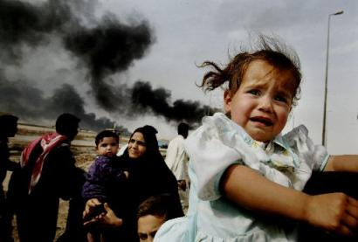
Does God Exist?
If God is the source of morality, why is there so much evil in the world?

Slide 19
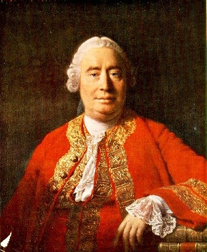
Does God Exist?
“Is he willing to prevent evil, but not able? Then he is impotent. Is he able, but not willing? Then he is malevolent. Is he both able and willing? Whence then is evil?” (David Hume).
If there is no God, why would we even care about “evil”?

Slide 20
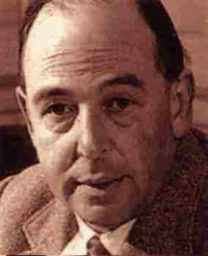
Does God Exist?
“We can, perhaps, conceive of a world in which God corrected the results of this abuse of free will by His creatures at every moment: so that a wooden beam became soft as grass when it was used as a weapon, and the air refused to obey me if I attempted to set up in it the sound waves that carry lies or insults. But such a world would be one in which wrong actions were impossible, and in which, therefore, freedom of the will would be void” (C.S. Lewis).

Slide 21
Does God Exist?
“God, who made the world and everything in it, since He is Lord of heaven and earth, does not dwell in temples made with hands. Nor is He worshiped with men's hands, as though He needed anything, since He gives to all life, breath, and all things. And He has made from one blood every nation of men to dwell on all the face of the earth, and has determined their preappointed times and the boundaries of their dwellings, so that they should seek the Lord, in the hope that they might grope for Him and find Him, though He is not far from each one of us” (Acts 17:24-27).
God made us
to “seek” Him

