Slide 1
Does God Exist?

Slide 2
Does God Exist?
Arguments for Existence
1. Ontological Argument.
2. Cosmological Argument.
3. Argument from Natural Law.
4. Argument from Morality.
5. Argument from Reason.
Reason is immaterial in nature, and could not result from a mere material, naturalistic cause.

Slide 3
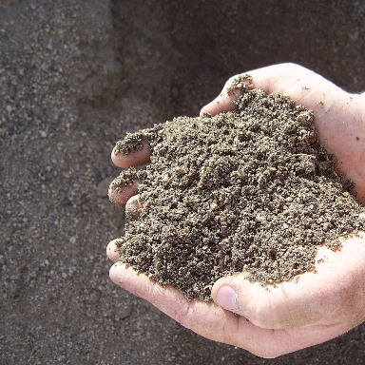
Does God Exist?
Does Matter Think?
Does it ponder the meaning of its own existence?
Why do we?
“The divine power is to be found in a principle of reason that pervades the whole of nature” (Cicero).

Slide 4
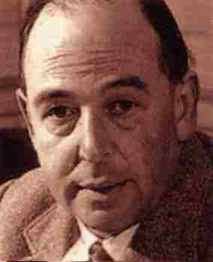
Does God Exist?
“One absolutely central inconsistency ruins [the popular scientific philosophy]. The whole picture professes to depend on inferences from observed facts. Unless inference is valid, the whole picture disappears... unless Reason is an absolute, all is in ruins. Yet those who ask me to believe this world picture also ask me to believe that Reason is simply the unforeseen and unintended by-product …”

Slide 5
Does God Exist?
“…of mindless matter at one stage of its endless and aimless becoming. Here is flat contradiction. They ask me at the same moment to accept a conclusion and to discredit the only testimony on which that conclusion can be based” (C.S. Lewis).
If we are nothing more that matter, how can we even ask the question “Does God Exist”?

Slide 6
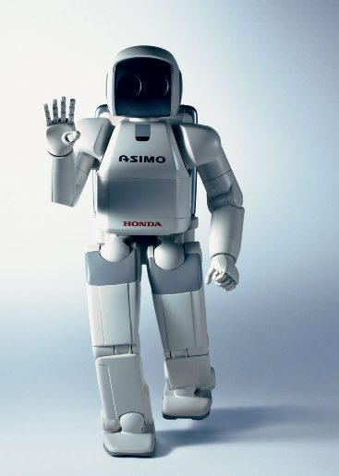
Does God Exist?
“Artificial Intelligence”
Will my computer one day start to reason?

Slide 7
Does God Exist?
“There is a spirit in man and the breath of the Almighty gives him understanding” (Job 32:8).
Reason is immaterial in nature
We are made in the image of God (Gen. 1:27-28).
“He fashions their hearts” (Psalm 33:13-15).

Slide 8
Does God Exist?
“‘Come now, and let us reason together,’ Says the LORD” (Isaiah 1:18).
Our very minds attest to the existence of God!

Slide 9
Does God Exist?
Arguments for Existence
1. Ontological Argument.
2. Cosmological Argument.
3. Argument from Natural Law.
4. Argument from Morality.
5. Argument from Reason.
6. Teleological Argument.
Design attests to a Designer.

Slide 10
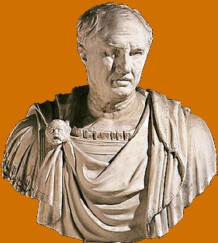
Does God Exist?
“When you see a sundial or a water-clock, you see that it tells the time by design and not by chance. How then can you imagine that the universe as a whole is devoid of purpose and intelligence, when it embraces everything, including these artifacts themselves and their artificers?” (Cicero).

Slide 11
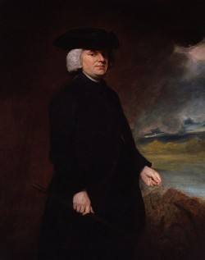
Does God Exist?
“In crossing a heath, suppose I pitched my foot against a stone, and were asked how the stone came to be there; I might possibly answer, that, for anything I knew to the contrary, it had lain there forever: nor would it perhaps be very easy to show the absurdity of this answer. But suppose I had found a watch upon the ground, and it should be inquired how the watch happened to be in that place;…”

Slide 12
Does God Exist?
“…I should hardly think of the answer I had before given, that for anything I knew, the watch might have always been there. ...There must have existed, at some time, and at some place or other, an artificer or artificers who formed [the watch] for the purpose which we find it actually to answer; who comprehended its construction, and designed its use.…”

Slide 13
Does God Exist?
“…Every indication of contrivance, every manifestation of design, which existed in the watch, exists in the works of nature; with the difference, on the side of nature, of being greater or more, and that in a degree which exceeds all computation.” (William Paley).
Is there a Divine “watchmaker”?

Slide 14
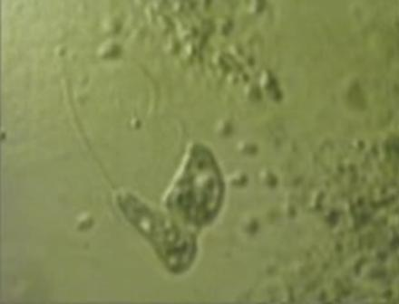
Does God Exist?
The Bacterial Flagellum

Slide 15
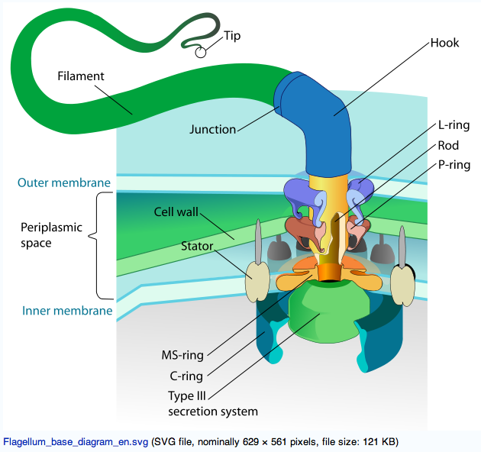
Does God Exist?
The Bacterial Flagellum

Slide 16
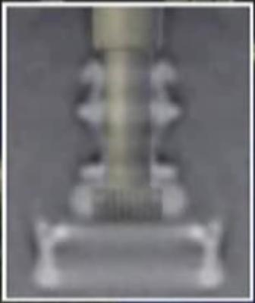
Does God Exist?
The Bacterial Flagellum
As seen through an electron mircograph magnified 50,000 times.

Slide 17
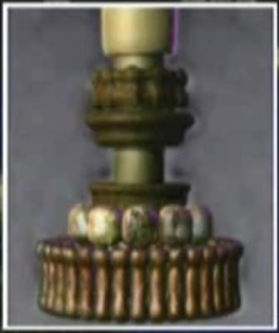
Does God Exist?
The Bacterial Flagellum
It is a microscopic outboard motor!

Slide 18
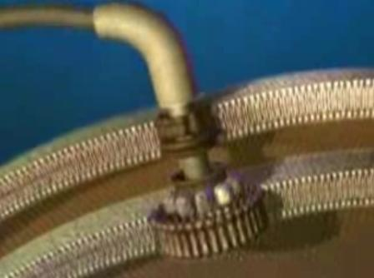
Does God Exist?
The Bacterial Flagellum
It runs at 100,000 rpm per second
and can reverse with ¼ turn!

Slide 19
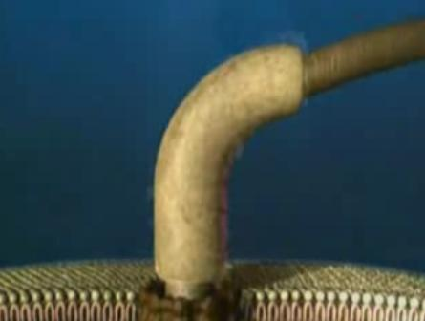
Does God Exist?
How is this machine formed?

Slide 20
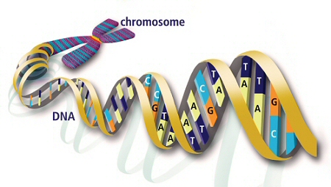
Does God Exist?
DNA
DNA contains four nucleotides which act as characters in a programming language.

Slide 21
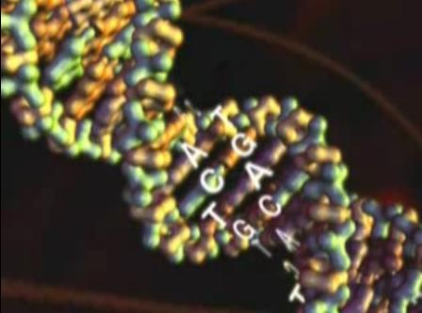
Does God Exist?
Much like a computer language, DNA in humans writes the 3 billion character code which forms an individual person.

Slide 22
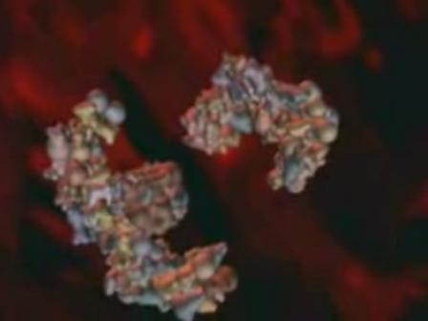
Does God Exist?
DNA sends instructions to form complex protein structures.

Slide 23
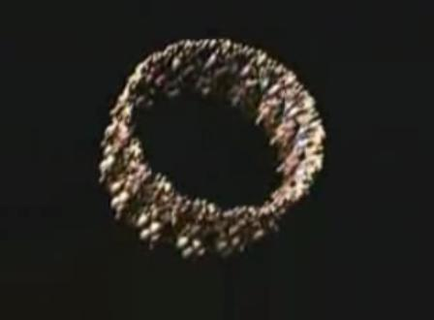
Does God Exist?
These protein structures form individual parts of cells.

Slide 24
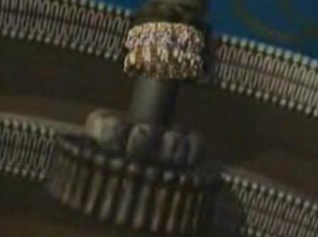
Does God Exist?
These are highly complex structures which follow the programming of DNA.

Slide 25
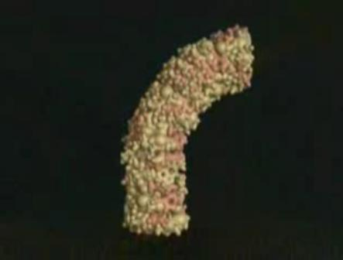
Does God Exist?
Such as the “hook” of the bacterial flagellum.

Slide 26
Does God Exist?
This is a precisely designed mechanism, for this complex nano-machine.

Slide 27
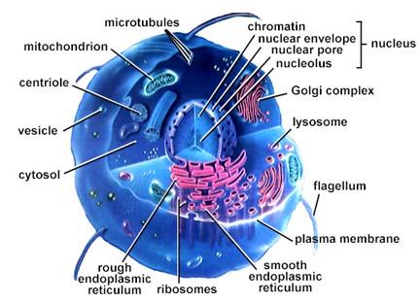
Does God Exist?
Even the most simple cell is a miniature “factory” which carries out manufacture, reproduction, energy production, repair and security.

Slide 28
Does God Exist?
Human life begins from two cells which blend ½ the DNA from the mother and father into one cell.
Within the nucleus of every cell in higher life forms is 1 gigabyte of coded information.
The human body is made up of 75 trillion cells (75,000,000,000,000).
Every three seconds 50,000 cells in our bodies die and are replaced by 50,000 more cells.

Slide 29
Does God Exist?
All of this happens in accordance with the programmed instructions of the DNA code.
Who wrote the program?

Slide 30
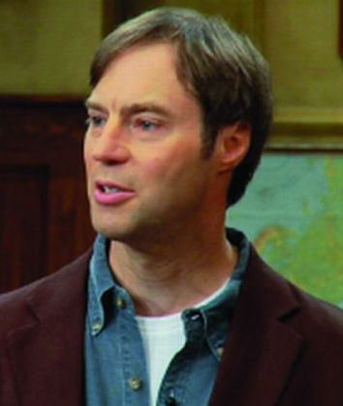
Does God Exist?
“Based on our uniform and repeated experience, which is the basis of all scientific reasoning about the past, there is only one known cause for the origin of information, and that cause is intelligence” (Stephen Meyer).

Slide 31
Does God Exist?
“I am fearfully and wonderfully made” (Psalm 139:13-16).
“The LORD God formed man of the dust of the ground” (Genesis 2:7).
“The hairs of your head are all numbered” (Matthew 10:29-31).
Every cell of our bodies is a testament to the existence, and mind of God!

Slide 32
Does God Exist?
Arguments for Existence
1. Ontological Argument.
2. Cosmological Argument.
3. Argument from Natural Law.
4. Argument from Morality.
5. Argument from Reason.
6. Teleological Argument.
7. Anthropic Argument.
The universe is “fine- tuned” for life.

Slide 33
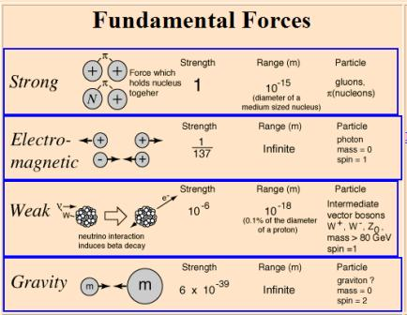
Does God Exist?

Slide 34
Does God Exist?
Natural Laws required for a universe:
Gravity for stars, galaxies, & habitable planets.
Strong nuclear force for chemistry. If it were reduced only slightly the only element left in the universe would be hydrogen.
Electromagnetic force for chemical bonding.
Cosmological constant (the speed at which the universe is expanding: any faster and objects could not form).

Slide 35
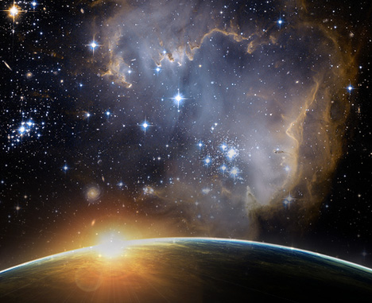
Does God Exist?
If any of these forces were even slightly weaker or stronger the universe (and especially life) could not exist. If gravity was slightly stronger all life (except bacteria would be crushed).

Slide 36
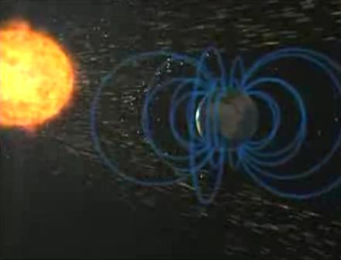
Does God Exist?
Factors necessary for complex life:
Magnetic fields (caused by liquid iron in core) to protect against solar wind.
Nitrogen/Oxygen atmosphere (for water & life).
Large moon (to stabilize rotation to provide stable seasons and moderate climate).
Dwarf star (too small, smaller habitable zone, closer, no rotation).

Slide 37
Does God Exist?
Factors necessary for complex life:
Right location in galaxy (the galactic habitable zone: too close to center, super novas, black holes—too far not enough heavy elements for allow for complex life; not too close to a spiral arm to avoid super novas).
System with larger planets to shield other planets from impact objects.

Slide 38
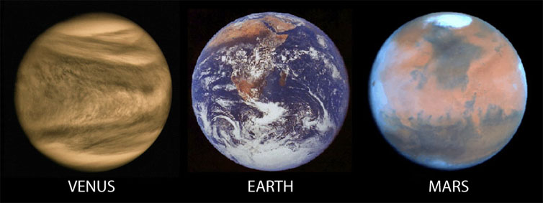
Does God Exist?
Importance of Earth’s Location
5% closer to sun would create a runaway “green house” effect such as we see on Venus and all liquid water would evaporate.

Slide 39
Does God Exist?
Importance of Earth’s Location
20% farther away and all water would freeze as we see on Mars.
Probability of all factors necessary for life 1/1,000,000,000,000,000.

Slide 40
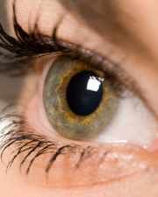
Does God Exist?
The Wonder of the Development of the Eye
When you and I were developing in the womb, 1,000,000 nerve endings left our brain, looking for 1,000,000 optic nerve in the developing eye!
God has been fine-tuning your life from the moment of your conception!

Slide 41
Does God Exist?
“Tell me if you know all this” (Job 38:16-38).
This entire universe is specially designed to allow and preserve life.
The earth is uniquely positioned to allow and preserve life.
Even the process of human development is a wondrous evidence of God’s existence!

Slide 42
Does God Exist?
Arguments for Existence
1. Ontological Argument.
2. Cosmological Argument.
3. Argument from Natural Law.
4. Argument from Morality.
5. Argument from Reason.
6. Teleological Argument.
7. Anthropic Argument.
8. Argument from Revelation.

Slide 43
Does God Exist?
God Has Revealed Himself
Through His Creation (Rom. 1:18-20; Psalm 19:1-6).

Slide 44
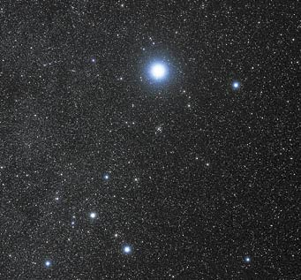
Does God Exist?
Canis Majoris

Slide 45
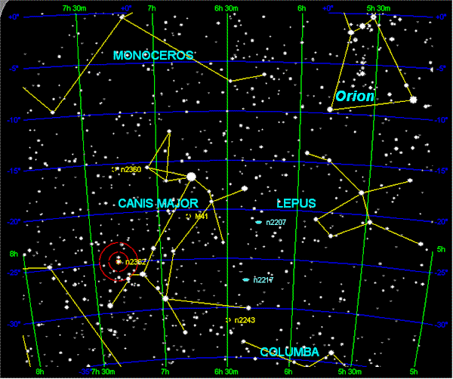
Does God Exist?
Canis Majoris

Slide 46
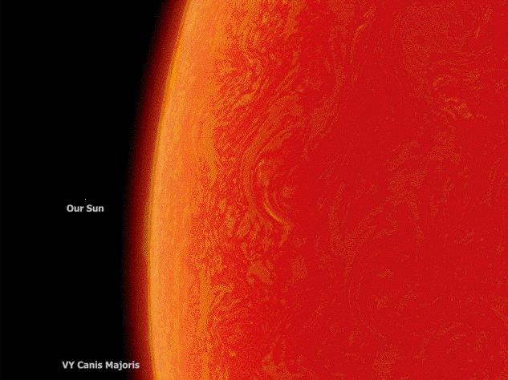
Does God Exist?
Canis Majoris
1.7 billion miles across!

Slide 47
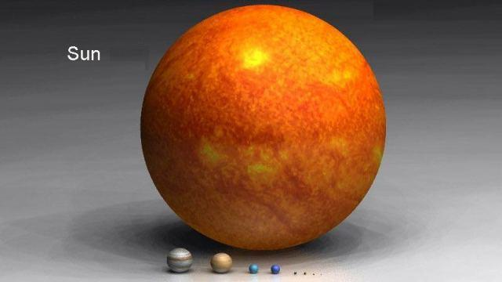
Does God Exist?
Our Solar System

Slide 48
Does God Exist?
Canis Majoris could hold 7 quadrillion (7,000,000,000,000, 000) earths inside it.
If the earth was a golf ball you could fill the entire state of Texas with golf balls 22 inches deep!

Slide 49
Does God Exist?
“By the word of the LORD the heavens were made, and all the host of them by the breath of His mouth” (Psalm 33:6).

Slide 50
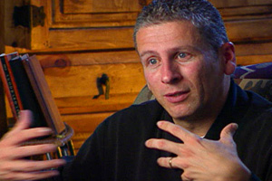
Does God Exist?
“Sin has a way of shrinking God down in our minds, and puffing us up in our own estimation. But just a glance into the universe that God has made resizes everything in a heartbeat” (Louie Giglio).

Slide 51
Does God Exist?
God Has Revealed Himself
Through His Creation (Rom. 1:18-20; Psalm 19:1-6).
Through His Word (Psalms 19:7-8; Deuteronomy 29:29).

Slide 52
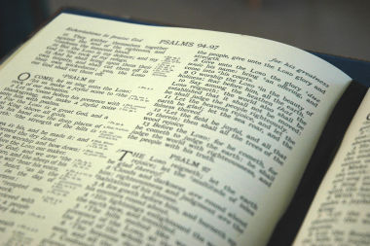
Does God Exist?
The Bible was written by about 40 hands, from different back- grounds and levels of education.
Over a span of some 1500 years.
Yet, it contains a unity of purpose and message unequalled in any human literature.

Slide 53
Does God Exist?
God Has Revealed Himself
Through His Creation (Rom. 1:18-20; Psalm 19:1-6).
Through His Word (Psalms 19:7-8; Deuteronomy 29:29).
Through His Son (Hebrews 1:1-4; 2 Timothy 1:8-10).

Slide 54
Does God Exist?
Jesus fulfilled over 300 OT prophesies about his birth, life, death, and teaching.
His life is attested by religious and secular historical writers.
His life has changed, laws, cultures, and individual lives more than anyone who has ever lived!

Slide 55
Does God Exist?
“God, who made the world and everything in it, since He is Lord of heaven and earth, does not dwell in temples made with hands. Nor is He worshiped with men's hands, as though He needed anything, since He gives to all life, breath, and all things. And He has made from one blood every nation of men to dwell on all the face of the earth, and has determined their preappointed times and the boundaries of their dwellings, so that they should seek the Lord, in the hope that they might grope for Him and find Him, though He is not far from each one of us…”

Slide 56
Does God Exist?
“…For in Him we live and move and have our being, as also some of your own poets have said, 'For we are also His offspring.' Therefore, since we are the offspring of God, we ought not to think that the Divine Nature is like gold or silver or stone, something shaped by art and man's devising. Truly, these times of ignorance God overlooked, but now commands all men everywhere to repent, because He has appointed a day on which He will judge the world in righteousness by the Man whom He has ordained. He has given assurance of this to all by raising Him from the dead” (Acts 17:24-31).
God made us
to “seek” Him
He will judge us through
Jesus Christ

