Slide 1
Ephesians 5:22-24
“Wives, submit to your own husbands, as to the Lord. For the husband is head of the wife, as also Christ is head of the church; and He is the Savior of the body. Therefore, just as the church is subject to Christ, so let the wives be to their own husbands in everything” (NKJV).

Slide 2
Ephesians 5:22-24
Submission of wife-husband illustrated by submission of church-Christ
Both “in everything” (24b)
Why?
Husband: “head of the wife” (23a)
Christ: “head of the church; and He is the Savior of the body” (23b)

Slide 3
Saint-Pierre, Martinique
May 8, 1902

Slide 4
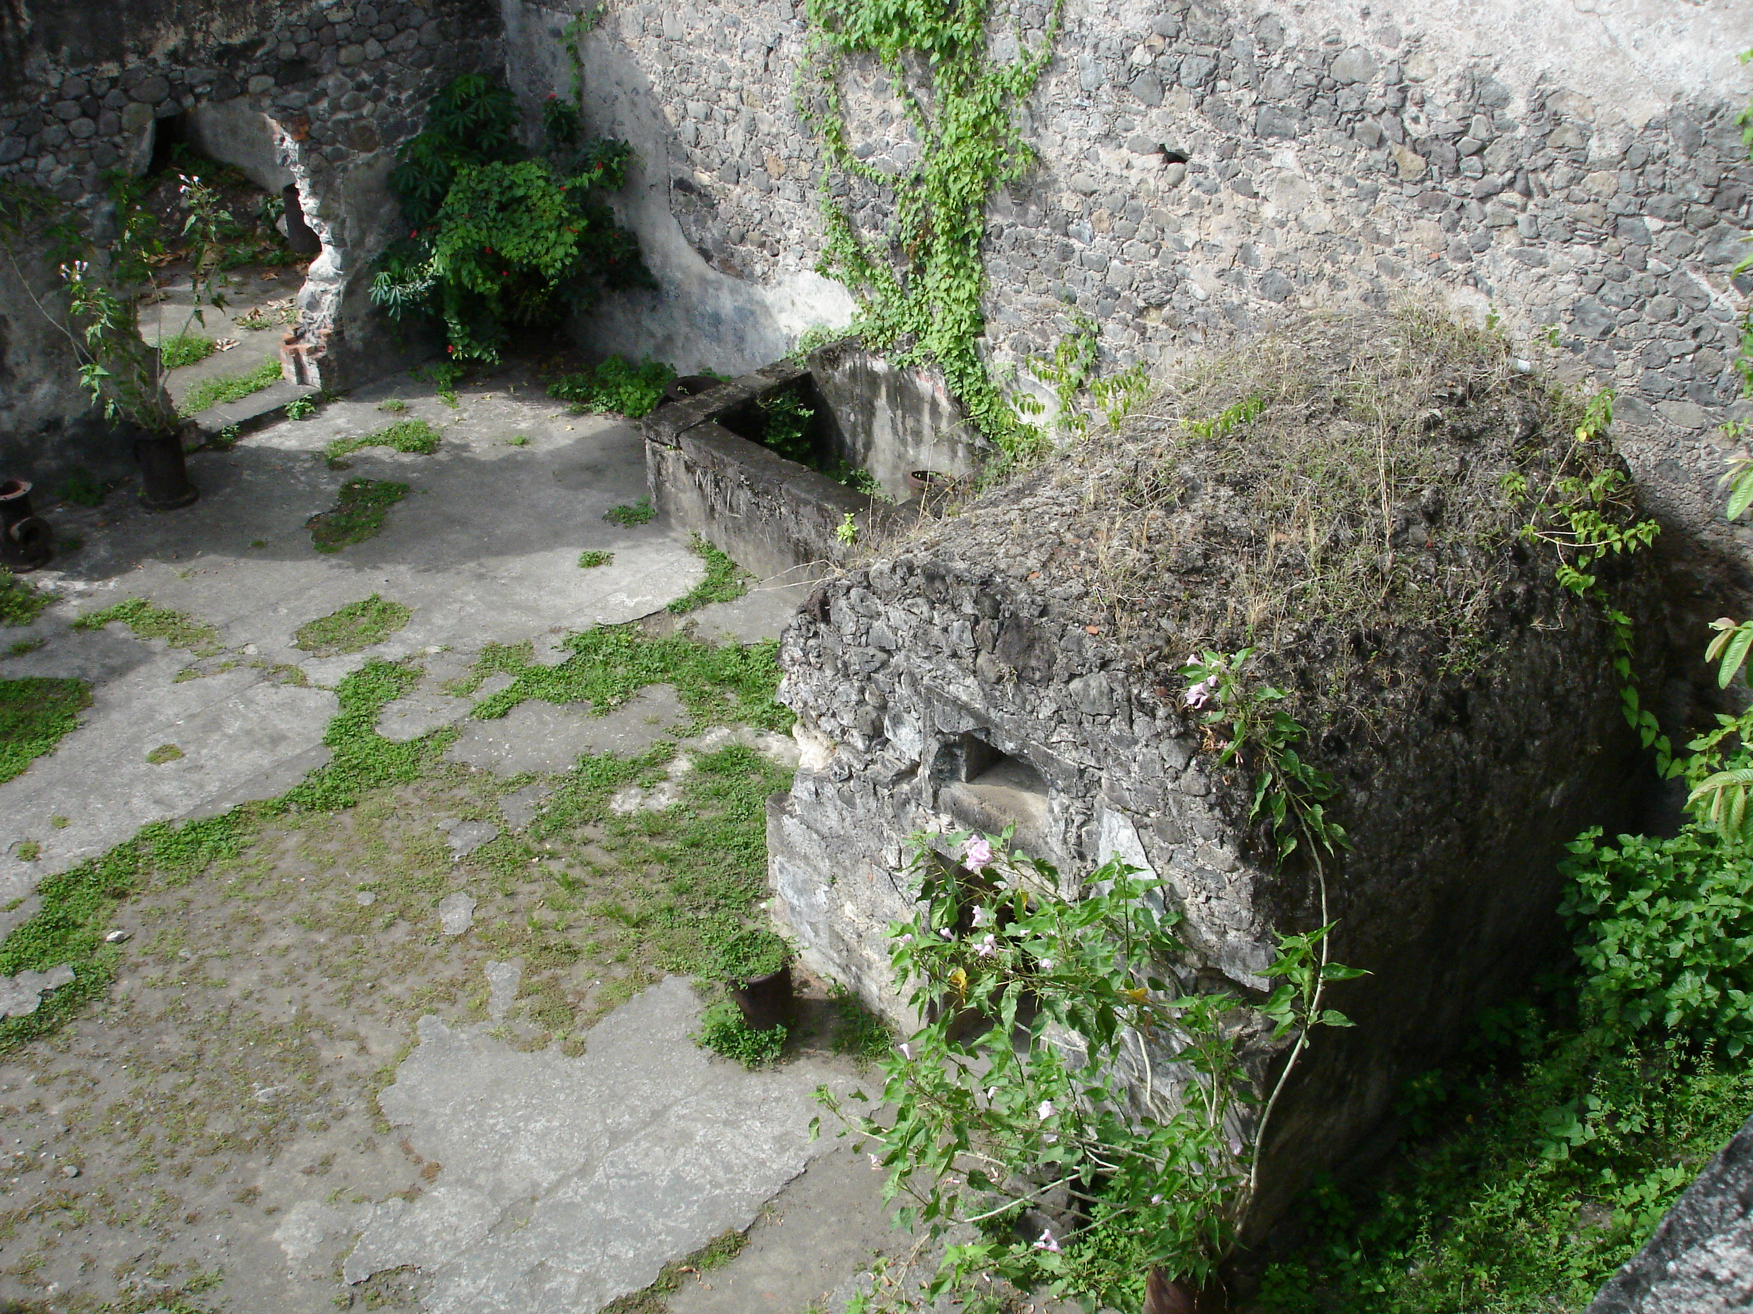
Saint-Pierre, Martinique
Ludger Sylbaris

Slide 5
The Church and Her Savior
We All Need a Savior
The Problem of Sin
All: “under law toward Christ” (1 Cor. 9:21)
To break Christ’s law (1 John 3:4), fail to obey it (Jas, 4:17), or violate conscience (Rom. 14:23) is “sin.”
Conflict, enmity, separation from God (Isa. 59:1-2; Rom. 8:7-8; Col. 1:21-23; Jas. 4:4)
Salvation
Words
Confusion

Slide 6
The Church and Her Savior
Divine Atonement
God is “of purer eyes than to behold evil, and cannot look on wickedness” (Hab. 1:13a).
“Greater love has no one than this, than to lay down one’s life for his friends” (John 15:13).
“For He made Him who knew no sin to be sin for us, that we might become the righteousness of God in Him” (2 Cor. 5:21).
“Just and the Justifier” (Rom. 3:26)
Salvation
Words
Confusion

Slide 7
The Church and Her Savior
Salvation
Words
Confusion
The Call of the Gospel
2 Thessalonians 2:13-14
1 Peter 2:9
Galatians 3:26-28
2 Timothy 1:9

Slide 8
The Church and Her Savior
The Lord’s Church
“Holy calling” unto fellowship in. . .
A body (1 Cor. 12:12-27), a family (Eph. 3:14-15), a vine (John 15:1-8), a flock (John 10:1-16), a building (1 Cor. 3:9), a temple (1 Cor. 3:16-17), and a kingdom (Col. 1:13-14).
Salvation
Words
Confusion

Slide 9
The Church and Her Savior
The Lord’s Church
Not different people in different relationships to God
Ways of describing those in fellowship with God in Christ that each teach us different things
Our focus is on the figure of “the church.”
Salvation
Words
Confusion

Slide 10
The Church and Her Savior
Two Words behind “Church”
Ekklēsia (ἐκκλησία)
“out-calling” or “out of the people”
Behind every use of “church”
Greek political assembly (Acts 19:39)
Assembly of disciples of Christ
Salvation
Words
Confusion

Slide 11
The Church and Her Savior
Two Words behind “Church”
Kuriakos (κυριακός)
“belonging to the Lord”
“Lord’s day” (Rev. 1:10)
“Lord’s Supper” (1 Cor. 11:20)
Used of “Lord’s household” (cf. Eph. 2:10)
Salvation
Words
Confusion

Slide 12
The Church and Her Savior
Early Translations
Transliterated ekklēsia
Germanic languages emphasized kuriakos
Kirche —> cirice —> chirche
Salvation
Words
Confusion
“Congregation” | “Church”
Tyndale; Great Bible; Bishop’s | Geneva; Rheims-Douay; KJV

Slide 13
The Church and Her Savior
Conceptual Confusion
Have we brought worldly concepts about the church into our own views?
What if all English Bibles had translated ekklēsia “congregation” or “assembly”?
Would we struggle with as many misconceptions?
Salvation
Words
Confusion

Slide 14
The Church and Her Savior
Conceptual Confusion
1. The Church Is a Building.
In NT ekklēsia never used of a building
It assembled in temple courts (Acts 5:12), private homes (Rom. 16:5; 1 Cor. 16:19; Col. 4:15), a school (Acts 19:9), and perhaps a building for that purpose (Jas. 2:2).
Salvation
Words
Confusion

Slide 15
The Church and Her Savior
Conceptual Confusion
1. The Church Is a Building.
The ekklēsia is commanded to assemble (Heb. 10:25)
Authority to secure a place for the ekklēsia to assemble, but the place is not the “church.”
Salvation
Words
Confusion

Slide 16
The Church and Her Savior
Conceptual Confusion
2. The Church Is Made up of Many Different Churches.
Jesus built His church (Matt. 16:18)
“There is one body and one Spirit, just as you were called in one hope of your calling” (Eph. 4:4)
Salvation
Words
Confusion

Slide 17
The Church and Her Savior
Conceptual Confusion
2. The Church Is Made up of Many Different Churches.
Universal (Heb. 12:23)
Local (Acts 11:23; Rev. 2:8)
Assembled (Col. 4:16; 1 Cor. 11:18)
Salvation
Words
Confusion

Slide 18
The Church and Her Savior
Conceptual Confusion
2. The Church Is Made up of Many Different Churches.
Called “church of God” (Acts 20:28; 1 Cor. 1:2; 10:32; 11:22; 15:9; 2 Cor. 1:1; Gal. 1:13; 1 Tim. 3:5), “church of the living God” (1 Tim. 3:15) “church of the firstborn (pl.)” (Heb. 12:23); “churches of Christ” (Rom. 16:16); “churches of God” (1 Cor. 11:16; 1 Thess. 2:14; 2 Thess. 1:4)
Salvation
Words
Confusion

Slide 19
The Church and Her Savior
Conceptual Confusion
2. The Church Is Made up of Many Different Churches.
Not formal titles of distinct organizations (or denominations).
Descriptions of ownership and identity
Taught and practiced the same (1 Cor. 4:17)
Salvation
Words
Confusion

Slide 20
The Church and Her Savior
Conceptual Confusion
3. The Church of Christ is a Denomination.
Sadly, more Christians now think this way.
Ed Harrell’s warning in 1962 has come true.
Amarillo church in cooperation with Baptist, Methodist, and Presbyterian congregations.
“Like all the nations” (1 Sam. 8:5b)
Salvation
Words
Confusion

Slide 21
The Church and Her Savior
Conceptual Confusion
3. The Church of Christ is a Denomination.
We are to be distinct from the world.
“And if anyone does not obey our word in this epistle, note that person and do not keep company with him, that he may be ashamed” (2 Thess. 3:14).
Salvation
Words
Confusion

Slide 22
The Church and Her Savior
Conceptual Confusion
3. The Church of Christ is a Denomination.
“If anyone comes to you and does not bring this doctrine, do not receive him into your house nor greet him; for he who greets him shares in his evil deeds” (2 John 10-11)
Are we like those who “loved the praise of men more than the praise of God” (John 12:43)?
Salvation
Words
Confusion

Slide 23
The Church and Her Savior
Conceptual Confusion
4. The Church and the Kingdom Are Different Groups.
Christ’s body (1 Cor. 12:12-27), His family (Eph. 3:14-15), His flock (John 10:1-16), or His kingdom (Col. 1:13-14)
Premillennialism | Distinct Aspects
Salvation
Words
Confusion

Slide 24
The Church and Her Savior
Conceptual Confusion
4. The Church and the Kingdom Are Different Groups.
Matthew 13:38, “The field is the world, the good seeds are the sons of the kingdom, but the tares are the sons of the wicked one.”
Kingdom describes realm, reign, jurisdiction
Salvation
Words
Confusion

Slide 25
The Church and Her Savior
Conceptual Confusion
4. The Church and the Kingdom Are Different Groups.
Specific aspects applied to the different figures
Kingdom has no elders, deacons; temple has no branches
Does not mean different people
Salvation
Words
Confusion

Slide 26
The Church and Her Savior
Conceptual Confusion
5. The Church Should Not Be Emphasized.
“Emphasize Christ, not the church”
Members of Christ’s body (Eph. 5:30)
Family of God (Eph. 3:14-15; Heb. 2:11).
Flawless? No, , but a special people (Titus 2:14; 1 Pet. 2:9)
Salvation
Words
Confusion

Slide 27
The Church and Her Savior
Conceptual Confusion
5. The Church Should Not Be Emphasized.
Because God set them apart unto Himself (Acts 20:32; 1 Cor. 6:11; Heb. 10:14; Jude 1).
This assembly of God’s people is special (Heb. 12:22-23).
We should appreciate it, respect its work, leadership, and identity.
Salvation
Words
Confusion

Slide 28
The Church and Her Savior
Conceptual Confusion
5. The Church Should Not Be Emphasized.
We should honor it.
To dishonor it is to dishonor God.
It belongs to Him. He established it.
Christ purchased it with His blood (1 Pet. 1:17-19).
Salvation
Words
Confusion

Slide 29
The Church and Her Savior
Conceptual Confusion
5. The Church Should Not Be Emphasized.
Old Testament Background
“Congregation of the Lord” (Num. 16:3; 20:4; Deut. 23:2-4; Mic. 2:5; 1 Chr. 28:8; et al.).
Qāhāl was a special assembly with rules regarding who could be a part of it.
Salvation
Words
Confusion

Slide 30
The Church and Her Savior
Conceptual Confusion
6. What the Individual Can Do the Church Can Do.
Can the local church do everything that individual Christians can do?
At the heart of institutional division
Salvation
Words
Confusion

Slide 31
The Church and Her Savior
Conceptual Confusion
6. What the Individual Can Do the Church Can Do.
“What! Do you not have houses to eat and drink in? Or do you despise the church of God?” (1 Cor. 11:22a).
Was it inherently sinful to eat food? No.
Salvation
Words
Confusion

Slide 32
The Church and Her Savior
Conceptual Confusion
6. What the Individual Can Do the Church Can Do.
In the context of the assembly it was to “despise the church of God” (11:22).
“If anyone is hungry let him eat at home, lest you come together for judgment” (11:34a).
Salvation
Words
Confusion

Slide 33
The Church and Her Savior
Conceptual Confusion
7. I Can Be Saved but Not Be a Member of the Lord’s Church.
Acts 2:46-47
“The Lord was adding to their number day by day those who were being saved” (NASB, cf. ESV, NIV, RSV, ASV, CSB).
Salvation
Words
Confusion

Slide 34
The Church and Her Savior
Conceptual Confusion
7. I Can Be Saved but Not Be a Member of the Lord’s Church.
Does that distinguish those who are “saved” from the group identified as the “church”?
No! Acts 5:11, same group “church.”
Salvation
Words
Confusion

Slide 35
The Church and Her Savior
Conceptual Confusion
7. I Can Be Saved but Not Be a Member of the Lord’s Church.
All mss epi to auto (ἐπὶ τὸ αὐτό)
Semi-technical term Acts 1:15; 2:1, 47; 1 Cor. 1:20; 14:23,et al. “signifies the union of the Christian body, and perhaps could be rendered ‘in the church fellowship.’”
Salvation
Words
Confusion

Slide 36
The Church and Her Savior
Conceptual Confusion
7. I Can Be Saved but Not Be a Member of the Lord’s Church.
The church is the saved
“Church of God which He purchased with His own blood” (Acts 20:28b)
“Church of the firstborn who are registered in heaven” (Heb. 12:23a)
Salvation
Words
Confusion

Slide 37
The Church and Her Savior
“Save Us”
“She will bring forth a Son, and you shall call His name Jesus, for He will save His people from their sins” (Matt. 1:21)
Yēšuaʿ (Hebrew for “Jesus,” i.e., “Yahweh is salvation”)
Matthew 8:23-27; 14:22-33

