Slide 1
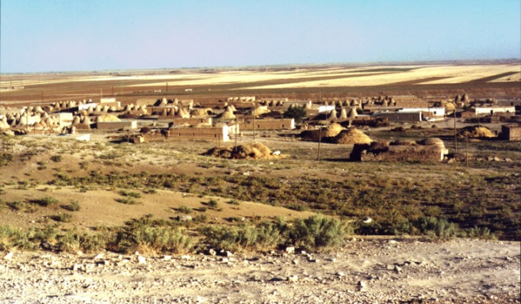
Joseph: Man of Dreams
Two
Patriarchs
I. Background of Joseph.
A. Parents. Jacob – son of Isaac – son of Abraham.
1. Jacob deceived Isaac and received the birthright (Gen. 29).
2. Loves Rachel (Gen. 29:11-14; 15-18; 23-27; 30).
3. Twelve sons: Leah (Reuben, Simeon, Levi, Judah, Issachar, Zebulon); Zilpah (Gad, Asher); Bilhah (Dan, Naphtali); Rachel (Joseph, Benjamin).
Delete text and place photo here.
Harran
Background
Life
Lessons

Slide 2
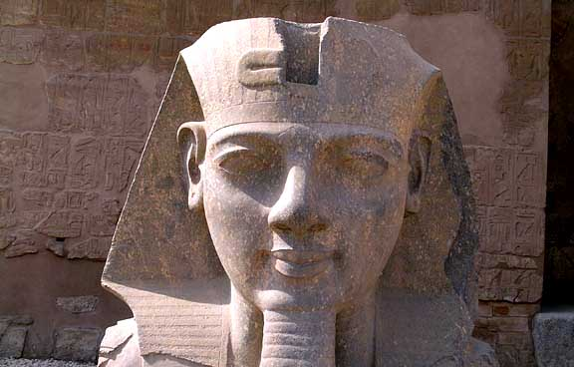
Joseph: Man of Dreams
Two
Patriarchs
II. The Life of Joseph.
A. Joseph’s dream (Gen. 37:1-11).
1. His brothers’ plot (Gen. 37:12-14; 18-36).
B. In Potiphar’s house (Gen. 39:1-23).
C. In prison (Gen. 40:1-3; 12-14; 18-19; 20-23).
D. Pharaoh’s dreams (Gen. 41:1-4; 5-7; 14-16; 25-42).
Delete text and place photo here.
Egyptian Pharaoh
Background
Life
Lessons

Slide 3
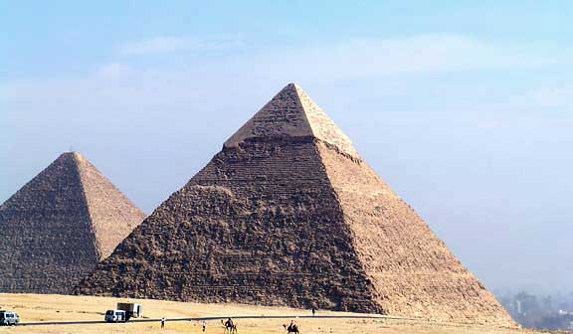
Joseph: Man of Dreams
Two
Patriarchs
II. The Life of Joseph.
E. His brothers (Gen. 42:1-4).
1. Joseph sees his brothers (Gen. 42:6-9; 17-24).
F. Brothers return to Jacob (Gen. 42:36-38; 43:8-10).
G. Joseph’s test (Gen. 44:4, 12-13).
H. Joseph makes himself known (Gen. 45:1-10; 50:22-26).
Delete text and place photo here.
Egyptian Pyramids
Background
Life
Lessons

Slide 4
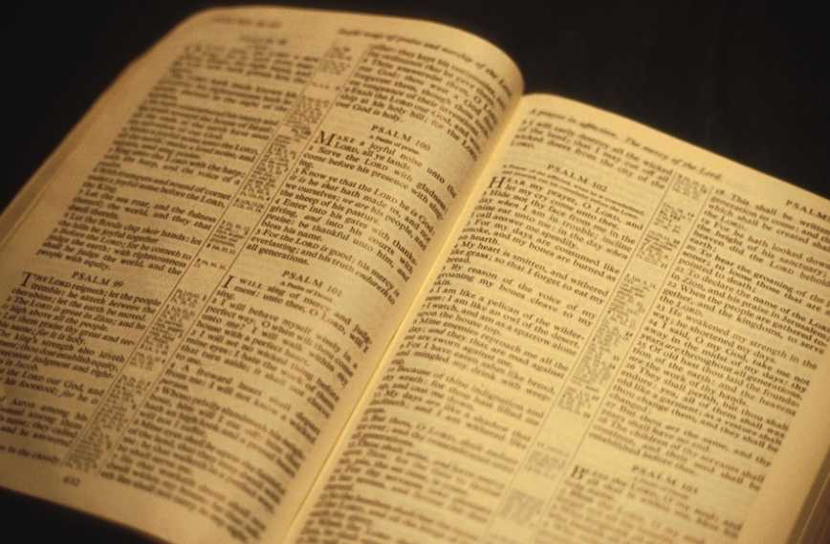
Joseph: Man of Dreams
Two
Patriarchs
III. Lessons from Joseph.
A. How to endure ridicule (Matt. 5:11-12).
B. How to resist temptation (James 4:7).
C. How to forgive others (Matt. 18:21-22).
D. How to give God the glory (Rom. 15:4-6).
Delete text and place photo here.
Background
Life
Lessons

