Slide 1
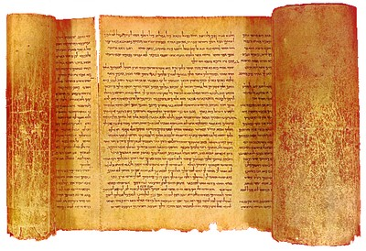
Isaiah 6:1-4
“In the year that King Uzziah died, I saw the Lord sitting on a throne, high and lifted up, and the train of His robe filled the temple. Above it stood seraphim; each one had six wings: with two he covered his face, with two he covered his feet, and with two he flew. And one cried to another and said…”

Slide 2
Isaiah 6:1-4
“…’Holy, holy, holy is the LORD of hosts; The whole earth is full of His glory!’ And the posts of the door were shaken by the voice of him who cried out, and the house was filled with smoke” (NKJV).

Slide 3
The Call of Isaiah
I. Isaiah sees…
A. The authority of God (Exod. 34:29; Psa. 19:1; 2 Chron. 2:5; Job 33:12).
B. The greatness of God (Psa. 145:1-7; Jer. 32:17-20; Rev. 15:3-4; John 3:16; 1 Cor. 6:19-20).

Slide 4
The Call of Isaiah
II. Isaiah’s realization.
A. He is unworthy (Isa. 6:5; Psa. 51:1-4; Luke 18:13).
B. God is merciful (Isa. 6:6-7; Rom. 5:8; Psa. 8:3-4; Eph. 2:8-9; 1 John 3:1).
C. Service is a privilege (Isa. 6:8; Matt. 16:24; Luke 14:26).

