Slide 1
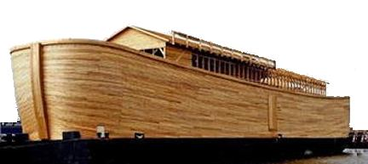
The Salvation of Noah (Genesis 6:13-22)
Noah
Christ
One Ark
One Wood
One Window
One Doorway
One Family
Safe in Ark
The Flood
One Church (Col. 1:17-20).
One Baptism (Acts 2:38; 8:38, 39).
One Book (2 Tim. 3:14-17).
One Way to God (John 10:1-7).
One Family in Christ (Eph. 3:14-15).
Safe in Christ (Rom. 8:1).
The Judgment

