Slide 1
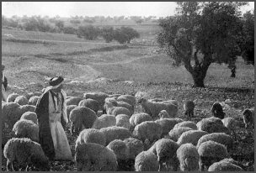
“The Good Shepherd” (John 10:11-18)
I. He Knows His Sheep (vs. 14). No. 272
“This one is known by Him” (1 Cor. 8:3).
“This is love for God” (1 John 5:3).
To be known by God we must love God and keep His commandments.

Slide 2
“The Good Shepherd” (John 10:11-18)
II. He Provides for Them (John 10:9). No. 375
“Every spiritual blessing” (Eph. 1:3).
“All things that pertain to life and godliness” (2 Pet. 1:3).
He provides for us through His word.

Slide 3
“The Good Shepherd” (John 10:11-18)
III. He Guides Them (John 10:2-5). No. 391
We can’t direct ourselves (Jer. 10:23).
“You will guide me in Youd counsel” (Ps. 73:24).
Will we let Him guide us?

Slide 4
“The Good Shepherd” (John 10:11-18)
IV. He Dies for Them (John 10:11). No. 123
Why would a shepherd risk His life?
The hireling does not care (John 10:12-13).
“Precious blood of Christ” (1 Pet. 1:17-25).

