Slide 1
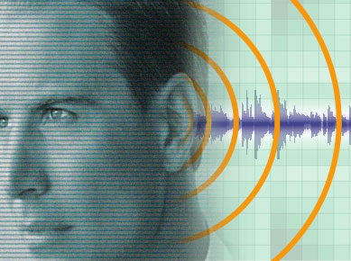
How Well Do You Listen?
Different Types Of Listeners
Those hard of hearing Matt. 13:13-15
Those dull of hearing Heb. 5:11
Those with itching ears 2 Tim. 4:3-4
Those with good and noble hearts, who listen with readiness Luke 8:15; Acts 17:11
What kind of listener are you?

Slide 2
How Well Do You Listen?
Importance Of Good Listening
To be blessed Matt. 13:16-17
To have saving faith Rom. 1:16-17; 10:14-17
To bear fruit Luke 8:15; Col. 1:6
To prevent apostasy Heb. 2:1-3
To avoid rejection Matt. 10:14-15; Acts 13:44-49
To escape condemnation Mt 12:41-42

