Slide 1
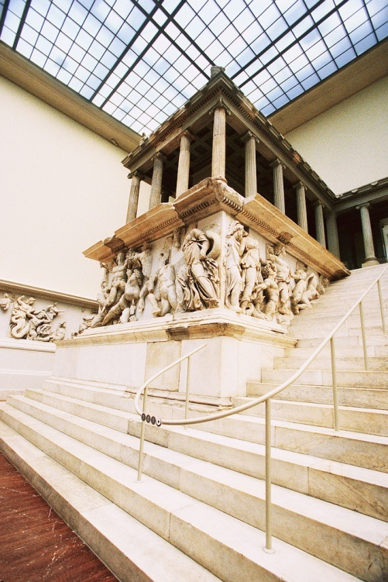
Modern idolatry
Temple of Zeus from Pergamum

Slide 2
MODERN IDOLATRY
MATTHEW 4:8-11
“Again, the devil took him to a very high mountain, and showed him all the kingdoms of the world in their glory. And he said unto him, ‘All these will I give you, if you will fall down and worship me.’ Then Jesus said unto him, ‘Be gone, Satan! For it is written, ‘You shall worship the Lord your God, and him only shall you serve.’”

Slide 3
GOD’S DISPLEASURE WITH IDOLATRY
First of the Ten Commandments
“You shall have no other gods before Me” (Exod. 20:3).
Children of Israel were to destroy the inhabitants of the land because they worshipped false Gods – Deut 7:1-6
Prophets continually pleaded for Israel to turn from other gods back to the True God of all the universe.

Slide 4
GOD’S DISPLEASURE WITH IDOLATRY
Paul preached against the false gods of the Gentiles in Athens– Acts 17:22-31
God has always hated those things that came between us and our service to Him!

Slide 5
Our idol may not look like this

Slide 6
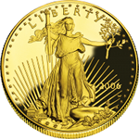
MODERN IDOLS
RICHES or WEALTH
Matthew 6:24
1 Timothy 6:8-10
Mark 10:17-22

Slide 7
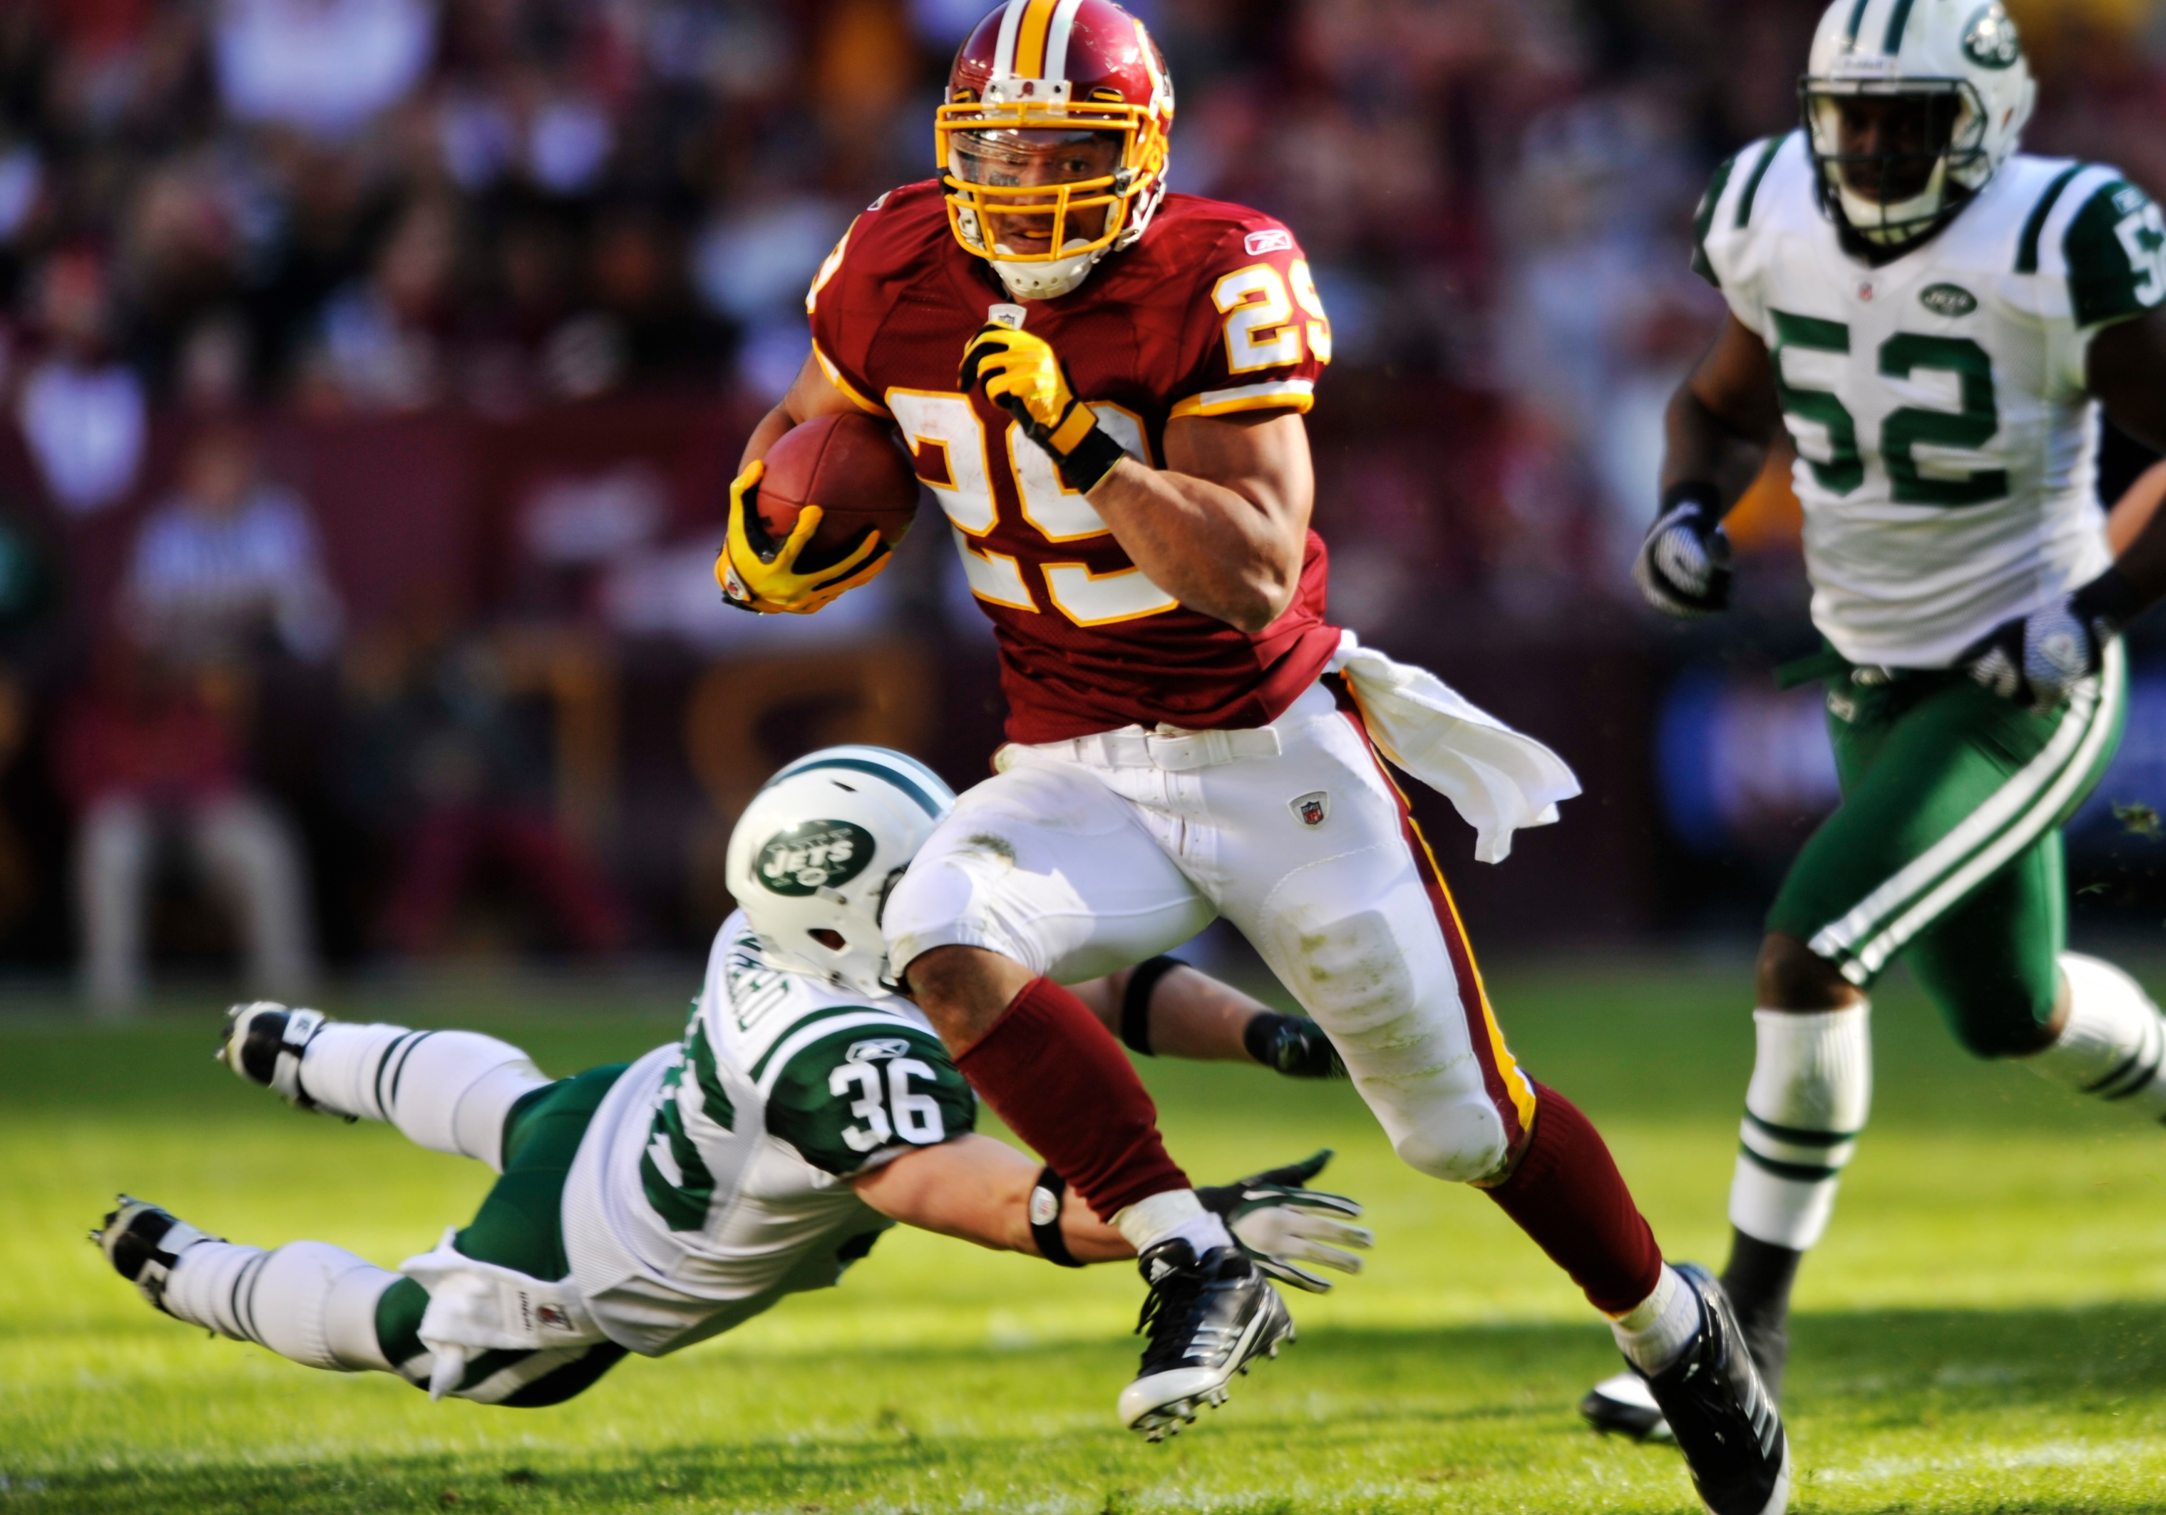
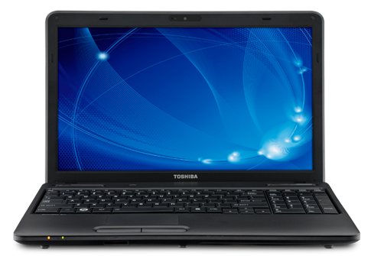
MODERN IDOLS
RECREATION
Sports
Computer
Internet
Games
Television
Other things

Slide 8
MODERN IDOLS
None of these things are necessarily wrong on their own!
1 TIMOTHY 4:8
”For bodily exercise profits a little, but godliness is profitable for all things, having promise of the life that now is and of that which is to come.”

Slide 9
MODERN IDOLS
RELATIONSHIPS
Family Relationship
Friendship
MATTHEW 10:37-39
“Whoever loves father or mother more than Me is not worthy of Me, and whoever loves son or daughter more than Me is not worthy of Me. And whoever does not take his cross and follow Me is not worthy of me. Whoever finds his life will lose it, and whoever loses his life for My sake will find it.”

Slide 10
MODERN IDOLS
JOHN 12:42
“Nevertheless, even among the rulers, many believed in Him, but because of the Pharisees they did not confess Him, lest they should be put out of the synagogue; for they loved the praise of men more that the praise of God.”

Slide 11
MODERN IDOLS
WHAT DOES YOUR IDOL LOOK LIKE?
Money?
TV, phone or computer?
Another person?
Yourself?

