Slide 1
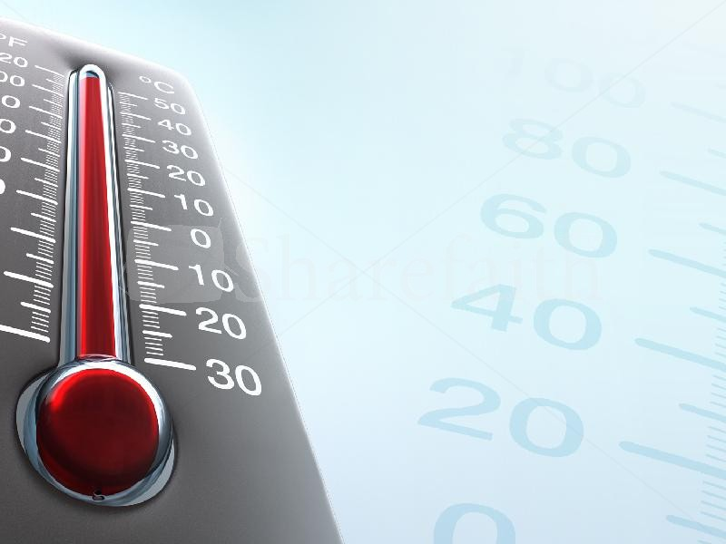
“Neither Hot Nor Cold”
(Revelation 2:14-22)
I. Sin (Col. 3:1-3, 5-10, 12-13).
A. Sins of commission (Heb. 10:26-27; Gal. 5:19-21).
B. Sins of omission (James 4:17; Matt. 5:38-48; Gal. 5:22-23).

Slide 2
II. Prayer (Col. 2:19).
A. Without ceasing (1 Thes. 5:17).
B. “In all things” (Phil. 4:5-7).
C. Intercession (Heb. 7:24-25; Rom. 8:26-28).

Slide 3
“Neither Hot Nor Cold”
(Revelation 2:14-22)
III. Study (2 Tim. 3:16; 2 Pet. 1:5-9).
A. Not ashamed (2 Tim. 2:14-16).
B. Not a “babe” (Heb. 5:12-6:6).

Slide 4
IV. Assembly with the church.
A. Forsaking the assembly (Heb. 10:23-31).
B. The church in Jerusalem (Acts 2:40-47).

Slide 5
V. Evangelism.
A. “Always be ready” (1 Pet. 3:15-16).

