Slide 1
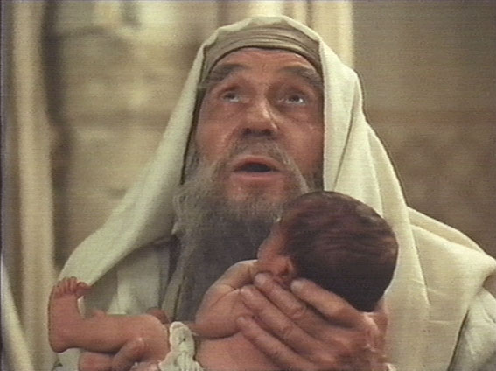
What Simeon Saw
I. Simeon Saw Salvation.
“My eyes have seen Your salvation” (Luke 2:30; Matt. 1:20-21).
John would “make ready a people for the Lord” (Luke 1:17; 1:67-79; Matt. 3:1-3).

Slide 2
What Simeon Saw
II. Simeon Saw Fulfilled Prophecy.
“You have prepared before the face of all peoples” (Luke 2:31).
Scripture fulfilled (Luke 24:25-27).
NT preaching (Acts 2:23; 3:18; Gal. 4:4).

Slide 3
What Simeon Saw
III. Simeon Saw Light for the Gentiles.
“A light to bring revelation to the Gentiles” (Luke 2:32a; Isa. 49:6; 51:4).
Christ revealed light to the Gentiles (Isa. 11:10; Psa. 98:2-3; Isa. 52:10).

Slide 4
What Simeon Saw
IV. Simeon Saw Glory for Israel.
“The glory of Your people Israel” (Luke 2:32b; Rom. 2:28-29; 9:6; Gal. 6:16).
Angel to Mary (Luke 1:30-33).
Paul at Antioch (Acts 13:42-47).

