Slide 1
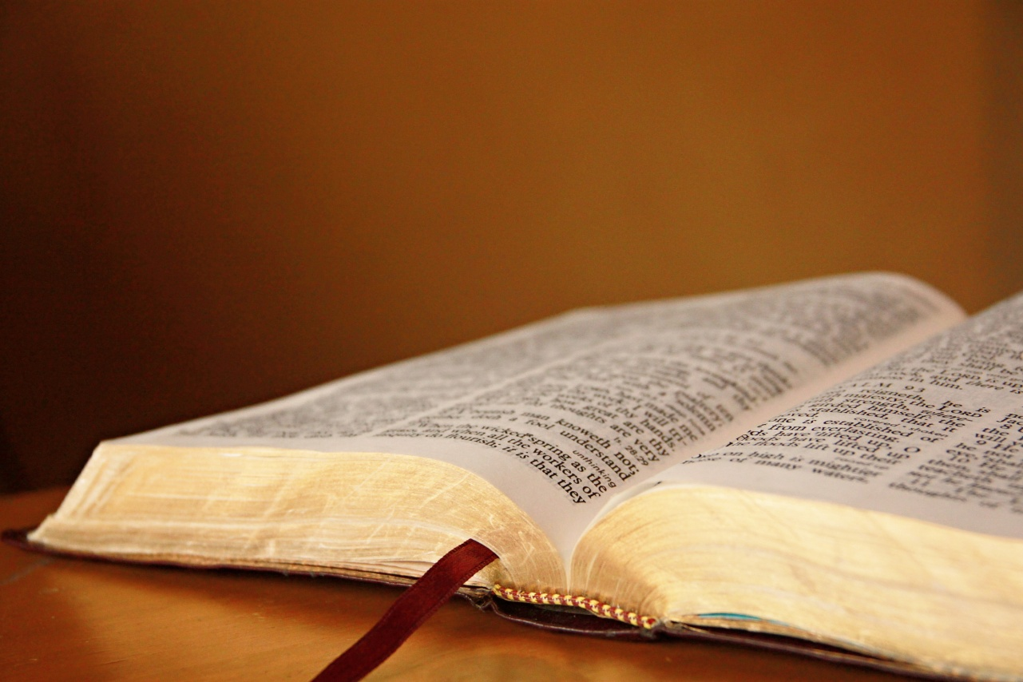
What’s Your Standard?
God’s Word?
John 12:45-49

Slide 2
What’s Your Standard?
The World?
Rom. 12:1-2; Jas. 4:4; 1 John 2:15-17

Slide 3
What’s Your Standard?
Your Opinions?
Isaiah 55:8-9; Jeremiah 10:23

Slide 4
What’s Your Standard?
Your Conscience?
Acts 26:9-11; 23:1; Romans 2:12-16

Slide 5
What’s Your Standard?
Your Friends?
1 Corinthians 15:33; Proverbs 12:26

Slide 6
What’s Your Standard?
Tradition?
Matthew 15:1-9; Colossians 2:8-10

Slide 7
What’s Your Standard?
Science?
1 Timothy 6:20-21; Deut. 29:29

Slide 8
What’s Your Standard?
No Standard?
Matt. 12:30; Rom. 1:28; Josh. 21:25

Slide 9
What’s Your Standard?
God’s Word!
Psa. 19:7-8; 1 Pet. 1:22-25; Matt. 24:35

