Slide 1
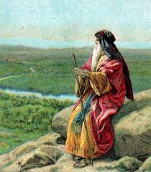
How Moses Entered The Promised Land

Slide 2
The Promised Land
1 Corinthians 10:1-11
Canaan was a fore-shadow of heaven
The Israelites lost their entrance
Could Moses lose it as well?
Numbers 20:1-11
Let us see all the reasons why Moses was allowed to enter the Promised Land

Slide 3
Moses Made It If:
Having other virtues make up for sin
Number 12:3
-Forsake the assembly BUT be generous
-Drink BUT never curse
If just a few sins don’t matter, then Moses made it to the Promised Land

Slide 4
Moses Made It If:
Doing things the old way still work
Exodus 17:6
- Following the 10 Commandments
- Saved like the Thief on the Cross
If there are other ways to obey God, then Moses made it to the Promised Land

Slide 5
Moses Made It If:
Results are all that matters
Numbers 20:11
- Institutionalism & the social gospel
- Authority in church structure & purpose
If God’s permission does not matter, then Moses made it to the Promised Land

Slide 6
Moses Made It If:
God is only concerned with serious laws
Numbers 20:8
- God is not a “Legalist”
- God is mainly concerned with love
If God is not precise in His law, then Moses made it to the Promised Land

Slide 7
Moses Made It If:
Sins can be blamed on others
Psalm 106:32
- Victims of upbringing or society
- Coerced by friends to sin
If sin is not the fault of the sinner, then Moses made it to the Promised Land

Slide 8
Moses Didn’t Make It!
But the LORD said to Moses and Aaron, "Because you have not believed Me, to treat Me as holy in the sight of the sons of Israel, therefore you shall not bring this assembly into the land which I have given them.“ Numbers 20:12

Slide 9
Moses Didn’t Make It!
"The LORD was angry with me also on your account, saying, 'Not even you shall enter there.” Deuteronomy 1:37

Slide 10
Moses Didn’t Make It!
'Let me, I pray, cross over and see the fair land that is beyond the Jordan, that good hill country and Lebanon.’ "But the LORD was angry with me on your account, and would not listen to me; and the LORD said to me, 'Enough! Speak to Me no more of this matter. Deuteronomy 3:25-26

Slide 11
He Didn’t Make It Because:
Just a few sins DO matter
For whoever keeps the whole law and yet stumbles in one point, he has become guilty of all. James 2:10

Slide 12
He Didn’t Make It Because:
Just a few sins DO matter
There are NO other ways to obey God
"Strive to enter through the narrow door; for many, I tell you, will seek to enter and will not be able.” Luke 13:24

Slide 13
He Didn’t Make It Because:
"Many will say to Me on that day, 'Lord, Lord, did we not prophesy in Your name, and in Your name cast out demons, and in Your name perform many miracles?’ "And then I will declare to them, 'I never knew you; DEPART FROM ME, YOU WHO PRACTICE LAWLESSNESS.'" Matthew 7:22-23
Just a few sins DO matter
There are NO other ways to obey God
Results DO NOT matter

Slide 14
He Didn’t Make It Because:
Just a few sins DO matter
There are NO other ways to obey God
Results DO NOT matter
God is concerned with ALL law
"Woe to you, scribes and Pharisees, hypocrites! For you tithe mint and dill and cummin, and have neglected the weightier provisions of the law: justice and mercy and faithfulness; but these are the things you should have done without neglecting the others. Matthew 23:23

Slide 15
He Didn’t Make It Because:
"The person who sins will die. The son will not bear the punishment for the father's iniquity, nor will the father bear the punishment for the son's iniquity; the righteousness of the righteous will be upon himself, and the wickedness of the wicked will be upon himself.” Ezekiel 18:20
Just a few sins DO matter
There are NO other ways to obey God
Results DO NOT matter
God is concerned with ALL law
Sins CANNOT be blamed on others

Slide 16
Moses’ Example
The Promised Land anti-types Heaven
Moses is a lesson to us:
Don’t lose your entrance within it

Slide 17
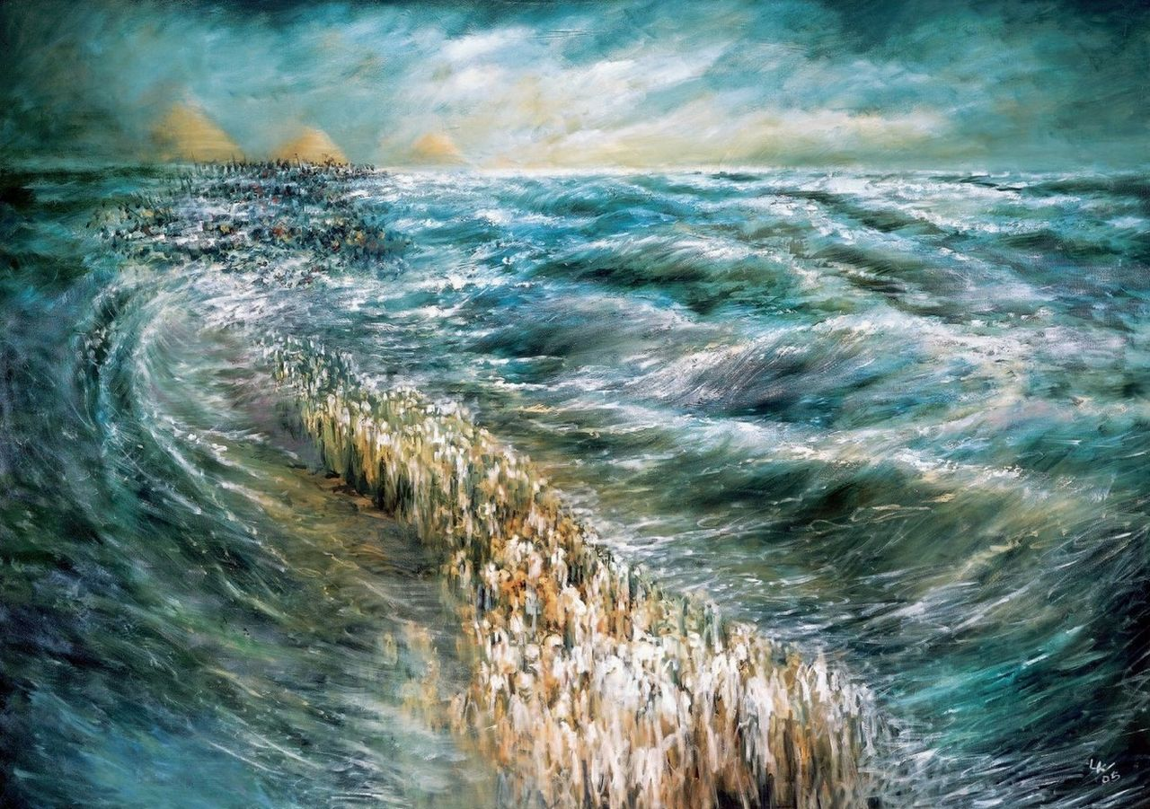
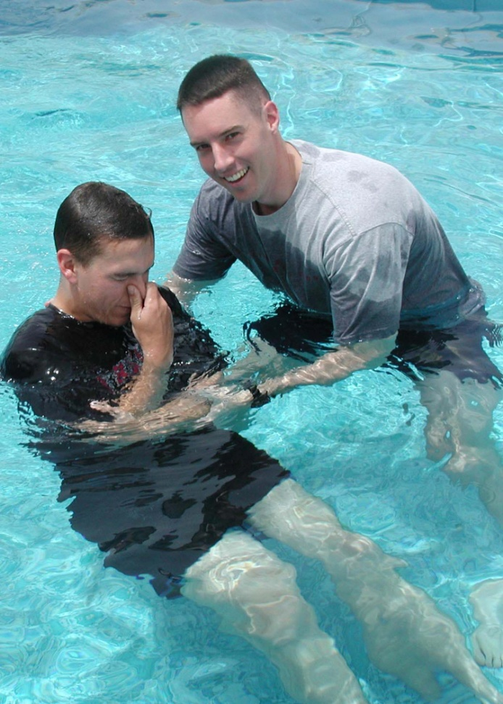
Moses’ Example
1 Corinthians 10:2 and all were baptized into Moses in the cloud and in the sea;
Acts 22:16 …. Get up and be baptized, and wash away your sins, calling on His name.'

