Slide 1
“You Idiot!”

Slide 2
Should Christians Call People “Idiots”?
Matthew 5:21-22
“You have heard that it was said to those of old, ‘You shall not murder, and whoever murders will be in danger of the judgment.’ But I say to you that whoever is angry with his brother without a cause shall be in danger of the judgment. And whoever says to his brother, ‘Raca!’ shall be in danger of the council. But whoever says, ‘You fool!’ shall be in danger of hell fire” (NKJV).

Slide 3
Should Christians Call People “Idiots”?
Context:
Series of antitheses.
“But I say to you” (cf. Matt. 5:22, 28, 32, 34, 44).
“As one having authority and not as the scribes” (Matt. 7:29).

Slide 4
Should Christians Call People “Idiots”?
Focus of this antithesis:
Accountability for our thoughts.
Thoughts can place one “in danger of the judgment” (5:22a).
God will judge us at “the judgment of the great day” (Jude 6).
Thoughts can “defile a man” (Matt. 15:19-20).

Slide 5
Should Christians Call People “Idiots”?
“Whoever says to his brother, ‘Raca!’” (5:22).
Answer “to the council (tō sunedriō).”
A. H. McNeile, “Probably not the supreme court at Jerusalem, but the local court of discipline (Josephus, Antiquities 4.8.14; cf. Matt. 10:17= Mark 13:9), which met in the synagogue” (Commentary on Matt. , 62).
Bab. Talmud claims every city with a population of 120 had its own Sanhedrin (Sanhedrin 17b).

Slide 6
Should Christians Call People “Idiots”?
“Whoever says to his brother, ‘Raca!’” (5:22).
Jerome said it was like the Greek word kenos, meaning “empty,” and he defined it to mean “useless or empty” and “without a brain” (Commentary on Matthew 5:22).”
George Lamsa in his Holy Bible from the Ancient Eastern Texts: Aramaic of the Peshitta claimed “raca” means “I spit on you.” This is probably a more modern definition in the Syriac community.

Slide 7
Should Christians Call People “Idiots”?
“Whoever says to his brother, ‘Raca!’” (5:22).
The related Hebrew word rêq meant “empty, vain, or worthless” and was used in the Old Testament of “worthless men” (Judg. 11:3; 2 Sam. 6:20; Prov. 12:11; 28:19).”

Slide 8
Should Christians Call People “Idiots”?
The Greek term “fool (mōros)”.
We get our word “moron” from this word.
Roger Congdon argues that Jews considered the older Aramaic term raca, “as equal to cursing, a terrible sin, while the modern (to them) word of foreign derivation carried no such odium” (119).
In English we do this with words of Angl0-Saxon versus Latin origin.

Slide 9
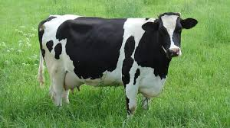
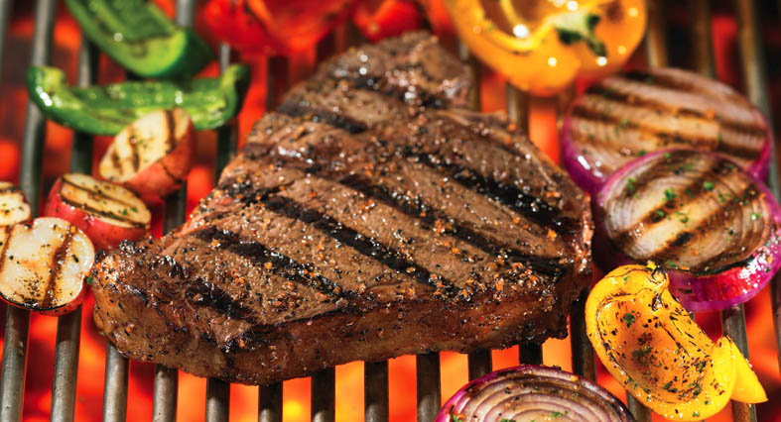
Beef
Cow
Latin: bovem
Anglo-Saxon: cū

Slide 10
Should Christians Call People “Idiots”?
The Greek term “fool (mōros)”.
Congdon argues further “in God’s eyes, an evil word in Greek, Latin, or modern English is just as bad as an evil word in Anglo-Saxon” (119).
Jesus isn’t saying some insulting words are better than others.
They knew raca was bad. He calls them to see that a sophisticated or tame sounding insult is just as bad—it can send one to hell!
Insults are a type of judgment.

Slide 11
Should Christians Call People “Idiots”?
The “fool” in Scripture.
Some have rationalized Jesus’ words to apply only to what the term “fool” infers about one to whom it is applied in Scripture.
Robert Mounce suggests, “The fool in Hebrew thought was not the intellectually incompetent but the person who was morally deficient. This kind of fool lived as if there were no God to whom he must account for his profligacy (cf. Ps. 14:1)” (45).
Psalm 14:1, “The fool has said in his heart, ‘There is no God.’”

Slide 12
Should Christians Call People “Idiots”?
How do New Testament writers uses the term “fool (mōros)”?
One may apply it to himself (1 Cor. 3:18; 4:10).
It can apply to things that are “foolish” (1 Cor. 1:27; 2 Tim. 2:23; Titus 3:9).
An apostle never calls someone a “fool (mōros).”
They will use the milder term aphron meaning “without reason” or “unwise” (Eph. 5:17; 1 Cor. 15:36; 2 Cor. 11:16; 1 Pet. 2:15).
The example of Michael (Jude 8-10).

Slide 13
Should Christians Call People “Idiots”?
Conclusion.
If it was wrong for an angel , is it right for us?
Is calling someone a “fool (mōros)” different from calling him or her “stupid” or an “idiot”?
Kenney Chumbley is right that Jesus “is teaching that insulting language—name calling, racial, ethnic, and social slurs, etc.—that demeans a fellow human being is condemned by God” (98).
It’s wrong to call a person a “fool,” but it’s also wrong to use more “acceptable” insults as well—Jesus says it can place us “in danger of hell fire.”

