Slide 1
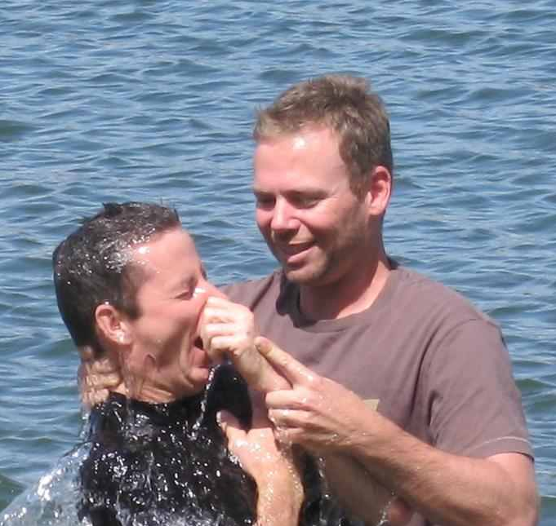
Things New Converts Need to Know
They were converted to Christ, not the people who converted them. (Rom. 12:4-5; Matt. 28:18-20; Col. 1:18; 3:17; 2 Tim. 4:10-11).

Slide 2
Things New Converts Need to Know
They have been called to work. (Acts 8:39; Mark 5:18-20; 1 Cor. 15:58 ).

Slide 3
Things New Converts Need to Know
They need to develop their abilities. (Heb. 5:12-14; Rom. 12:4-8; Matt. 25:24-30).

Slide 4
Things New Converts Need to Know
They need to turn to their brethren for help (Titus 2:1-4; 1 Pet. 5:2-3; Heb. 13:17; Gal. 6:2; Jas. 5:16).

